Slide 1
IRON MAN 2 Themes
Joshua Keller, Tiffany Leung, Jacob Watson, Hui Zheng
The ethics of disrespecting the intellectual property rights of others
The side-effects and potential threats of putting too much trust in technology
Notes:
After watching Iron Man 2, we discovered two main themes of the movie that we felt matched the issues we have been learning about in this class: The ethics of disrespecting the privacy and intellectual property rights of others, and the dangers from technical errors and security issues by putting too much trust in technology.
One of the main themes of the movie is distinguishing the line between actions that are ethical and justified and actions that are unethical. Two of the most debatable pieces of property are the Iron Man Suit and the Arc Reactor. Some of the questions we explored are “Should the government have altered the suit even though it did not have the permissions to?” and “Do those with power have the right to spy on others, even if they believe it is for ‘the greater good’”?
When we put too much trust in technology including automation and AI, it would be easily put us endanger of technical error and cyber attack. The movie reflects this danger in treating people when Drones flying over people’s head and firing over Tony, while all these Drones was controlled by bad guy Vanko. The movie also showed the unreliable side of the technology by the failure of ex-wife missile during the combat.

Slide 2
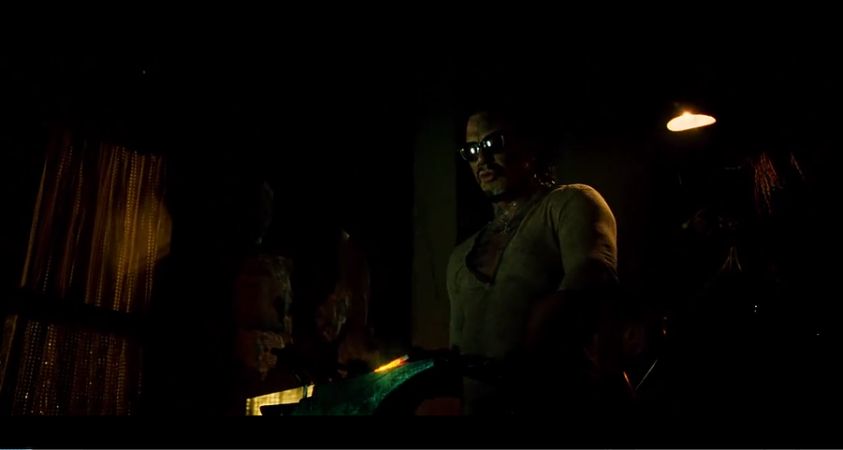
Joshua Keller, Tiffany Leung, Jacob Watson, Hui Zheng
Ivan Vanko wants revenge for the deportation of his father, Anton Vanko, who worked with Howard Stark on the original ARC reactor.
[6]
Notes:
The movie opens with the death of Anton Vanko, a prominent Russian physicist who had worked with Tony Stark’s father, Howard Stark, on the original ARC reactor. When Anton wanted to sell it to the Russians, Howard responded by having him deported to Siberia. Ivan Vanko, his son, vows revenge on Stark.

Slide 3
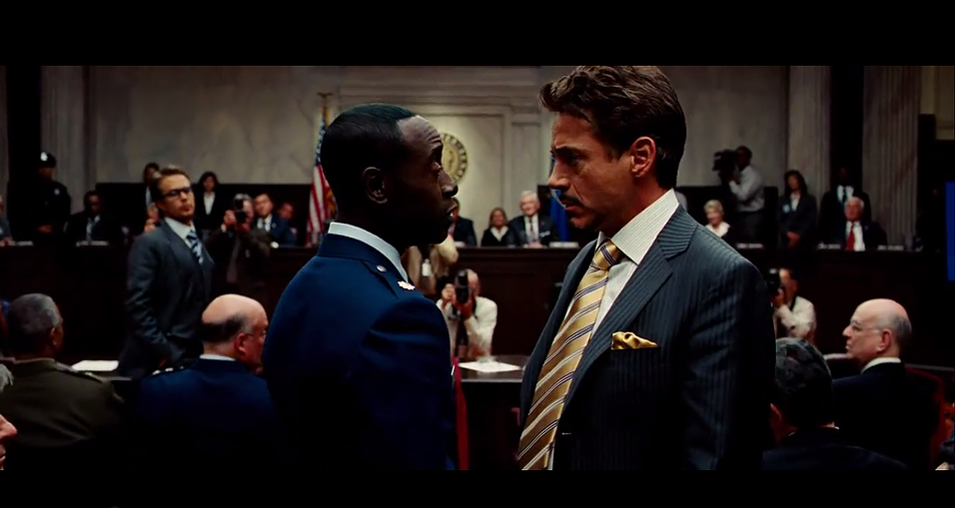
Joshua Keller, Tiffany Leung, Jacob Watson, Hui Zheng
The U.S. government is looking to take the Iron Man tech from Tony Stark, but Tony denies they have the right or reason to do so.
[6]
Notes:
However, the U.S. government has become nervous over the idea of the Iron Man technology being in private hands, and the threat of foreign nations building their own, and holds a senate hearing to try to make Stark give them the armor. Stark claims that it is his intellectual property, and they have no justification to make him hand it over.

Slide 4
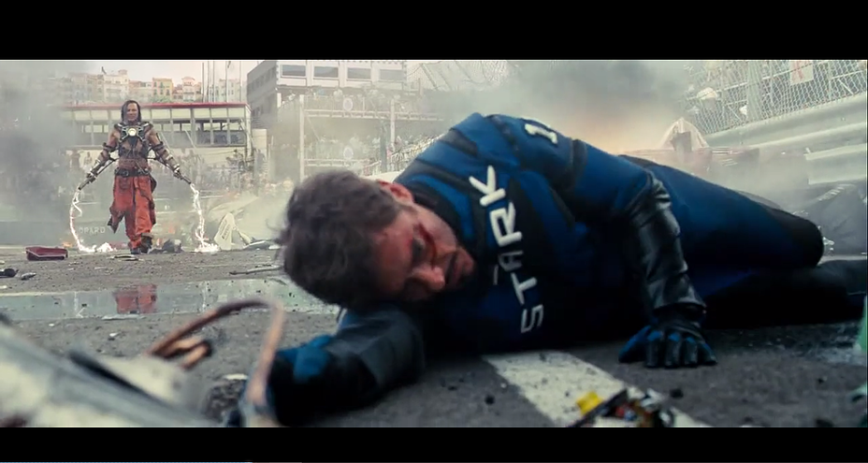
Joshua Keller, Tiffany Leung, Jacob Watson, Hui Zheng
Ivan Vanko attacks Tony Stark during a race. Tony manages to beat him as Iron Man, but the presence of an ARC reactor in Vanko’s suit gives credit to the U.S. government’s concerns about Iron Man copycats.
[6]
Notes:
While racing in the Monaco Historic Grand Prix, Tony is attacked by Vanko, who is using an ARC Reactor powered suit with plasma-whips. Tony is able to beat him as Iron Man, but Vanko’s copycat ARC Reactor proves the U.S. government’s fears about Iron Man copycats to be more real than Tony thought.

Slide 5
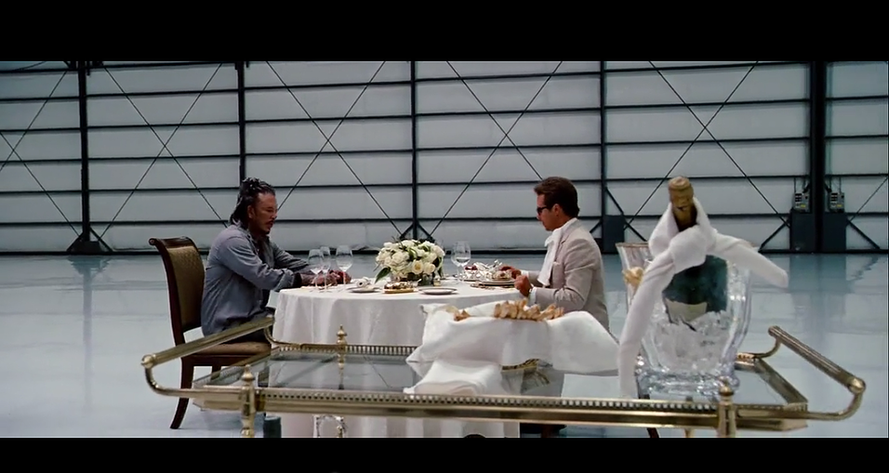
Joshua Keller, Tiffany Leung, Jacob Watson, Hui Zheng
Justin Hammer, Tony Stark’s rival, breaks Vanko out of jail, and asks him to build a suit that can outcompete Stark’s. Vanko has other plans, and changes the Hammer Suit into a humanoid drone called the Hammer Drone.
[6]
Notes:
Tony Stark’s rival, Justin Hammer, breaks Vanko out of jail under the condition that Vanko builds Hammer a suit that would outclass Iron Man and destroy Stark Industries. Vanko has another take on this, as he changes the Hammer Suits into Hammer Drones, as Vanko claims “People cause problem”.

Slide 6
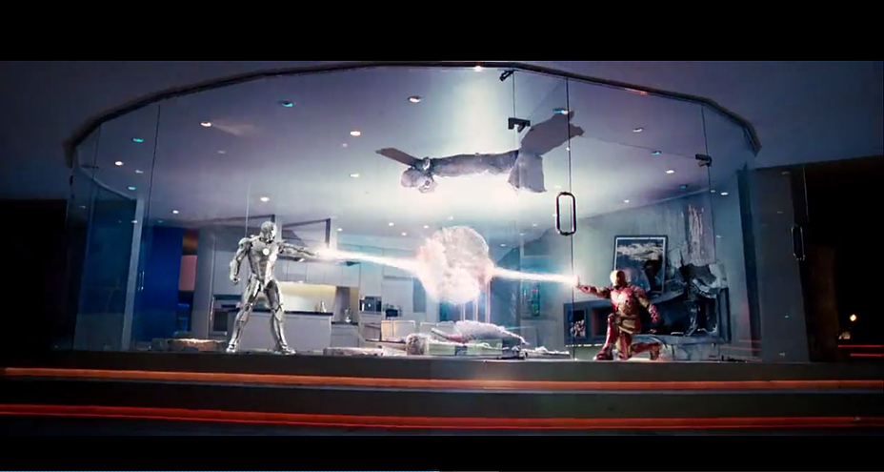
Joshua Keller, Tiffany Leung, Jacob Watson, Hui Zheng
Stark begins to act recklessly with the Iron Man suit. In an attempt to stop him, Rhodes takes the Mark II Iron Man suit and fights Tony. After a draw, Rhodes leaves with the Mark II suit, and delivers it to the U.S. Army.
[6]
Notes:
Aware he doesn’t have much time to live left, Tony gets drunk at his birthday party and begins using his suit recklessly. Lt. Rhodes, worried about Stark’s actions hurting Iron Man’s image, suits up in the Iron Man Mk. II armor and attempts to restrain Stark. After they fight to a draw, Rhodes leaves with the Mk. II armor and delivers it to the U.S. military.

Slide 7
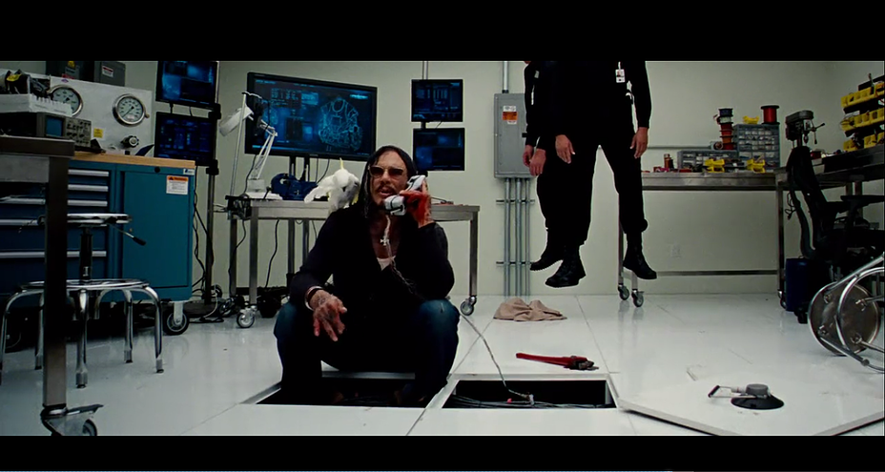
Joshua Keller, Tiffany Leung, Jacob Watson, Hui Zheng
Vanko, who has broken out of custody at Hammer Industries, taunts Tony over the phone. After tracing the call to somewhere near the Expo, Tony Stark suits up as Iron Man and heads to the Expo.
[6]
Notes:
Stark receives a startling call from Hammer Industries H.Q. Vanko reveals himself to be alive, and taunts Stark over the phone just long enough for Stark to trace the call to the area of the Expo. Worried that something is seriously wrong, Stark suits up into Iron Man, and heads out to the Expo.

Slide 8
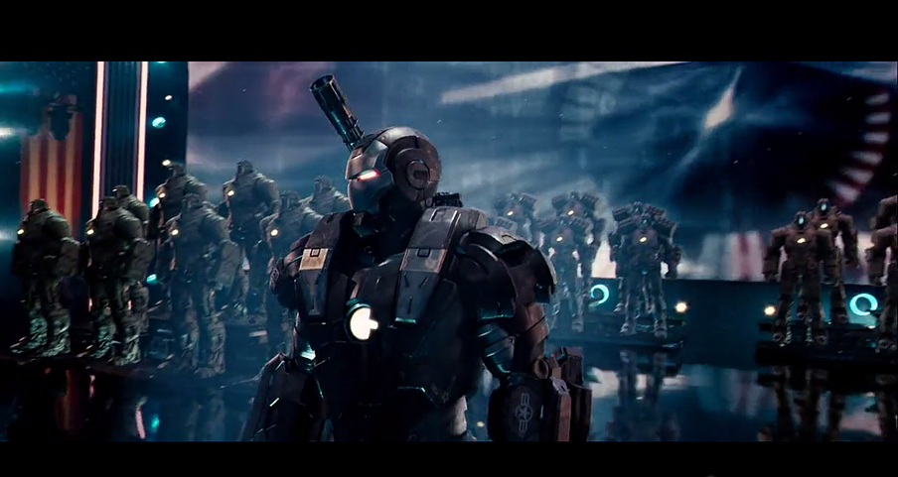
Joshua Keller, Tiffany Leung, Jacob Watson, Hui Zheng
At the Expo, Hammer is showing off the Hammer Drones and the refitted Iron Man Mark II, now called War Machine. After Tony’s arrival, Vanko hacks War Machine and the Hammer Drones to attack the crowd.
[6]
Notes:
At the same time, Hammer is introducing his products at the Stark Expo. He reveals the Hammer Drones as military robots that could replace human troops, and the War Machine, a joint redesign of the Iron Man mk. II suit between Hammer and the U.S. Government. As Iron Man arrives at the Expo, Vanko hacks into War Machine and the Hammer Drones, and remotely order them to attack Iron Man and the crowd.

Slide 9
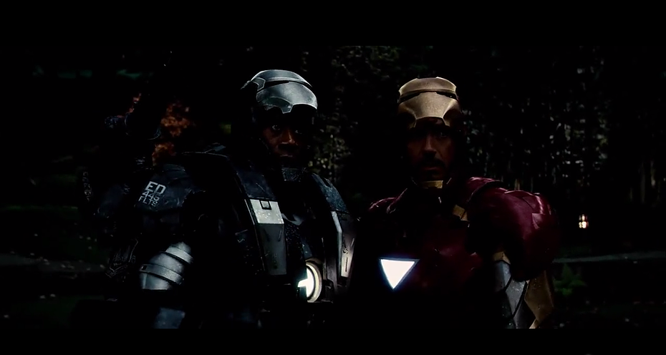
Joshua Keller, Tiffany Leung, Jacob Watson, Hui Zheng
After an aerial fight, a S.H.I.E.L.D. agent frees Rhodes/War Machine from Vanko’s control; he and Iron Man team up to defeat Vanko’s Hammer Drones and Vanko.
[6]
Notes:
Iron Man attempts to buy time to figure out a way to free Rhodey from the hacked War Machine while stopping the Hammer Drones from killing civilians fleeing the Expo. During this fight, a S.H.I.E.L.D. agent infiltrates Hammer Headquarters and makes it to the control room. Vanko has disappeared, but the agent is able to restart the War Machine suit, giving control back to Rhodes. Iron Man and War Machine beat Hammer drones and Vanko.

Slide 10
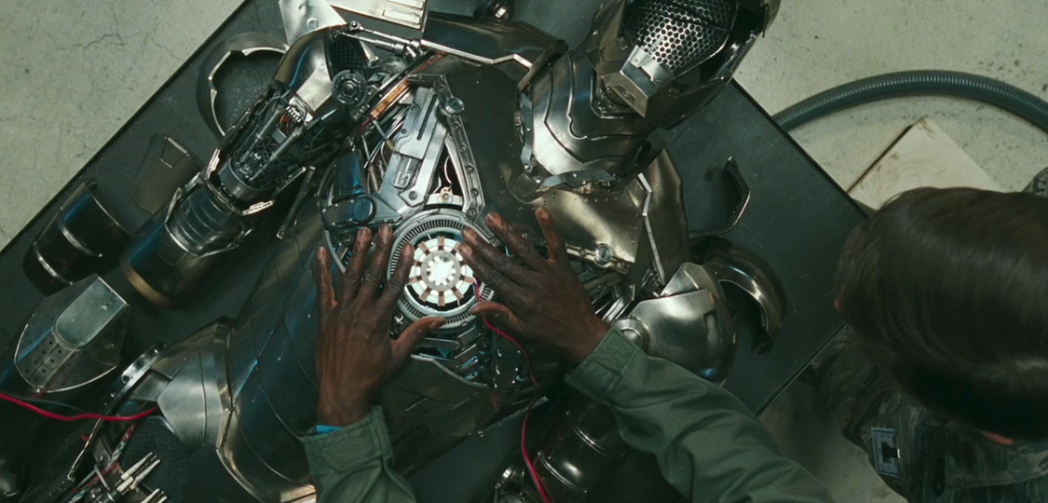
Ethics of disrespecting the IP of others
Joshua Keller, Tiffany Leung, Jacob Watson, Hui Zheng
Intellectual Property: Iron Man Suit
Suit is a “Trade Secret” of Tony Stark
Government has no right to demand Tony give up his trade secret without any compensation
Tony shares his trade secret with Rhodey
Rhodey shares trade secret with government, allowing them to use technology
http://moviecultists.com/wp-content/uploads/2009/12/iron-man-2-war-machine-suit.jpg
[1]
Notes:
To begin, we consider how intellectual property is handled in the world of Iron Man 2. The Iron Man suit could be considered as a “Trade Secret” of Tony Stark. He has not patented or protected the technology in any way, the only projection is Tony’s refusal to share the information with others. When the government demands Tony hand over the Iron Man technology, they are asking Stark to hand over his Trade Secret for use by the U.S. military. While the government has the right under the 5th amendment to appropriate technologies, it does not give them the right to just take the technology without compensation. The act of doing so is illegal, and immoral, as it infringes on Tony Stark’s rights, making it unethical. However, the situation changes when Tony Stark allows Rhodey to take the Iron Man mk. II suit. By doing so he is sharing his trade secret with Rhodey, and therefore giving Rhodey the right to use that information how he wants. When Rhodey decides to share that technology with the U.S. govt. he is again sharing that trade secret with them, giving the government the right to use it how they want. For that reason, when the government rebuilt the Iron Man mk. II suit into War Machine, they had the legal justification to do so, and were not infringing on Stark’s right’s by doing so, making their actions ethical.
PIC: http://moviecultists.com/wp-content/uploads/2009/12/iron-man-2-war-machine-suit.jpg
intellectual property rights real world examples
http://prospect.org/article/stark-reality-defense-contracting-0
-we can talk about Kalashnikov and the AK-47 and Tetris as examples of inventors not getting proper compensation
Should the government be allowed to completely take the Iron Man suit from Tony Stark by claiming that the suit is too dangerous of a “weapon” to be privately owned?
In a case when a privately owned “weapon” is more powerful and advanced than current military technology, should the government be given the right to ignore IP laws and take away such a weapon?
Senate hearing
Is it ethical for the government to take the Iron Man Tech from Stark to “protect the people”?
Iron man suit is a powerful weapon, but the technology is the property of Stark.
conclusion
Rhodey taking the Iron Man prototype and allowing modification by the government
Is it ethical of the government to hand over the suit to Hammer Industries, and is it ethical of Hammer Industries to modify that suit?
Taking the suit from Tony and using that technology without his explicit permission is violating “Trade Secret” laws.
Does this count as fair use?
conclusion

Slide 11
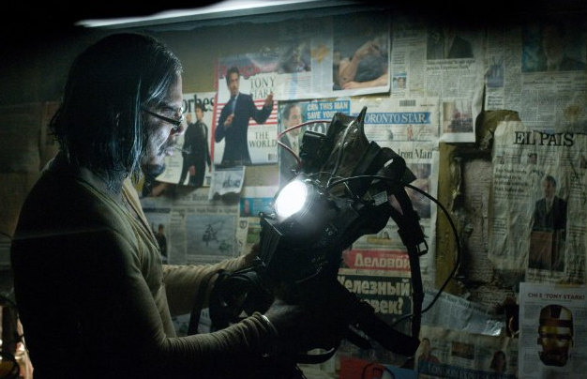
Ethics of disrespecting the IP of others
Joshua Keller, Tiffany Leung, Jacob Watson, Hui Zheng
Intellectual Property: ARC Reactor
Howard Stark took credit for the invention of the Arc Reactor
Was it right to take away Vanko’s ownership even if what he wanted to do was unethical?
Alexey Pazhitnov, the inventor of Tetris had his work sold away by the Soviet government.
Unethical according to Second Formulation of Categorical Imperative
http://www.swiftfilm.com/wp-content/uploads/2012/05/Screen-Shot-2012-05-01-at-5.06.48-PM.png
Notes:
Another issue in the movie is who gets the credit for the creation of the ARC Reactor. Though both Howard Stark and Anton Vanko worked together to develop the ARC Reactor, only Howard Stark was publicly credited with the creation of the device while Anton was deported to Siberia. This left us to consider if it is ethical for the government to have the power to control who can be credited with the creation of a device, and if the government has the right to control the monetary rewards for doing so. This is not a fictional concern, as similar events have happened in real life one example being Alexey Pazhitnov, the Inventor of Tetris, who had his game sold by the Soviet Government to Nintendo and did not receive any money for his work until much later in his life. When considering a situation like this, we must conclude that this is unethical, as governments, (and Howard Stark) taking away the results of someone else’s work, and taking the additional benefits that come with it, goes against the second formulation of the Categorical Imperative of Kantianism, as it is using a person, the inventor, to reach a goal, the invention and its monetary value, and is therefore unethical.
PIC: http://www.swiftfilm.com/wp-content/uploads/2012/05/Screen-Shot-2012-05-01-at-5.06.48-PM.png

Slide 12
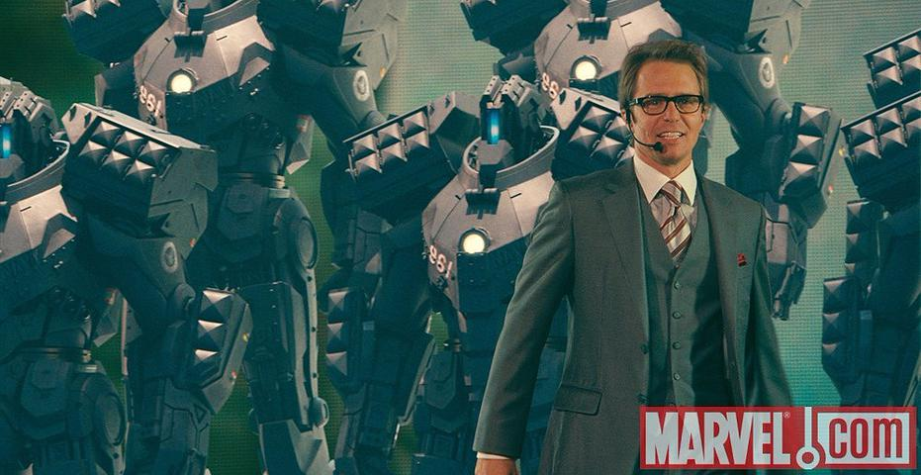
Too much trust in technology
Joshua Keller, Tiffany Leung, Jacob Watson, Hui Zheng
Hammer Drones
Developing technology is not reliable because of potentially unresolved error and security issues
Errors of Omission: Ex-wife missile failure
In real life, Challenger explosion killed seven astronauts in 1986
Errors of Commission: Hammer Drones attack citizen with under controlled
In real life, Zombie virus allows remote control network
http://marvel.com/images/gallery/movie/130/images_from_iron_man_2#0-649251
[3][4][5]
Notes:
US Army is about shrink the brigade combat team from 4000 soldiers to 3000, by replacing lost soldiers by robot. In the movie changing suits to robot drones was a reflection of automation and employment in the book. However, using automation robot instead of employing human beings will arise issues and threats. The main threat comes from errors of omission and errors of commission.
http://www.defensenews.com/article/20140120/DEFREG02/301200035/US-Army-Studying-Replacing-Thousands-Grunts-Robots
For Errors of omission: The ex-wife missile from hammer technology fails after Rhodey eject it, this is the identical case that shows user put trust and expect on technology and failed. However, two character in the movie are lucky because of the overpowered suit. In real life, the explosion of the Challenger on January 28th, 1986, killed seven astronauts and potentially lost 1.4 Billion Dollars in which, 1.2 Billion Dollars are count to the space shuttle. If the failure of the ex-wife happens in the real life, this failure will cause accident which will let people die, and the Patriot Missile in the textbook is a good example. http://www.xiamenair.com/servicecenter/details?guid=c5c55ddb-91fc-4803-aae0-740617e538a5
For Errors of Commission: The automation in the movie using network, the movie shows that’s easy for Vanko to break into the network and control the drones as a cyber hack. Vanko aimed at leaving a backdoor to control the drones killing Tony. The error of commission also reflected at the end of the movie, when all the broken Drones trying to explode and hurt people. This scene portrayed Zombie software virus, which is program that allow hackers using affected computer to do criminals. We are live under large amount of threat from internet. This year, 2015 317 million malware were generated this year, compared to last year 252 million, increased by 25.8%.The data is provided by Symantec Internet Security Threat Report. https://www4.symantec.com/mktginfo/whitepaper/ISTR/21347932_GA-internet-security-threat-report-volume-20-2015-social_v2.pdf

Slide 13
Too much trust in technology
Joshua Keller, Tiffany Leung, Jacob Watson, Hui Zheng
Hammer Drones
Hammer hires a criminal
KMPG found that 52% of businesses from their research wouldn’t be dissuaded in hiring a criminal hacker
UK government and Joint Cyber Reserve Unit
Fully armored robotic drones were implanted with backdoors
Drones do not have morals
Should Hammer have hired and trusted a criminal?
Should we trust criminals to provide secure technology?
[2]
Notes:
Hammer and the U.S. government were so focused on their goal of an advanced robotic weapon system that could rival Iron Man that they didn’t consider the potential consequences of what these weapons could do if it ended up in the wrong hands. Hammer knowingly hired a criminal to build and program the Drones.
In 2014, KMPG conducted research that found “52 percent [of businesses] said they wouldn’t be dissuaded from hiring a hacker [to improve their IT security] even if they had a criminal record. The UK government has also said that it isn’t averse to using the expertise of criminal hackers…[launching] a new £500m initiative known as a Joint Cyber Reserve Unit”.
Even though it was being developed by a criminal, Hammer trusted the technology to be safe and secure. As a result, the Drones created were a fully armored robotic weapons system capable of mass destruction. The consequence was the Drones were hacked via a backdoor implanted by Vanko and used to attack the civilians that the government sought to protect.
A drone is a not humane. When it was hacked and commanded to destroy, it did not question whether or not what it was about to do was moral. The problem with technology is that it is only reliable when it is doing what it is intended to do. Once the technology is repurposed maliciously by someone else such as Vanko, then it can be easily used against whoever is trusting that technology.
Should Hammer have hired and trusted a criminal? Furthermore, referring back to the KPMG research, should consumers trust businesses that hire criminal hackers to improve IT security when those same hackers could secretly put backdoors that would directly hurt consumers as Vanko did?

Slide 14
Conclusions
Joshua Keller, Tiffany Leung, Jacob Watson, Hui Zheng
Ethics of disrespecting the intellectual property rights of others
Proper procedure must be followed to ethically use another’s IP
Inventors have a right to profit off of their work
The side-effects and potential threats of putting too much trust in technology
Developing technology is unreliable
Technology can be hacked and used immorally against its owners
Notes:
When trying to use another person’s IP, it’s important to follow the right protocols in order to make sure you’re using it ethically.
It is unethical to take away the rights and benefits of someone else’s work. Inventors should have ownership of what they created.
Due to the errors of omission and commission, the technology can be unreliable, especially for those under development.
There is always a possibility that technology can be hacked and used in immoral ways that it wasn’t intended for. So it is a dangerous idea to heavily rely on technology without factoring the potential consequences.

Slide 15
References
Joshua Keller, Tiffany Leung, Jacob Watson, Hui Zheng
[1] Farley, R., & Isaacs, D. (2010, May 10). The Stark Reality of Defense Contracting. Retrieved October 5, 2015.
[2] Temperton, J. (2014, November 17). Half of UK businesses will consider hiring hackers. Retrieved October 5, 2015. [3] Challenger’s Disaster, Xiamen Air, Retrieved October 5, 2015 from: http://www.xiamenair.com/servicecenter/details?guid=c5c55ddb-91fc-4803-aae0-740617e538a5 [4] US Army Studying Replacing Thousands of Grunts with Robots, AUL McLEARY, Retrieved October 5, 2015 from http://www.defensenews.com/article/20140120/DEFREG02/301200035/US-Army-Studying-Replacing-Thousands-Grunts-Robots [5] Symantec Internet Security Threat Report, Symantec Inc, Retrieved October 5 2015 from https://www4.symantec.com/mktginfo/whitepaper/ISTR/21347932_GA-internet-security-threat-report-volume-20-2015-social_v2.pdf
[6] Favreau, J. (Director). (2010). Iron Man 2 [Motion picture on DVD]. USA: Paramount Pictures.
[7] Quinn, M. Ethics for the Information Age. 6th ed. Boston: Pearson, 2014. Print.

