Slide 1
Alex Shoop, Laura Antul, Nicholas Muesch, Dennis Silva
Notes:
Introduce ourselves and movie

Slide 2
OUTLINE
Plot summary
Technologies
Conclusion & Arguments
References
Notes:
Outline of our presentation
The plot summary will go through the basic world of the movie and how the story unfolds.
The technologies will outline the most important technologies in the film and their real life counterparts
Both of the above will be referenced in our arguments.

Slide 3
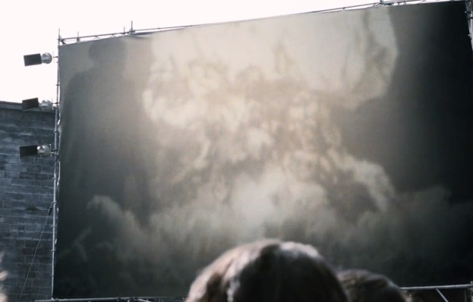
PLOT SUMMARY
Uprising
Notes:
Nick will talk
Prior to the first movie, an uprising took place where various districts tried to rebel against the Capitol. Because of this rebellion, the Capitol instated what is known as the Hunger Games. This event was created to remind each tribute of the failed uprising and a way to make each District know that they had a price to pay because of it. The Game Maker spins the games as a way to bring everyone together.
Note They are called The Hunger Games most likely because when an individual requests food from the District, their name gets added another time to the bowl for the reaping

Slide 4
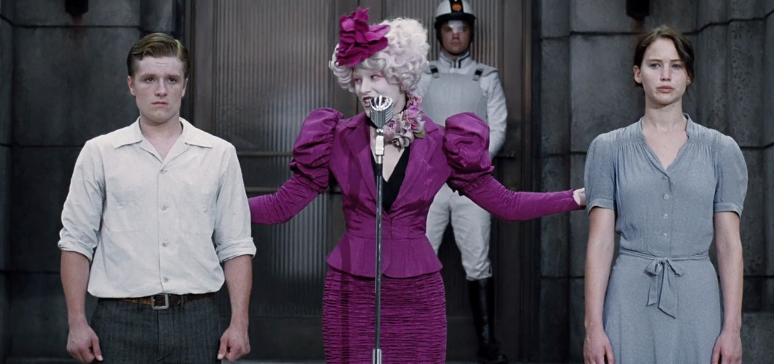
PLOT SUMMARY
The reaping
Notes:
Nick will talk
Actually mention Katniss and Peeta and how they are chosen from District 12
Each year, the Hunger Games takes place and consists of 24 people. One boy and one girl from each District. Everyone in a District shows up to a part of the district and is registered, and someone from the Capital randomly chooses, from a pile of names, two tributes to enter the games. The people eligible to enter the games are those aged between 12 and 18 and every year you are alive, your name gets added again to the list of possible tributes. When Katniss’ younger sister Prim is chosen, Katniss volunteers to take her place. The boy chosen from this district, district 12, is Peeta.

Slide 5
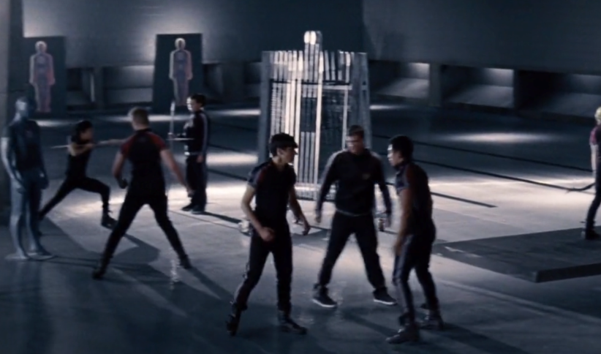
PLOT SUMMARY
Training
Notes:
Nick will talk
After being chosen, the tributes are sent to the Capital where they begin training and showing off their skills and talents. For Katniss this is her bow and arrow skills. Some Districts, like district 1, train their people to participate in the hunger games and have two people volunteer. This shows how prepared some Districts are and ow proud they are of their representatives. This also shows how winning the hunger games may bring pride to the winning District.
It is here where each tribute receives a score based on their talents. This score ultimately helps the tributes obtain sponsors who will send the tributes supplies during the games. Katniss receives a the highest score, of 11 out of 12, by shooting an arrow into the spectators room and hitting an apple into the wall.

Slide 6
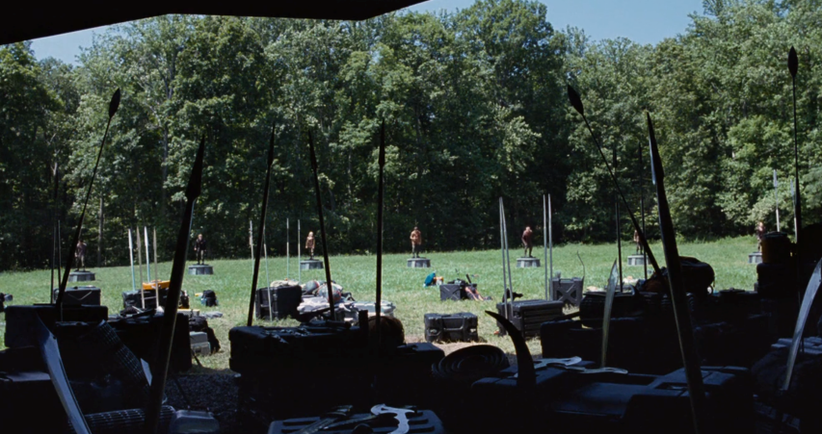
PLOT SUMMARY
The games
Notes:
Nick will talk
During the games, the goal is to be the last man standing. Therefore, 23 people are supposed to either die or be killed. This event is broadcast to the citizens of the Districts as well as the Capital members. It takes place inside a domed arena in which the Game Maker and his subordinates have complete control. They can manipulate the environment and watch every player. Katniss and Peeta struggle to both simply survive and become the last person standing.

Slide 7
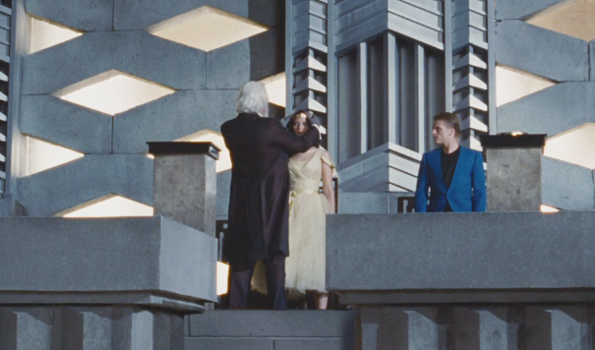
PLOT SUMMARY
The winners
Notes:
Nick will talk
After Katniss and Peeta are the last two alive, they threaten to commit a double suicide so that the games will have no winner. The game maker then decides that it is in the Capitals’ best interest to allow two winners and declares the games over. They ultimately return to their Districts where Katniss is reunited with her younger sister Prim and her mother.

Slide 8
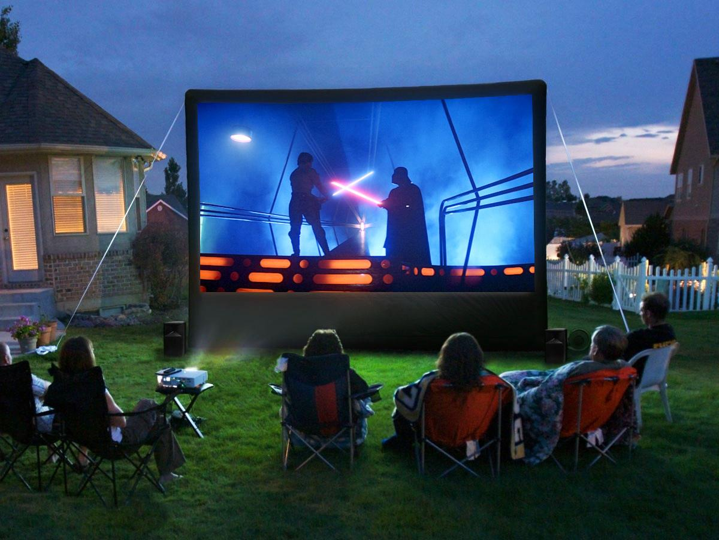
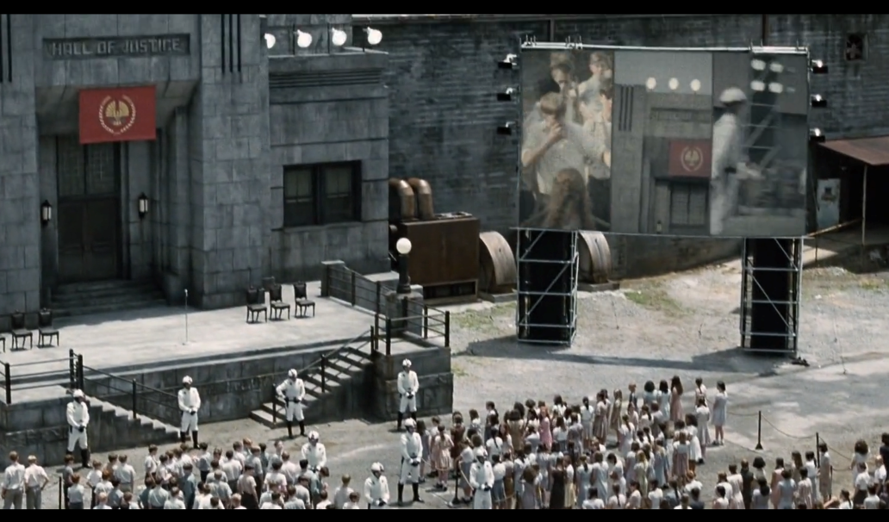
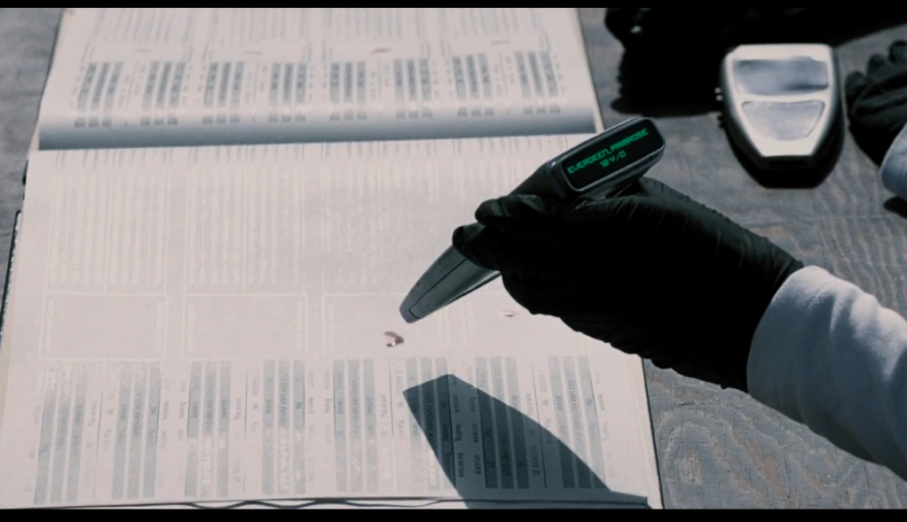
TECHNOLOGIES
Top: http://www.wicked-gadgets.com/wp-content/uploads/2014/09/Outdoor-movie-screen.jpg
Bottom: https://www.fbi.gov/news/stories/2011/november/dna_112311/image/codis-seal
Notes:
Nick will talk
Brief explanation of each tech
Projector screens in each district to show the citizens content that the Capitol wishes
We have projector screens and television sets around the world, easy comparison there
Blood Scanner is used to identify each tribute as they enter the reaping. This presumably uses DNA Scanning
The USA has CODIS, Combined DNA Index System which is a national DNA database housing the DNA of convicted criminals
We use blood samples to obtain a persons identity through DNA and put them into the database.
Sources: http://www.wicked-gadgets.com/wp-content/uploads/2014/09/Outdoor-movie-screen.jpg
https://www.fbi.gov/news/stories/2011/november/dna_112311/image/codis-seal

Slide 9
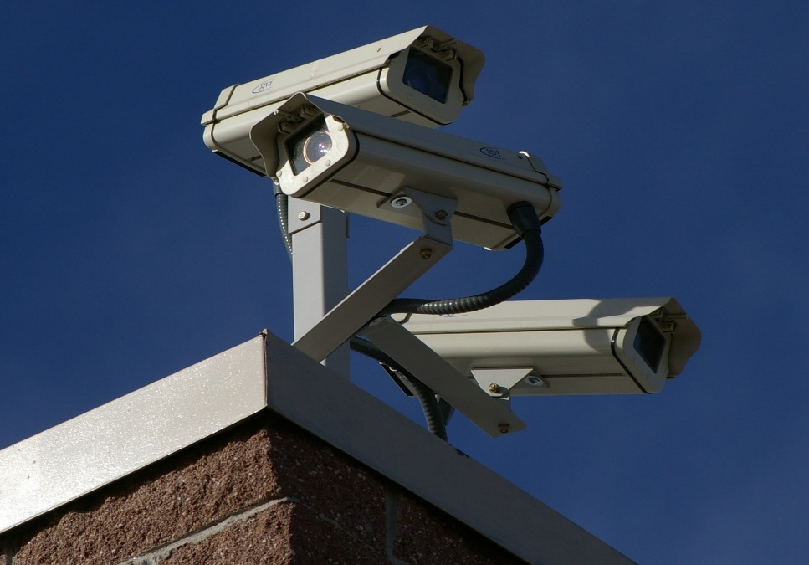
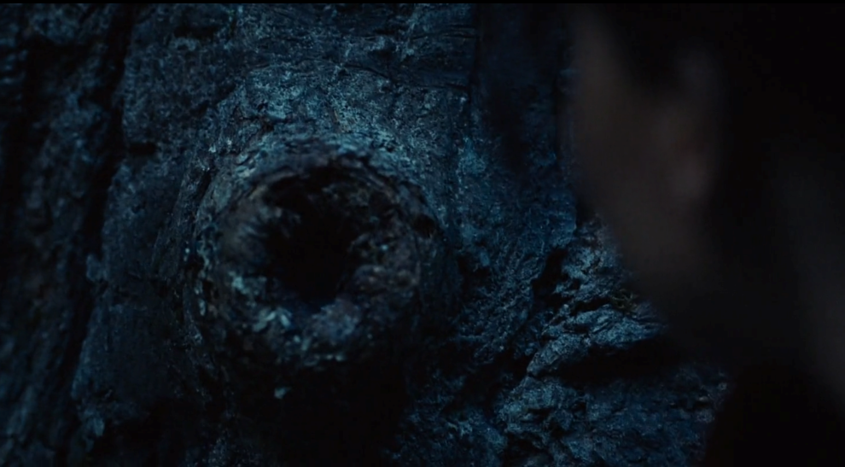
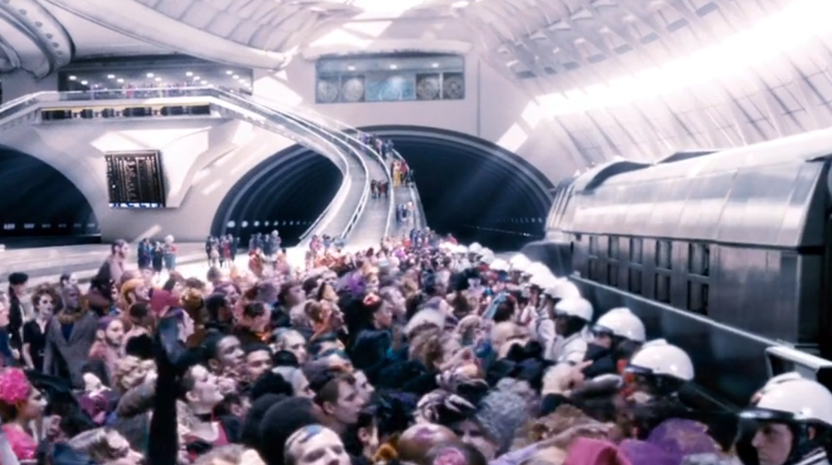
TECHNOLOGIES
Top: https://upload.wikimedia.org/wikipedia/commons/a/a1/Three_Surveillance_cameras.jpg
Bottom: https://upload.wikimedia.org/wikipedia/commons/9/91/AGV_.italo_Napoli_side_view.JPG
Notes:
Nick will talk
Surveillance cameras in the Game. Katniss finds a camera in a tree that zooms in on her. This footage is used to relay back to the Capital and ultimately the projector screens in the District for entertainment purposes
We have surveillance cameras. Can talk about both CCTVs that exist in cities/traffic lights as well as reality shows and their popularity
The final episode of the first season of Survivor gained over 51 million viewers!
High speed trains are used for the Capitol members and tributes to easily transport to different locations. Not available to the District citizens
Europe has a lot of High Speed trains. The AGV Italo has an operational speed of 360kmph
Air ship carriers are also used for transportation. This is a spaceship like vehicle flying in our atmosphere
Sources: https://upload.wikimedia.org/wikipedia/commons/a/a1/Three_Surveillance_cameras.jpg
https://upload.wikimedia.org/wikipedia/commons/9/91/AGV_.italo_Napoli_side_view.JPG
https://en.wikipedia.org/wiki/List_of_Survivor_(U.S._TV_series)_episodes#Borneo_.28Season_1.2C_2000.29

Slide 10
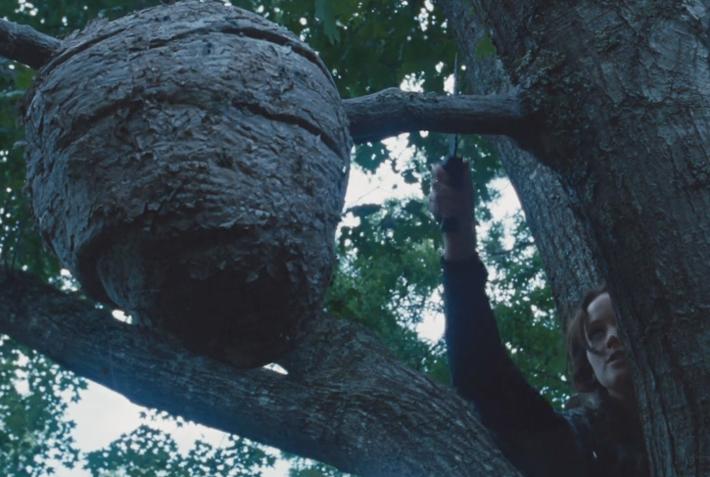
TECHNOLOGIES
http://imgsrv.1077theend.com/image/DbGraphic/201308/2606847.jpg
Notes:
Nick will talk
Genetic Modification: The tracker jackers are genetically modified wasps that inject poison into whoever they sting. This poison causes hallucinations and possibly death There are also beasts that are some sort of genetically modified creature that are blood thirsty.
We have some genetically modified animals in the USA like the glow in the dark rabbit. This project started in 2006 and injects jellyfish DNA into rabbit embryos.
Sources: http://www.technobuffalo.com/wp-content/uploads/2015/05/Minecraft-HoloLens.jpg
http://i2.cdn.turner.com/cnn/2013/images/07/10/3d.printing.jpg

Slide 11
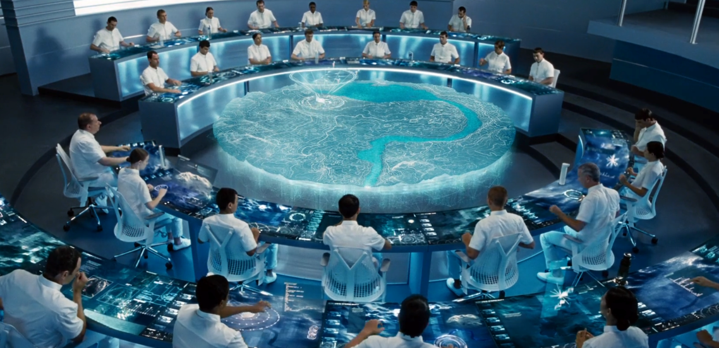
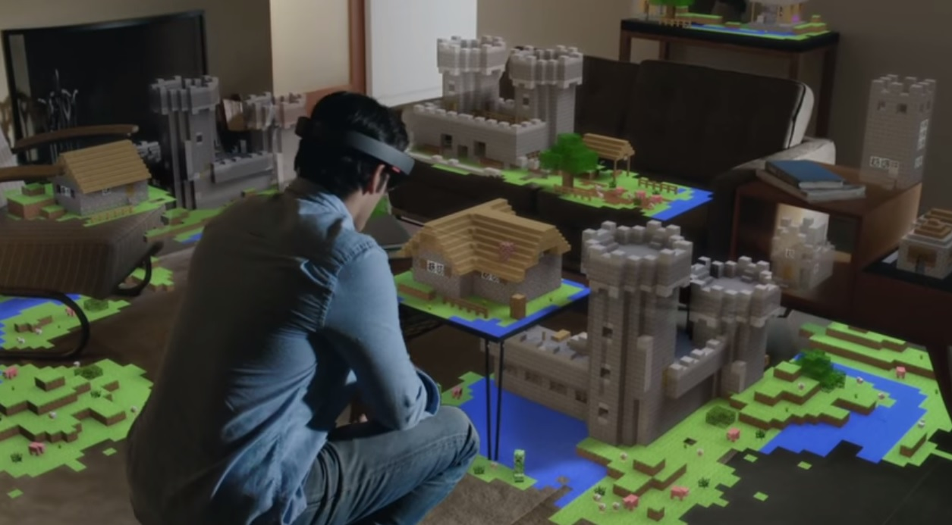
TECHNOLOGIES
http://www.technobuffalo.com/wp-content/uploads/2015/05/Minecraft-HoloLens.jpg
Notes:
Nick will talk
The dome itself that surrounds the arena during the games.
The British military is working on a force field like technology to protect tanks/vehicles against attacks using super capacitors.
Game Control Room: This is a room where a bunch of Capitol members can manipulate the Hunger Games Arena
Does this by pinch/touch, and dragging and dropping from one screen to another by hand.
They create a forest fire, down trees, insert blood thirsty genetically modified beasts
This technology doesn’t 1-1 map to our world, but we can imagine a few technologies combined that may produce this in the future
Firstly, we have augmented reality headsets in todays society, consider Microsoft’s Hololense. This allows us to see and add more into our society than is actually there, albeit in a virtual manner.
Sources: http://www.technobuffalo.com/wp-content/uploads/2015/05/Minecraft-HoloLens.jpg
http://i2.cdn.turner.com/cnn/2013/images/07/10/3d.printing.jpg

Slide 12
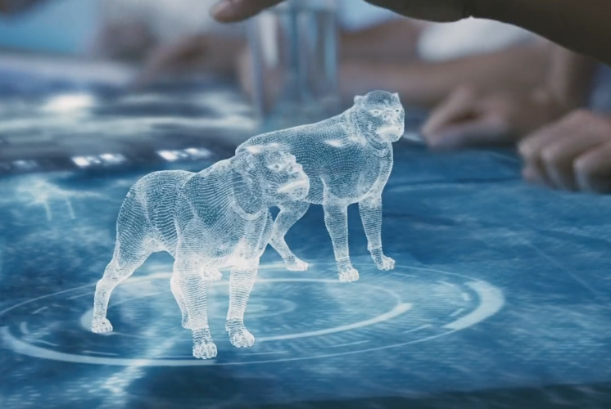
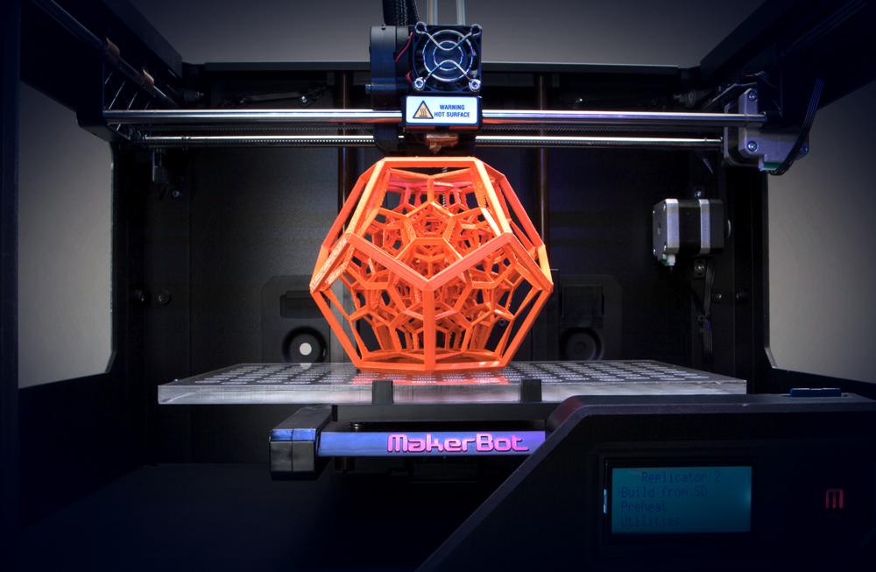
TECHNOLOGIES
http://i2.cdn.turner.com/cnn/2013/images/07/10/3d.printing.jpg
Notes:
Nick will talk
Game Control Room: This is a room where a bunch of Capitol members can manipulate the Hunger Games Arena
The other technology that can be used with some form of augmented reality is 3d printing. Imagine we are able to use some augmented reality headset to virtually see what we want in the world, and subsequently physically create it in the world with a 3d printer. These are the closest technologies we have to the complex technology that is the fictitious Game Room
Sources: http://www.technobuffalo.com/wp-content/uploads/2015/05/Minecraft-HoloLens.jpg
http://i2.cdn.turner.com/cnn/2013/images/07/10/3d.printing.jpg

Slide 13
Conclusion Summary
Our increasing reliance on technology puts us at a higher risk of being controlled
1. Technological segregation
2. The games causing fear/harm
3. Media distortion
Notes:
LAURA talks!!!!
The conclusion we wish to argue is that since we have most of the technologies present in the movie, we need to be careful in who controls the technology or we may end up like the Districts of Panem.
We argues this through the lenses of the technological segregation between the Capitol and the Districts and how our society is similar.
We argued also that the govt used the games and the tech in it to install fear in its people
Finally, we argued our point through the fact that when a government of single entity has control over the media, facts and perception becomes distorted

Slide 14
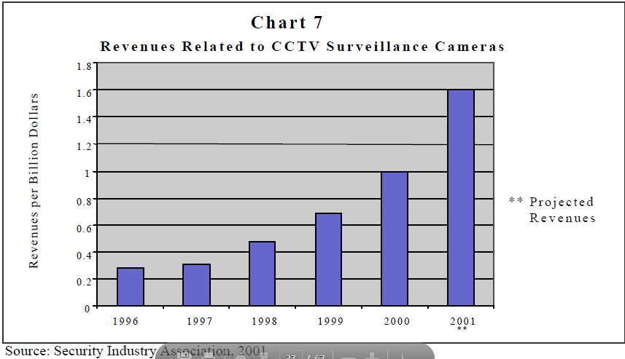
Technological Segregation
1. Government has access/uses:
Recording devices
District residents DNA
2. Government controls all tech
Notes:
Laura will talk.
Based on the observation that throughout the movie tech segregation inflates the govt’s power over the people, combined with the fact that we already have access to most of this tech, this could happen to our world. This is because the govt has control over some tech i.e. Egyptian rebellion disconnecting internet for a few days. Different companies and their govt have access to cameras like CCTVs, ATM cameras and traffic light cameras.
This conclusion draws directly from three topics addressed in this course, privacy and the government, intellectual property, and information privacy. The first way in which the governments control is increased is through the numerous forms of surveillance throughout the Districts.
Recording devices -> privacy and govt Through the use of video cameras, audio recorders, and other technological surveillance techniques, the government is constantly monitoring the citizens of the districts. If an action is deemed to be in opposition to the government’s rules there can be reprisals for the individual as well as any others in association. Surveillance diminishes the need to trust the surveilled, as its presence will pressure that person to conform and so render his actions more predictable [2]. This can already be seen in major cities in our world through the use of CCTV, traffic light cameras, and ATM cameras. The revenue related to the sales of CCTV’s has only increased since 1996 and was expected to be as high as 1.6 billion dollars in 2001. These recording devices only convey video in most cases and are supposedly used to help lower crime rates but it still inflates the governments control over the people as they or select organizations are the only ones with access and the civilians being filmed did not give permission to be one film.
District DNA -> information privacy
There are some aspects of invasion of citizen privacy within Panem, namely with the blood registration during the reaping. From a district's civilian's perspective, it only seems like the blood sample is for reaping selection purposes; on the other hand, it would not be surprising if the Capitol were to use the DNA retrieved from a citizen's blood for scientific purposes such as genetic modification/research or further surveillance. The issue with privacy on this matter is the "information inherent in DNA and the individual’s lack of control over such information" [1]. The government takes control of the people through their blood but also through their rights and more specifically their right to intellectual property.
Govt controls tech -> intellectual property
The Capitol has all sorts of high-tech devices at their disposal such as, hover trains, and game control technologies. The Districts from what we have seen in the movie have little to no access to technology which is made even more apparent by Katniss's astonishment when she enters the Capitol and sees how different it is from her District [1]. We can draw this back to our society in the case of the rebellion in Egypt where the citizens were disconnected to the Internet. Despite who invented these technologies in the first place they are now owned by the Capitol and the inventors do not have the rights to their own intellectual property now or in the future. Due to the fact that "The Capitol has established total surveillance in the arena and nearly total surveillance in the districts.." (Dunn, and Michaud pg. 48)[3], implies it would be next to impossible for any invention created by someone in the districts to stay in their hands or have rights to it. This in turn violates any rights the people could have over their own intellectual property. While our society has various copyright and Intellectual Property laws, it has been argues in this class that these are not enough to protect content creators.
Work and Tech ->
The citizens of the Capitol lead very mundane lives and their easy accessibility to technologies of all kinds leads to a lack of tasks for them to perform themselves. The automation of these everyday tasks leaves the Capitol’s citizens to lack purpose in their lives and in many cases the games are the most exciting event in their lives causing them to look forward to the event. The government controls the games and in turn controls one of the only sources of excitement that the Capitol’s citizens has in their lives. INCREASED RELIANCE ON AUTOMATION, THE MACHINES ARE TAKING ALL OUR JOBS!!
Government control of the people is prevalent throughout the movie despite location but the games themselves act as way the government can further increase the power the government has over it’s people.

Slide 15
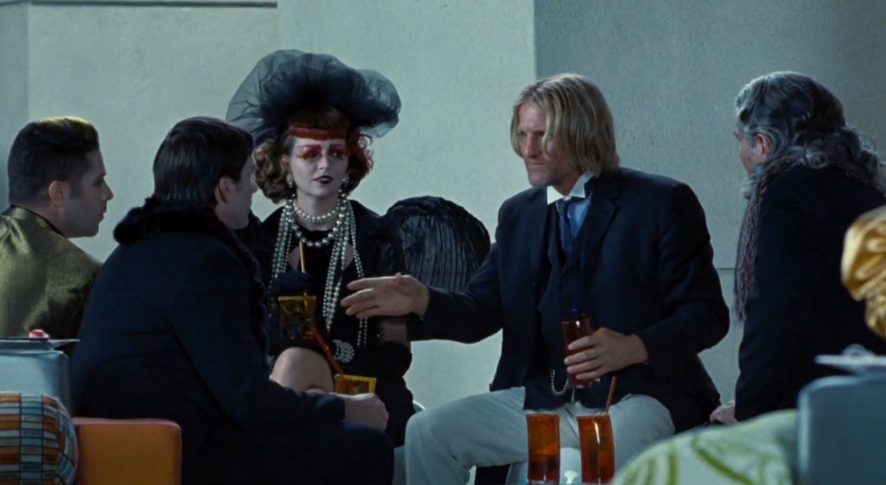
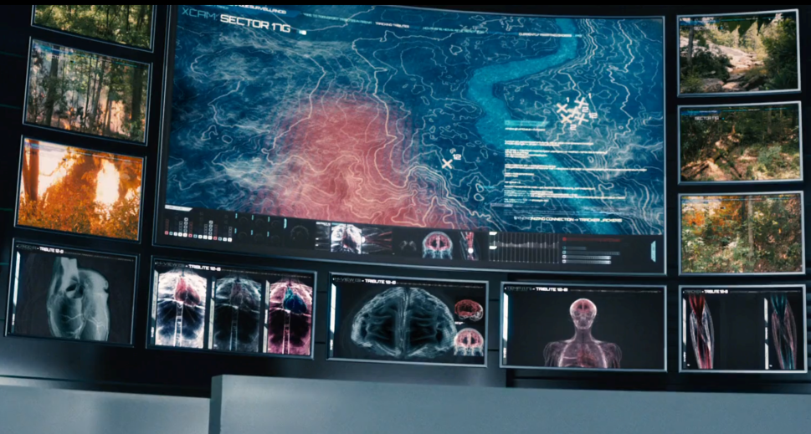
The Games instilling fear/harm
Surveillance. Contestants have to please:
Game Makers
Sponsors
2. Risk of game arena failure
Notes:
THE GAMES THEMSELVES DIRECTLY, UTILIZE TECHNOLOGY TO INSTILL FEAR IN THE PEOPLE OR HARM (WHAT HAPPENS IF THE TECH GOES WRONG), KEEP UNDER GOVERNMENT CONTROL, FREEDOME OF SPEECH ACTING ON CAMERA, ERROR IN TECH SCANNERS
Shoop will talk
Sprinkle Gladiators EVERYWHERE.
Our second conclusion is in regards to the actual games, and how the technology utilized serves to instill fear/harm in the contestants. The supporting topics for our 2nd conclusion are freedom of speech and error failure risk.
As Laura mentioned, government surveillance is very prominent in the movie, and that is especially true within the actual games. There are cameras everywhere so that the game masters/controllers can see all contestants to know what exactly they are doing. The contestants have to always act like they’re being watched. They need to please many people during the hunger games, firstly the game makers.
If the game makers are displeased with the boring or poor performance of a player, they may throw some disasters at the players such as the fire in the woods inorder to make Katniss go back to the main arena center.
Another obvious group that the players need to please are the sponsors, as seen in the picture above. The sponsors have the money and ability to send care packages to contestants if they wish to. If the player doesn’t satisfy any sponsor, then he/she won’t receive any gift, which can be serious in the case where Katniss got a bad injury but was saved thanks to a care package that had special ointment to treat the wound.
As for the error failure risk field, the entire game arena is mainly digital and manually controlled by the game makers. There is definitely a potential of risk, both for the contestants and game makers.
There’s risk for the players because if something breaks such as an issue where hundreds of wild beasts get created, then all contestants would die quickly.
There’s risk for the game makers because their goal is to provide entertainment by operating the game arena. If something fails and is unplanned, it could harm the entertainment value thus disappointing/angering the Capitol/President Snow.
There is also the implication on how the concept that the games are being televised could be connected with our IRL reality TV programming. Dennis can talk further about that.
•Contestants have to try and please everybody
•Consequences with not pleasing a certain group. Like not pleasing game makers, more bad stuff gets thrown at you in the game i.e. fire. Not pleasing sponsors, you don’t get medicine. Not pleasing district, you are a bad representative and a disgrace.
•Risk to contestants, cause if beasts or whatever stuff gets wild, they all could die.
•Risk to game makers, cause their goal it to provide entertainment. Things may not go as planned if device failure happens
•So the games instill fear.
•Last mention, about reality TV implications, as Dennis will talk about.

Slide 16
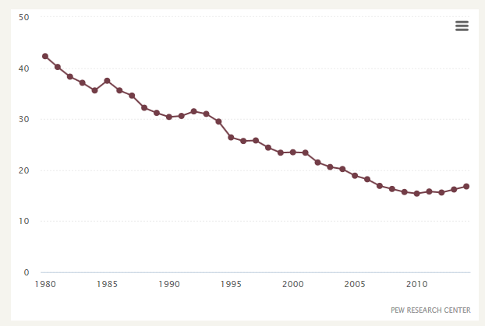
Media Distorts Reality
Lack of news media in districts
Capitol talk-show segment
District 11 live feed incident
“Network TV: Evening News Ratings Over Time”
http://www.journalism.org/media-indicators/network-evening-news-ratings-over-time/
Notes:
Dennis talks:
North Korea censoring content.
This brings us to our third and final overall conclusion: the media distorts reality. We argue that the media utilizes and manipulates technology to induce false perceptions of reality in the watchers.
Firstly, one can see that there is a severe lack of media within the districts outside of the events of The Hunger Games. Common forms of media such as television, radios, computer networks, and even newspapers are seen to be non-existent within the districts. This lack of media is a form of reality distortion. Events that happen in the capitol or other districts, that are not directly brought to district’s attention, are made to seem un-important. When news is brought to the Districts, majorly pertaining to the games and the past uprising, it is distorted to reflect the views of the Capitol and President Snow. In the US today, the public receives information about the people in power through journalists and news reporters through various forms of media. One can argue that the media today often reports their news in a subjective way, and we must take it with a grain of salt, whether or not it was intentional [1]. In North Korea the government controls the media content in its entirety, therefore North Korea provides biased news content to create a false perception of reality in its citizens.
In addition, the media uses The Hunger Game talk-show segment to distort the severity of the games themselves. The talk show-segment has each of the contestants talk about their likes and dislikes, views, and personalities in order to create a persona for the audiences. The media distorts this perception by thrusting these personas and false identities on these individuals and distracting the audience through entertainment. The media distorts the image of those in the games just relatable enough such that those in the capitol care just enough to invoke sponsorship and entertainment value, yet are still accepting that their death means little. They become desensitized to the violence through the immersion of their technology and fall for the allure of entertainment by reality television [2]. In our world reality TV shows
Finally, we can see the consequences of what happens when this distortion of reality is not maintained. When Hunger Games contestant Rue from District 11 dies suddenly, Katniss is shown on camera conducting a proper burial of Rue’s body. The distortion that the contestants lives' meant very little except to pay for the ‘sins’ of past rebellions was disrupted. This lead to District 11 rebelling against the Capitol’s control in their district. It can thus be said without this constant distortion of the games, the districts would more likely to disagree with the actions taken by the Capitol, the game makers, as well as the media. Thus, looking at these three main points, one can see that exposure to this virtual entertainment media attempts to distance the audiences from the true reality they reside.
[1] http://lup.lub.lu.se/luur/download?func=downloadFile&recordOId=2302969&fileOId=2302977
[2] http://go.galegroup.com.ezproxy.wpi.edu/ps/retrieve.do?sort=RELEVANCE&inPS=true&prodId=LitRC&userGroupName=mlin_c_worpoly&tabID=T001&searchId=R1&resultListType=RESULT_LIST&contentSegment=&searchType=BasicSearchForm&currentPosition=1&contentSet=GALE%7CH1100117210&&docId=GALE%7CH1100117210&docType=GALE&role=LitRC

Slide 17
Conclusion Summary
Our increasing reliance on technology puts us at a higher risk of being controlled
1. Technological segregation
2. The games causing fear/harm
3. Media distortion
Notes:
Dennis talks:
In summary, we concluded that the technological control the Capitol has over its Districts may be on its way to our society.
We argued this through the lenses of technological segregation between the Capitol and the Districts, the governments use of the games and the tech in it to install fear in its people, as well as the fact that when a government of single entity has control over the media, facts and perception becomes distorted.
This concludes our presentation. Are there any questions, comments, or concerns?

Slide 18
REFERENCES
Hunger Games. Dir. Gary Ross. Perf. Jennifer Lawrence. Lionsgate, 2012. Film.
Surette, Ray. "The thinking eye: Pros and cons of second generation CCTV surveillance systems." Policing: An International Journal of Police Strategies & Management 28.1 (2005): 152-173.
"Internet Encyclopedia of Philosophy." Internet Encyclopedia of Philosophy. N.p., n.d. Web. 08 Oct. 2015.
Flanagan, Victoria. Technology and identity in young adult fiction: the posthuman subject. Palgrave Macmillan, 2014.Pages 132-144
Roman-Santos, Candice. "Concerns Associated with Expanding DNA Databases." Hastings Sci. & Tech. LJ 2 (2010): 267.
Connors, Sean P. ""I Try to Remember Who I Am and Who I Am Not""Science Fiction and Speculative Fiction Challenging Genres. Ed. P. L. Thomas. Dordrecht: Springer, 2013. 145-65. Print.
Hsu, Jeremy. "'Hunger Games' Exposes Myth of Technological Progress."LiveScience. TechMedia Network, 23 Mar. 2012. Web. 22 Sept. 2015.
Michaud, Nicolas, and Dunn, George, eds. Blackwell Philosophy and Pop Culture : Hunger Games and Philosophy : A Critique of Pure Treason. Hoboken, NJ, USA: John Wiley & Sons, 2012. ProQuest ebrary. Web. 22 September 2015.
Freedom of Speech definition. Dictionary.com, n.d. Web. 08 Oct. 2015.
"Surveillance Under the USA PATRIOT Act." American Civil Liberties Union. N.p., n.d. Web. 08 Oct. 2015.
Leveson Nancy, Turner Clark S.,“An Investigation of the Therac-25 Accidents”.
Petersson, Sara. "The Hunger Games by Suzanne Collins: Entertainment or Social Criticism?." (2012).
Muller, Vivienne. "Virtually Real: Suzanne Collins’s The Hunger Games Trilogy." International Research in Children’s Literature 5.1 (2012): 51-63. Rpt. in Contemporary Literary Criticism. Ed. Lawrence J. Trudeau. Vol. 355. Detroit: Gale, 2014. Literature Resource Center. Web. 8 Oct. 2015.
Notes:
References will be shown here. All references that will be used for this PowerPoint are currently in out Website under the references tab.

