Slide 1
Virtual Reality
Future Problems and Considerations
Mead Landis, Alex Ruggiero, Charles Sinkler, Logan Tutt
Notes:
Alex- Introduce all

Slide 2
Outline
Definition of VR
History of VR
Current State
Expected Future
Privacy Concerns
Crime in VR
Media Portrayal
VR in the Workplace
Notes:
Alex- go over outline of presentation

Slide 3
Definition of VR
From Merriam Webster -
“an artificial environment which is experienced through sensory stimuli (as sights and sounds) provided by a computer and in which one's actions partially determine what happens in the environment”
Touch and haptic feedback are beginning to become common as well
[15]
Notes:
Alex- go over definition
VR is defined as “an artificial environment which is experienced through sensory stimuli (as sights and sounds) provided by a computer and in which one's actions partially determine what happens in the environment” by the dictionary
Because a large number of VR definitions include non-stereoscopic games and media, it is important to distinguish between those and head mounted and full immersion systems. We are focusing on the head mounted systems for our research.

Slide 4
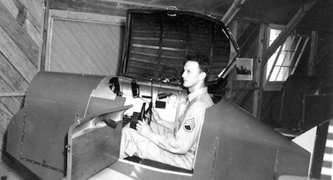
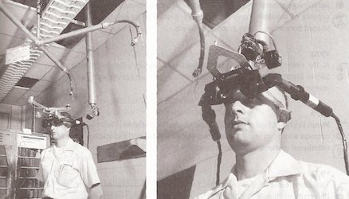
History of VR
1838 - Stereoscopic Photo Viewer
1929 - First Flight Simulator for Military
1960s - Many Different HMDs (Head Mounted Displays)
1995 - Virtual Boy Console
2003 - Second Life Game
[14],http://www.vrs.org.uk/images/link-trainer-1.jpg, http://www.vrs.org.uk/images/ivan-sword-of-damocles.jpg
Notes:
Alex-
Virtual Reality has been investigated as far back as 1838.
The stereoscopic photo viewer gives the user the feeling of depth in photos. Of course had no motion or interaction, but is a rudimentary immersive device.
The Link Trainer - First flight simulator. Used for military training purposes. From the beginning, VR was known to be useful to military.
In the 1960s, many different people investigated Head Mounted Displays. Sword of Damocles most advanced for its time.
Ivan Sutherland (Sword of Damocles creator) thought up the Ultimate Display idea. A chair in VR good enough to sit in. Handcuffs in VR would be binding. A bullet in VR would be fatal.
Became more and more possible with computer advances. Virtual Boy Console was one of the first 3-D video games. Interactive, but with simple wireframe graphics.
In 2003, Second Life came out. In 2013 had 1 Million regular users.

Slide 5
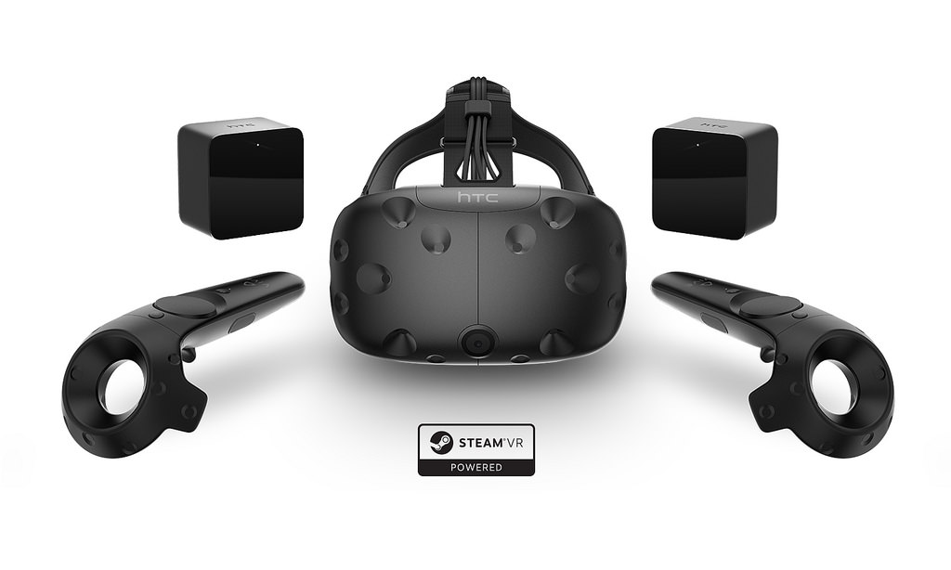
Current State of VR
Two main VR competitors
Oculus Rift
Kickstarter in 2012
Focused on seated experiences.
Release of Oculus Touch soon will add hand tracking and some room scale ability.
HTC Vive
“Room Scale” allows for head and hand tracking in 5m x 5m room
https://c2.staticflickr.com/2/1471/25845851080_21ea8a50d9_b.jpg
Notes:
Logan-
There are currently two main companies producing VR HMDs
Vive is focused on immersive room scale experiences, allowing for movements and interactions in a large room. Hand controllers and accurate tracking allow for extremely immersive experiences
Oculus focuses on seated experiences controlled by a gamepad. They are starting to follow htc’s lead with touch, but still focusing on 180degree expereinces

Slide 6
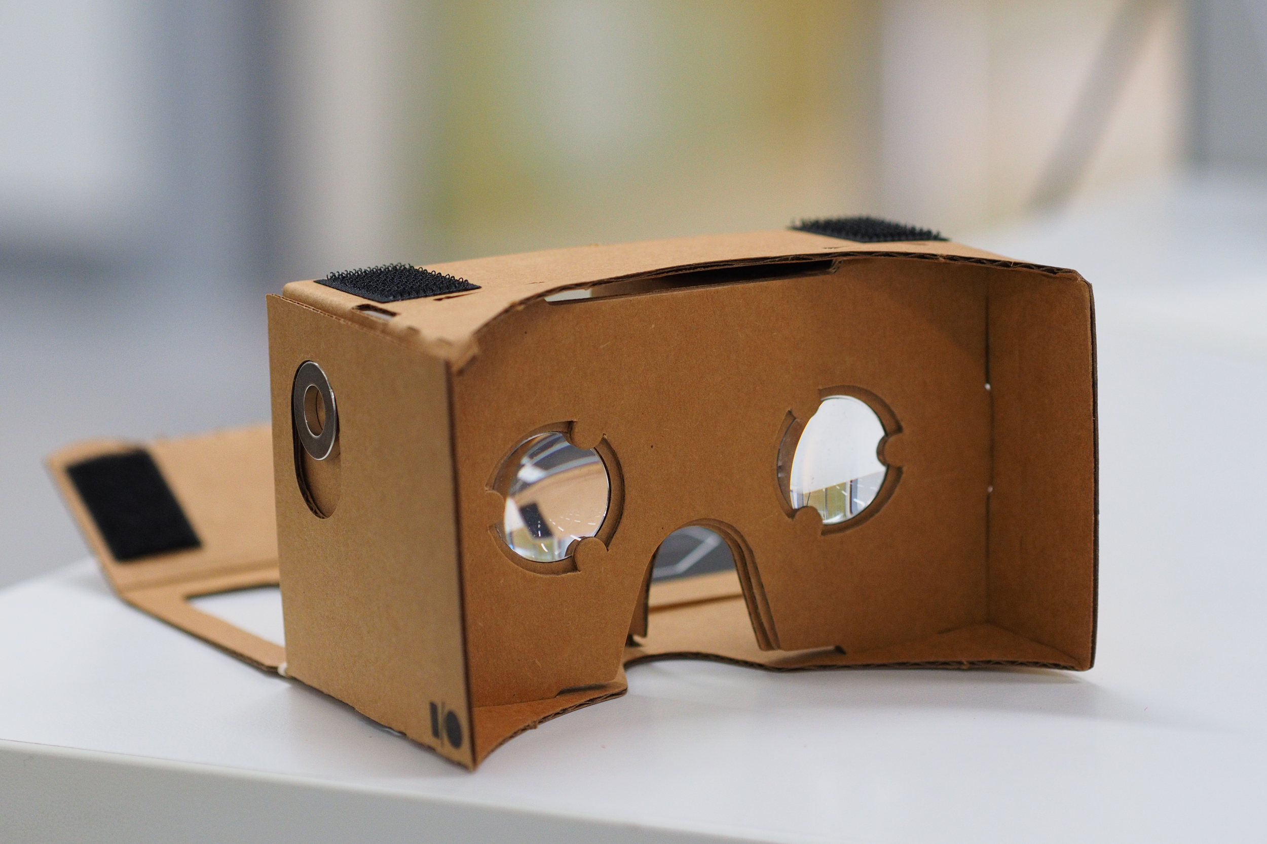
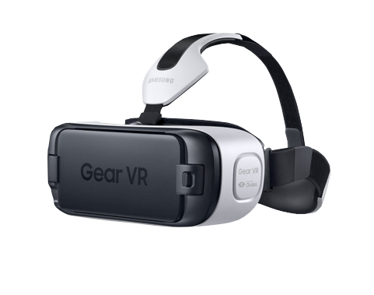
Current State of VR
Other VR companies
Samsung Gear VR
Uses smartphone for display
Playstation VR
VR HMD designed specifically for Playstation 4
Google Cardboard
Inexpensive headset made of cardboard and lenses for use with smartphone
Many new startups appearing
https://upload.wikimedia.org/wikipedia/commons/9/95/Assembled_Google_Cardboard_VR_mount.jpg,
https://upload.wikimedia.org/wikipedia/commons/d/d7/Samsung_Gear_VR_V1.png
Notes:
Logan-
Many other HMDs are starting to become available.
Rift and Vive are expensive ($600-$800)
Gear and Playstation VR aim to be low cost alternative
Only allow for seated use
Cardboard is extremely low cost, but allows for an introduction to VR
Many new companies are entering the field, and many new products and improvments are appearing

Slide 7
Predicted Future VR Timeline
1 Year (2017):
VR Will continue gaining market share for casual gamers, as VR games become more realistic
5 Years (2021):
VR technology will become common for other forms of entertainment such as 3-D movies and other non-interactive entertainment
10-15 Years (2026-2031):
VR will become the standard for entertainment as well as teleconferencing.
Notes:
Mead-
Virtual reality will continue growing at an increasing rate.
Within a year’s time, we predict the market for video-game related VR will expand rapidly, but will not extend far beyond video games.
In Five years, VR will expand into mainstream entertainment like 3-D movies and television.
In Ten years, VR will be a standard facet of entertainment as well a key tool in telepresence including teleconferencing and working remotely.

Slide 8
Privacy: Data Collection
Oculus’ Privacy Policy: Information is automatically collected about:
“games, content, apps or other experiences you interact with”
“your physical movements and dimensions”
“how users respond to our marketing efforts”
“We may share information about you for any other purpose for which you give us your consent.”
[6] www.pixabay.com/
Notes:
Mead-
Oculus, owned by facebook, has a privacy policy that seems to be quite the opposite.
Oculus admits they intend to measure everything possible pertaining to users of their platform, and then use it, at a minimum, to target advertisements toward users.
However, this data is far more useful than it initially appears: [Next Slide]

Slide 9
Privacy: Data Mining
Data within the Data:
Physical
Height, weight, age, body type, arm span, caloric intake, chronic illnesses, handicaps, bone structure, athleticism, pain tolerance, eyesight, strength, clothing sizes, sports aptitudes, color-blindness, genetics, etc.
Mental
Stress tolerance, personality type, reaction time, behaviour when lying, happiness, anger, mental conditions, intelligence, political stance, will power, lifestyle etc.
[1] [8]
Notes:
Mead-
If data mining can precisely determine when a pregnant woman is due from what she buys at target, imagine what a company could find from hours of full-body, millimeter-accurate measurements.
Data miners will easily determine physical characteristics such as clothing measurements or deformities, however this will also be able to discern many more incriminating and private aspects from people’s lives.
Derived metrics could range from mood and caloric intake to chronic illnesses such as arthritis and mental conditions like depression or adhd.
In 2014, researchers at LoughBorogh University devised a test to determine what sports an indivdual would be best suited on based upon select characteristics such as height, aggression, focus, coordination, and age.
This level and quantity of data is unparalleled, and so will require careful footing in the near future.

Slide 10
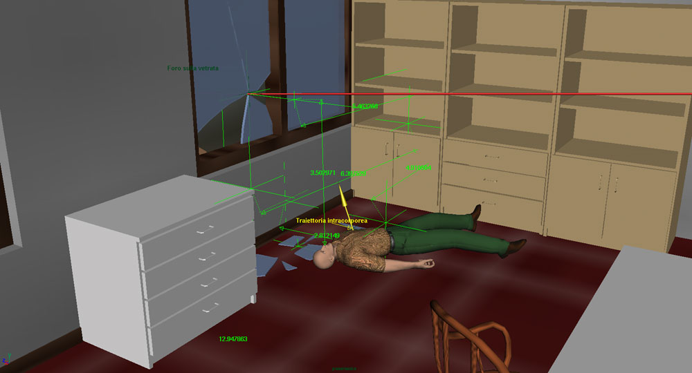
Crime
Jurors and VR - crime scene recreations
If something happens in VR, when will it be considered real enough to be a crime?
Virtual reality is already realistic enough to play on people’s emotions
VR Milgram Experiment shows this - participants acted as if situation was real
[3],[4], http://i.cmpnet.com/infoweek/1038/news_csi_secondary.jpg
Notes:
Charlie-
VR has some implications on crime:
Jurors may soon be able to visit recreations of crime scenes in VR, in order to get a immersive view of the environment and other evidence. This likely won’t affect the way that crimes are perpetrated, but it does affect the way that they are punished. If this happens, it is likely that the evidence presented in VR will have some problems being permissible in court.
If something happens in VR, when will it actually be considered a crime? Conclusion we came to is when it affects a person’s life in a similar manner to a real-world crime. There are already issues with personal privacy, as noted earlier. What about personal belongings or otherwise?
VR is already realistic enough that it can play on people’s emotions. Stanley Milgram experiment shows that VR can be realistic enough to trick people into thinking they are doing real harm. Anything that happens in VR might be able to affect people’s emotions more than in a non-immersive video game.

Slide 11
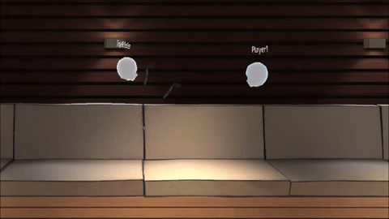
“Personal Bubble” Solution
BigScreen game had issues with virtual groping and harassment
Implemented a Personal Bubble approach:
If another user comes within a set space of you, they simply disappear
http://cdn.uploadvr.com/wp-content/uploads/2016/06/BigScreen-Person-Space-Bubble.gif [7]
Notes:
Charlie-
The Game BigScreen came up with a unique solution to issues with putting many people in VR in an interactive environment.
They had issues where people would virtually grope others, violating their personal space and being disruptive. Because VR can be so realistic and immersive, the people being virtually groped felt violated
To solve this issue, they implemented personal space bubble. In this bubble, other users will simply disappear from view, avoiding any issues with groping or other lude gestures.

Slide 12
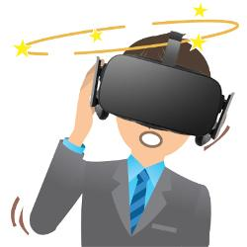
VR Sickness
Potential to cause users to become physically sick
Symptoms include nausea, headaches, vertigo, and vomiting
Caused by conflict between visual and vestibular systems
[8],[9],http://www.phonearena.com/news/A-new-research-deals-with-VR-motion-sickness-in-an-innovative-way_id82273
Notes:
Logan-
Badly done VR systems can cause users to experience discomfort and sickness.
Variety of symptoms, similar to motion sickness
Symptoms can last for hours or even days
Artificial motion, lag, and tracking failures can be a cause of this sickness.
Eyes and balance don’t match, causing the sickness
Solutions are being developed including inner ear stimulation devises and special movement methods, like teleportation and “arm-swing” locomotion

Slide 13
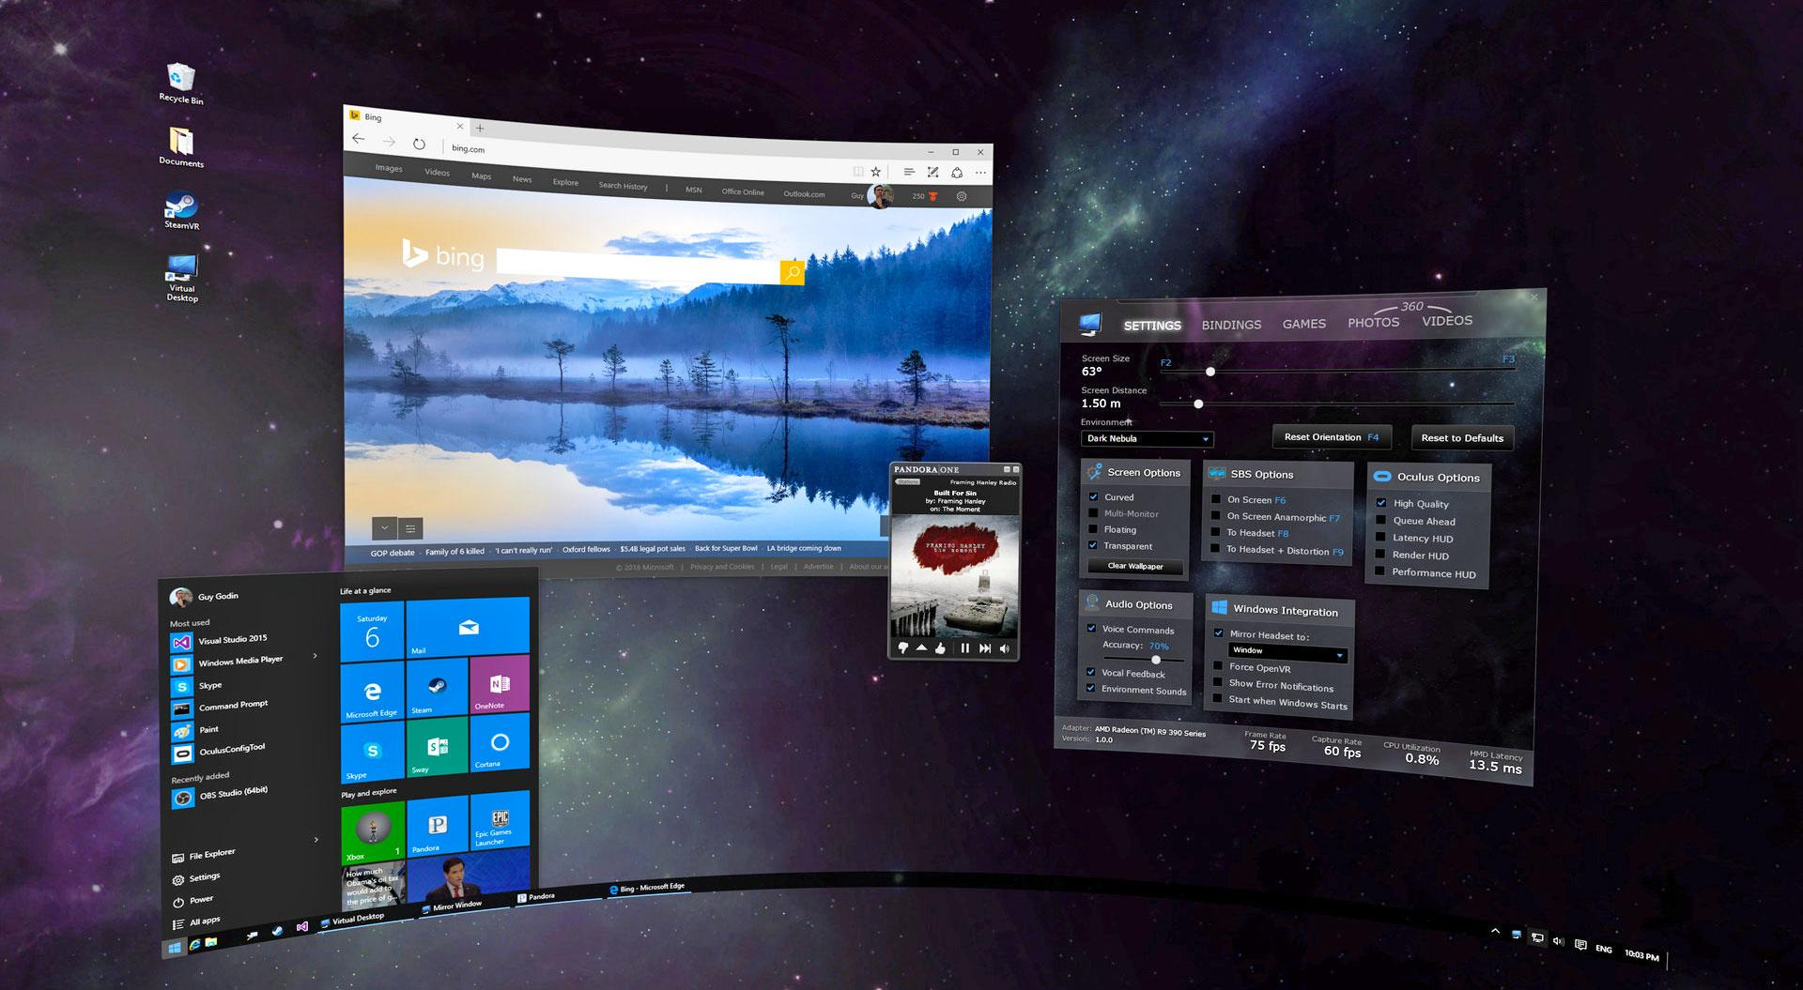
Virtual Reality in the workplace
Replacement for conventional monitors
Visualizations of designs and data
Modeling of systems in 3D
Virtual Teleconferencing
[11],[13], https://www.engadget.com/2016/04/18/virtual-desktop-vr-windows/
Notes:
Logan-
VR can allow for much better visualisation, as 3d objects and systems can be represented and seen much better
Virtual desktops allow for users to not be limited by a screen.
Potential for CAD with VR (Dassault partnership with HTC)
VR can be a great method of communicating over long distance, using virtual conference rooms or other methods.
Remote workers can interact with others like they were at the office.
In theory, conventional offices n some industries could no longer be needed at all once vr has improved

Slide 14
VR in Media
Rick and Morty - M Night Shaym-Aliens! (S1E4)
Virtual Reality used as tool to steal sensitive information
Surrogates (2009 Film)
VR used as tool to control robots - people die when using them, however.
Very futuristic, but who knows how far VR will come?
[5] http://s3cf.recapguide.com/img/tv/138/1x4/Rick-and-Morty-Season-1-Episode-4-3-7d3d.jpg
Notes:
Charlie-
VR is often portrayed in popular media in a rather negative light.
It is often seen as a means of control, from “The Matrix” world of controlling the entire population, to an episode of “Rick and Morty” where aliens used VR to steal information
Media also often portrays fear of potential unintended effects of VR. In “Surrogates”, a weapon is developed that can kill VR users, and in “The Lawnmower Man” VR gives a user super powers but also drives him insane.

Slide 15
Conclusion
Virtual Reality will be a technological revolution similar to the television or computer
Virtual Reality will change the way that people receive their entertainment and communicate with work within the next 10-15 years
VR will have a similar effect on entertainment and communication as the television and the radio
For VR to become commonplace, the public view of it must change
Notes:
Charlie-
VR will be a revolution in human computer interaction
Will have a similar effect as the television or radio did.
Will take 10-15 years for it to become the standard
Public view must change
Currently seen as a novelty or gimmick, but that will change as it enters the workplace
Media portrayal is currently negative, but will likely improve over time

Slide 16
References
[1] Kashmir Hill. How Target Figured Out A Teen Girl Was Pregnant Before Her Father Did. http://www.forbes.com/sites/kashmirhill/2012/02/16/how-target-figured-out-a-teen-girl-was-pregnant-before-her-father-did/#7c4fbf2034c6
[2] LaViola, J., Joseph. (2000). A discussion of cybersickness in virtual environments. ACM SIGCHI Bulletin, 32(1), 47-56. doi:10.1145/333329.333344
[3] Pullen, John Patrick. Virtual Reality Brought Me to Tears. http://time.com/4172998/virtual-reality-oculus-rift-htc-vive-ces/ (9/27/16)
[4] Gershman, Jacob. Virtual Reality Aims to Transport Jurors to Crime Scenes. http://blogs.wsj.com/law/2016/05/24/virtual-reality-research-aims-to-transport-jurors-to-crime-scenes/ (9/27/16)
[5] Surrogates Synopsis. IMDb. http://www.imdb.com/title/tt0986263/synopsis?ref_=tt_stry_pl (9/27/16)
[6] Oculus Privacy Policy. https://www3.oculus.com/en-us/legal/privacy-policy/ (10/5/16)
[7] Feltham, Jamie. BigScreen Adds Personal Space Bubble to Stop Trolls in their Tracks. UploadVR.http://uploadvr.com/bigscreen-adds-personal-space-bubble-stop-vr-trolls-tracks/ (10/5/16)

Slide 17
References
[8] LaViola, J., Joseph. (2000). A discussion of cybersickness in virtual environments. ACM SIGCHI Bulletin, 32(1), 47-56. doi:10.1145/333329.333344
[9] http://www.immotionar.com/en/blog/2016/march/04/the-time-of-conundrum-lesson-1-how-to-develop-a-reduced-nausea-first-person-controller-in-vr/
[10] Which sport are you made for? Take the test, Loughborough University,, http://www.lboro.ac.uk/departments/ssehs/news/2014/which-sport-are-you-made-for-take-the-test.html (10/6/16)
[11] http://www.forbes.com/sites/centurylink/2014/06/12/how-virtual-reality-will-change-life-in-the-workplace/#6e030fb754c3
[12] Virtual Reality Society. History of VR. http://www.vrs.org.uk/virtual-reality/history.html (9/18/2016)
[13] http://www.3ds.com/press-releases/single/htc-partners-with-dassault-systemes-to-spearhead-virtual-reality-for-enterprise/
[14] Slater, M et al. A Virtual Reprise for Stanley Milgram Experiment. https://www.ncbi.nlm.nih.gov/pubmed/17183667 (10/4/16)
[15] Virtual Reality [Def. 1]. (n.d.). In Merriam Webster Online,from http://www.merriam-webster.com/dictionary/virtual%20reality

