Slide 1
Class 11
Work
Keith A. Pray
Instructor
socialimps.keithpray.net
Notes:
Here’s the title slide. Excited already, aren’t you?
Last paper average:
Total points not counting extra credit so far:

Slide 2
Overview
Review
Assignment
Students Present

Slide 3
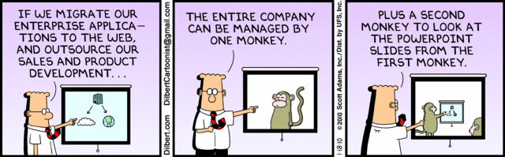
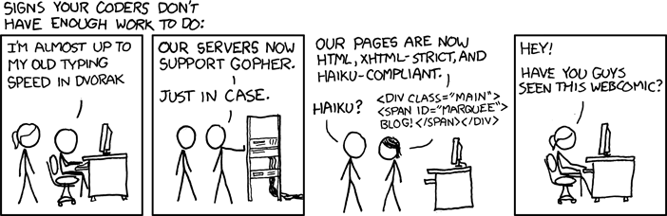
http://xkcd.com/554/
Notes:
Poll class:
Expected salary range upon graduation? Min, Max? Put on board.
Assume 40 hour work week.
How many people would work:
32 hours for 0.8 * Max? Put on board.
24 hours for 0.6 * Max? Put on board.
…continue until Min is reached.

Slide 4
Group Quiz
List 2 ways IT can lead to organizational change.
List 4 ways a Video Game Producer may protect its IP and what specific IP each protects.
List a computing technology that can be used to protect an individual’s privacy.
List a computing technology that can be used to intrude upon an individual’s privacy.
Notes:
Could split into groups of 4-5 for this.
Fill time with Work Discussion on Course Web Site
Maybe watch video: wait until after this batch of student presentations, no thunder stealing
CGP Grey
Humans Need Not Apply (15:00) – 2014-08-13
http://www.youtube.com/watch?v=7Pq-S557XQU
Last access 2016-04-22
Look at:
BBC Intelligent Machines
http://www.bbc.com/news/technology-33978561
BBC Likelihood of robot taking your job
http://www.bbc.com/news/technology-34066941
Kickstarter Charter
https://www.kickstarter.com/charter?ref=about_subnav

Slide 5
Overview
Review
Assignment
Students Present
Notes:
Review Group Assignment Details.

Slide 6
Overview
Review
Assignment
Students Present

Slide 7
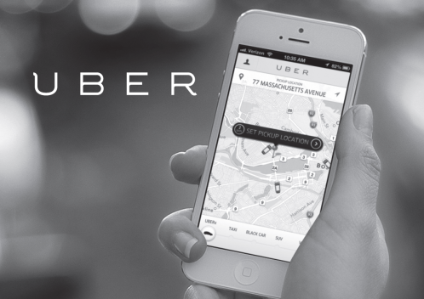
App economy: Uber’s effect
Joe Fainer
Uber is laying the way for the sharing economy based companies that thrive off of mobile apps.
[3]
Notes:
Today I will discuss the effect that Uber has on the idea of app economy. To be a bit more specific, I will be dealing with the idea of sharing economy, a new style of companies that breaking into the app business. Uber is the perfect example to demonstrate this change in the economy because of it popularity and well known financial success.

Slide 8
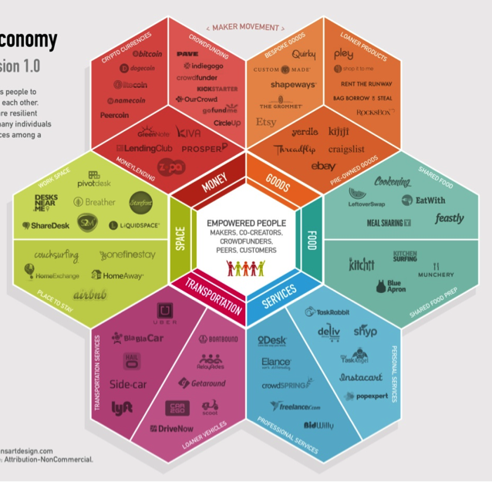
Sharing economy
Joe Fainer
What is Sharing Economy
  “Sharing goods and services”
  A.K.A. “collaborative economy” or “peer economy”
Consumer Benefits Include:
  Reduced cost
  Convenience
Service Provider Benefits Include:
  Additional Income
  Flexibility
  Ease of Entry
[1] [2]
Notes:
Sharing economy is the sharing of goods and service. The idea is based on renting a service or item that people could use when your not using it. Such services and items include lawn tools, cars, babysitting, empty rooms, and dog walkers.
The benefits of sharing economy include reduced cost because the process reduces the need for owning items or for acquiring a term rental. Services can be matched against each other also lowering the cost due to a lack of regulation.
People provide the service or item because it allows them to make additional money with a flexible schedule. AirBnB allows the use of empty homes and rooms to be rented while the owners are not using them. There is also a easier entry into these services, especially Uber because they don’t have to get a special taxi license.
The ability for the sharing economy to be as popular as it is, is due to the ability to create applications that allow the millions of people with smart phones to easily find items and services they require.

Slide 9
Uber Leading the app economy
Joe Fainer
Uber provides transportation services.
App Store revenue is expected to be $51 billion in 2016.
  4.2 million apps available.
Uber’s expected revenue is $1.1 billion in 2016.
  70-80% of each fare goes to the driver.
[5] [7] [8]
Notes:
Uber is part of the sharing economy, providing transportation services for people looking for a ride. However, its major service provisions are done through its mobile app. Many of the sharing economy companies operate through mobile applications due to the potential to reach a high number of clients and the convenience of app usage.
With the app economy expected to make $51 billion in revenue sales this year, Uber is able to be accountable for 2% of the total revenue. Considering that App Economy takes into account every source of income a app can make, from advertisements to in app purchases, to paying for the app itself, and with a total of over 4.2 millions apps on the markets, Uber is doing particularly well.

Slide 10
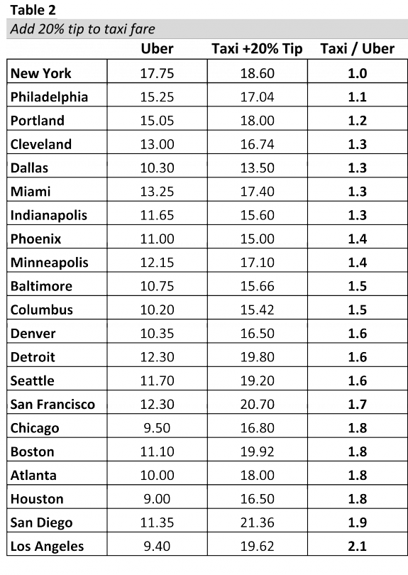
Uber vs. taxis
Joe Fainer
Uber:
  Rates generally lower
  Less waiting/planned pickup
  Electronic Paying
  Driver Rating
Taxis:
  Uber’s surge pricing
  Cheaper in traffic
[6]
Notes:
There is huge questions over whether to take a taxi or an Uber. Uber generally has more appealing quailities, which has lead to its quick adoption and growing business. As seen through the chart (test is done on 5 miles, 30mph, no idling), Ubers cost is generally lower than taxi fares. However, taxis have the appeal during times of surge pricing in which taxis become cheap. Surge pricing occurs when there is a bigger desire for rides than drivers available. For example holidays or weekends. “Moreover, in many cities, Uber’s pricing depends on the speed of the ride. Regular taxis charge riders per mile when moving, and per minute when idling. Uber charges riders per mile and minute whether they’re moving or idling. So, Uber prices drop as speed increases, since it is charging simultaneously for the miles and the driving time. As a result, taxis may become a more attractive option during times of traffic” Other than the difference in price, Uber has two more appealing qualities. You are allowed to pay before the ride, allowing people to not take cards or wallets with them. People using Uber can also get reviews about the driver, which make people feel safer than jumping into a taxi with an unknown driver.

Slide 11
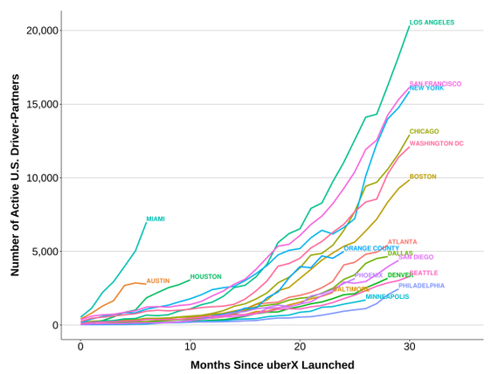
Interest in working for uber?
Joe Fainer
Uber has drawing qualities.
  Flexible schedule
  Reasonable Income ($25/hr)
Negative Aspects:
  Maintenance and insurance not covered
  Unsustainable wages.
[6]
Notes:
For many of the same reasons that the sharing economy is so beneficial, Uber peaks peoples interest to “work” for. Working for Uber provides drivers with flexible schedules. It also provides a reasonable wage for those that work. Between a flexible schedule and reasonable wages people are able to make additional income for their various reasons. However, there are many negative aspects in working for Uber as well. Drivers have complained about the lack of coverage for car maintenance, as well as the inability to live off being a driver. For many of these reasons, drivers have filed lawsuits against Uber looking for better benefits as employees of Uber.

Slide 12
Uber setting an example
Joe Fainer
California Labor Commission ruled that an Uber Driver is “an employee, not a contractor.”
  Resulted in Uber paying her $4,142.20 for her traveling expenses.
Boston driver looking to gain full employee benefits such as “wage protections, overtime pay, rest and meal breaks, and others worker benefits.”
Lawsuits against drivers for various other crimes or accidents.
[6] [9] [10] [11]
Notes:
In a San Francisco case, it brings to attention that Uber drivers are considered contractors not employees. Uber, after the ruling, insisted that its drivers are contractors which is what gives them there freedom and flexibility. The result of the case forced Uber to “reimburse” the driver for her traveling expenses as a employee. Meanwhile Uber is receiving many lawsuits of similar manner, one from a man in Boston on behalf of all Mass uber drivers. “Lawyers for California and Massachusetts drivers in the case reached a tentative $100 million settlement earlier this year that would not change drivers' statuses, but would add certain protections and allow them to solicit tips. The settlement has not been approved and a number of drivers' groups are unhappy with the deal. Only drivers in Massachusetts and California would be eligible for the payout, but drivers across the U.S. would gain new termination protections”
There are also lawsuits for deaths by uber drivers, assaults and rapes, antitrust violations, denying service animals inside cars, and for not conducting proper background checks.

Slide 13
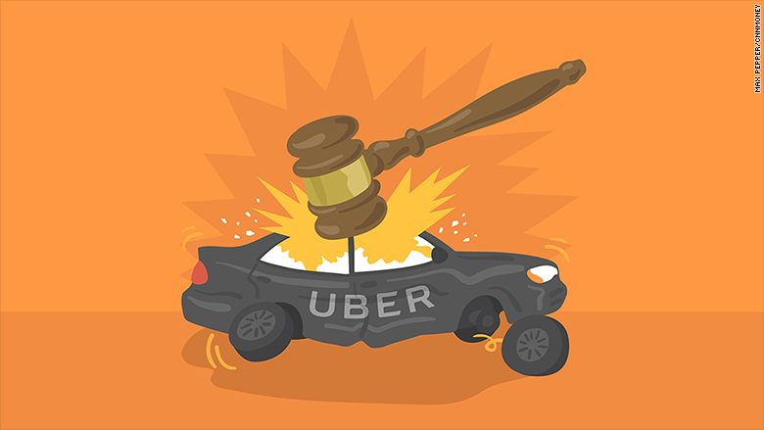
conclusion
Joe Fainer
With the rise of sharing economy through mobile applications, there need to be more regulations.
Uber is setting many precedents through its lawsuits, but laws and regulations are specific to each type of app.
Questions?
Notes:
Mobile applications allow sharing economy companies to become very profitable. However, there are many legal and labor force questions regarding sharing economy companies like Uber and AirBnB. Uber being a front runner in the sharing economy is therefore facing the front of all lawsuits and attempts to regulate this new technology based economy. Only time will tell how regulations will be enacted, but from research they will be unique from modern economy regulations and be specific from app to app and company to company.

Slide 14
References
Joe Fainer
[1] Jacob Morgan. Why The Collaborative Economy Is Changing Everything. http://www.forbes.com/sites/jacobmorgan/2014/10/16/why-the-collaborative-economy-is-changing-everything/#47bc4def4fc1
[2] "Sharing Economy." Opposing Viewpoints Online Collection. Detroit: Gale, 2016. Opposing Viewpoints in Context. Web. 28 Sept. 2016.
[3] Aleks Buczkowski. Uber Acquires Bing Maps. This Means That Here Will Be Bought By German Carmakers. http://geoawesomeness.com/uber-acquires-bing-maps-this-means-that-here-will-be-bought-by-german-carmakers/ (Picture)
[4] The App Economy Forecast 2016. http://waracle.net/app-economy-forecast-2016/
[5] Eric Newcomer. Uber Loses at Least $1.2 Billion in First Half of 2016. http://www.bloomberg.com/news/articles/2016-08-25/uber-loses-at-least-1-2-billion-in-first-half-of-2016
[6] Derek Thompson. The Uber Economy. http://www.theatlantic.com/business/archive/2015/01/is-uber-a-middle-class-job-creator-or-not/384763/
[7] Georgios Petropoulos. Uber and the Economic Impact of Sharing Economy Platforms. http://bruegel.org/2016/02/uber-and-the-economic-impact-of-sharing-economy-platforms/

Slide 15
References
Joe Fainer
[8] Number of Apps Available in Leading App Stores as of June 2016. https://www.statista.com/statistics/276623/number-of-apps-available-in-leading-app-stores/
[9] Sam Sanders. California Labor Commission Rules Uber Driver Is An Employee, Not a Contractor. http://www.npr.org/sections/thetwo-way/2015/06/17/415262801/california-labor-commission-rules-uber-driver-is-an-employee-not-a-contractor
[10] Eric Levenson. Driver Files Federal Lawsuit Against Uber On Behalf of All Mass. Drivers. https://www.boston.com/news/technology/2016/06/10/driver-files-federal-lawsuit-uber-behalf-mass-drivers
[11] Heather Kelly. Uber’s Never-ending Stream of Lawsuits. http://money.cnn.com/2016/08/11/technology/uber-lawsuits/

Slide 16
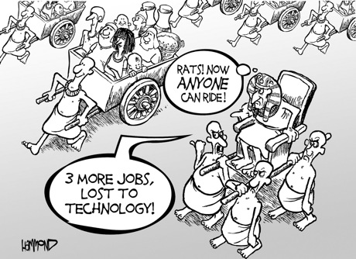
Technological Unemployment
Jacob Hackett
What is it?
Why now?
Potential solutions
Case study
Conclusions
[10]
Notes:
Hi everyone. My name is Jake and today I’ll be talking about technological unemployment. On the agenda is a definition, why it’s important now, and I’ll also cover a case study that shows when one of the potential solutions I discuss helped ease the burden of technological unemployment. I’ll discuss some potential solutions that can help ease the transition and talk about how they could apply to the case study. I’ll end my talk with some conclusions about what you heard. If you have any questions, I’ll be happy to answer them at the end.

Slide 17
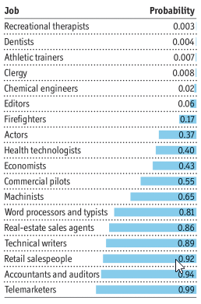
What is Technological Unemployment?
Jacob Hackett
New technology replaces jobs
Debated since 19th century
Mostly dismissed as not an enduring problem
Historians and Economists vs. Techies
47% of US jobs are at high risk
[1] [2]
Notes:
A brief description of what technological unemployment is: It’s an idea that when new technology is developed, it causes a loss of jobs. This can be bad for a number of reasons, perhaps most importantly due to displaced workers. This topic is not a new one and has been discussed since the 19th century by people such as Adam Smith and Karl Marx. For a long time, most economists and historians dismissed the idea because it is not an enduring problem. Even today, most economists and historians think that technological unemployment won’t cause long term job loss. They argue that though technological advances may disrupt some jobs, they create even more. However, others such as Elon Musk, Stephen Hawking, and Bill Gates issued warnings that AI “could leave half the world unemployed”. The actual answer may be somewhere in the middle but according to a study that looked at the future of employment and how susceptible our jobs were to computerisation, they aren’t wrong. That 2013 study found that 47% of US jobs are at high risk. That means that 47% of US jobs could be automated in the next couple decades. This image compiled some of the jobs that the study looked at. Jobs like telemarketers, accountants, and salespeople are at a risk above 90%. Just telemarketers make up over 200,000 US jobs.

Slide 18
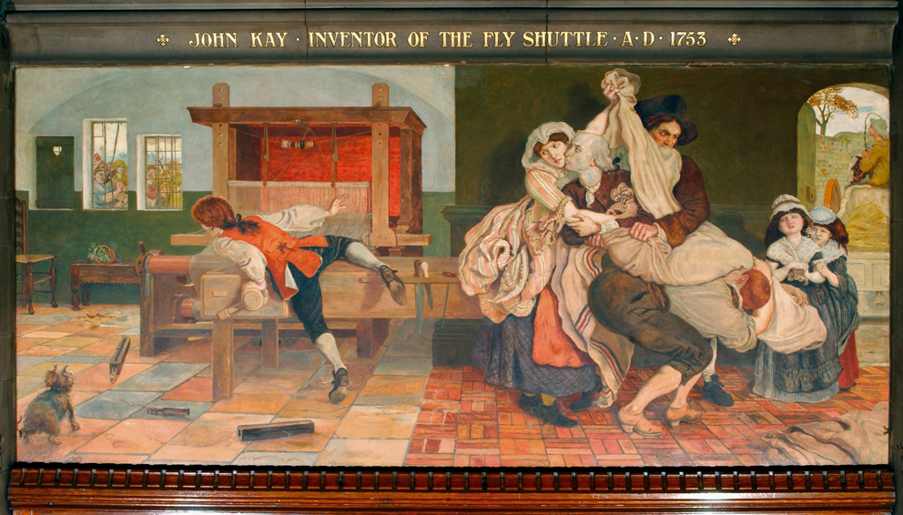
History of Technological Unemployment?
Jacob Hackett
Industrial Revolution
Little aid
Wages didn’t increase until 1820
Luddite fallacy
[9] [14]
Notes:
Technological Unemployment is not a new idea. This has been a widely discussed topic since the 19th century. One time period during which we observed a lot of displaced workers and poor working conditions was during the Industrial Revolution. During this time, workers received little to no aid from government and minimum wage didn’t increase until all industries stabilized around 1820. Many workers opposed the industrial revolution, claiming that all of the jobs will be gone by the time automation and innovation was finished. These people became known as the Luddites. This is actually where we get the term “Luddite fallacy” from. This fallacy revolves around the idea that the job market is stagnant and so when jobs are taken by machines, there are less jobs left for humans. We, of course, now this is false as technology almost always creates more jobs than it destroys. Here we can see John Kay, who invented the Fly Shuttle, a machine that revolutionized weaving. Workers, seen on the right, are breaking in to destroy the machine because they feared for their jobs.

Slide 19
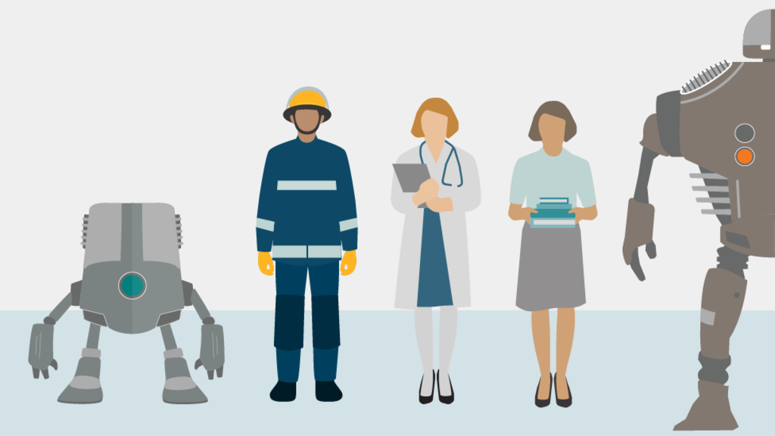
Why is it more important now?
Jacob Hackett
Big data
Machine learning
Mobile robotics
Internet of Things
Potential to replace majority of jobs relatively quickly
How fast can the job market adjust?
[11]
Notes:
With more computing power, we are seeing emerging technologies ranging from big data to machine learning and more. These technologies have the potential to replace the majority of human employees in a relatively short time. Big data can affect doctors, insurance agents, teachers and more. IoT can reach bank tellers and secretaries. The possibilities for machine learning and mobile robotics seem almost endless. If we do not plan appropriately, this could displace millions of people with no support to find a new job. The question is: How fast can the job market adjust to such change?

Slide 20
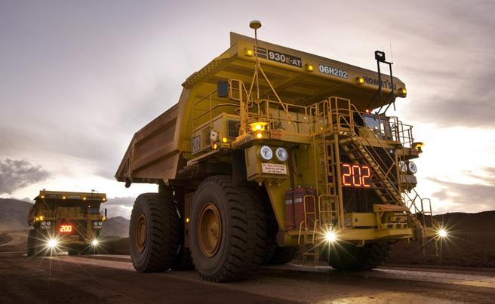
Case Study: Rio Tinto Autonomous Trucks
Jacob Hackett
Massive hauling trucks introduced in 2013
Digging site to loading site
66K employees in 2013, 54K in 2015
Drivers to maintenance and controllers
[4] [5] [6] [7] [8]
Notes:
Rio Tinto Group is one of the world’s larging metals and mining corporations. They introduced self driving hauling trucks in a mine in Australia in 2013. The trucks use over 200 sensors to autonomously navigate from the digging site to the loading site. Naturally, this eliminated the need for truck drivers. Partly due to this and also due to decreasing market prices for Rio Tinto’s commodities, the company has gone from 66,000 employees in 2013 to 54,000 employees in 2015. They have shifted their hiring priorities away from truck drivers and more towards maintenance workers and controller operators. This study shows the potential effect on other driving professions across the world. Rio Tinto did not handle this situation with the best interest of their employees at hand and there was no good plan laid out for the displaced workers.

Slide 21
Potential Solutions
Jacob Hackett
Education
Basic Income
Public guaranteed job
Shorter working hours
Ban innovation
[12] [13]
Notes:
There are a number of potential solutions that will ease the burden of job loss. Most of them have been implemented in the past to react to other instances of technological unemployment and include some form of government aid. The first would be education. With many skilled or unskilled workers out of a job, they must find another skill in order to find another job. Rio Tinto could have sponsored educational sessions to help truck drivers transition to a new career in the company such as the new maintenance positions. Providing education is just one way to give them the opportunity to find employment. A basic income is the idea that all citizens receive an unconditional sum of money or form of social security. This would assist displaced workers during their transition phase to a new career.

Slide 22
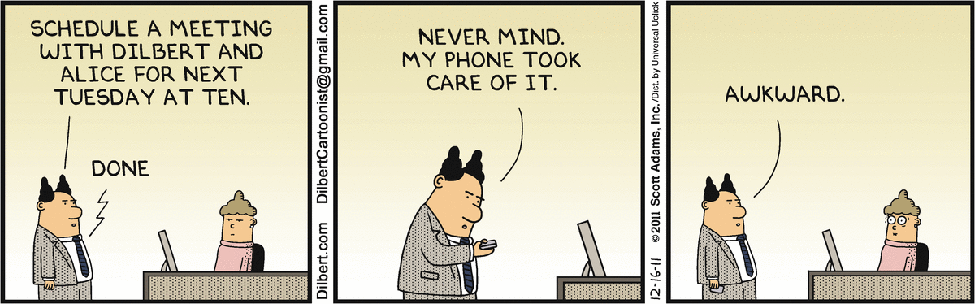
Conclusions
Jacob Hackett
Excess of technological problems
More tools to solve those problems
Unlikely to see long-term technological unemployment
Painful for some industries
Government assistance
[16]
Notes:
In conclusion, there are still an excess of technological problems to be solved and we are only creating more problems to solve them with. It’s ultimately unlikely that we see any long-term technological unemployment but it’s still a good idea to prepare for it with the rapid development of new disruptive technologies. The transition will likely be painful for some industries, as we saw with Rio Tinto drivers. Ultimately, many of the solutions involved government aid for displaced workers. Education, guaranteed job programs, and shorter work hours combined with wage adjustments are all ideas that will help reduce the pain of technological unemployment.

Slide 23
REFERENCES
Jacob Hackett
[1] Frey, C. B., & Osborne, M. A. (2013, September). The Future of Employment: How Susceptible are Jobs to Computerisation?Oxford Martin School. Retrieved September 20, 2016, from http://www.oxfordmartin.ox.ac.uk/downloads/academic/The_Future_of_Employment.pdf
[2] Image: http://cdn.static-economist.com/sites/default/files/imagecache/original-size/images/print-edition/20160625_SRC152.png Accessed September 22nd, 2016
[3] Mokyr, Joel, Chris Vickers and Nicolas L. Ziebarth. 2015. "The History of Technological Anxiety and the Future of Economic Growth: Is This Time Different?" Journal of Economic Perspectives, 29(3): 31-50.
[4] http://www.riotinto.com/media/media-releases-237_10603.aspx Accessed September 20th, 2016
[5] https://www.australianmining.com.au/features/unions-vs-rio-the-automation-battle/ Accessed September 20th, 2016
[6] http://www.telegraph.co.uk/technology/news/11940333/Driverless-trucks-transport-iron-ore-at-Rio-Tinto-mines-in-Australia.html Accessed September 20th, 2016
[7] http://www.mining-technology.com/features/featurerio-tinto-rolling-out-the-worlds-first-fully-driverless-mines-4831021/ Accessed September 20th, 2016
[8] Image: https://au.news.yahoo.com/thewest/wa/a/29819102/robot-trucks-outperform-human-drivers-rio/#page1 Accessed September 20th, 2016
[9] Image: https://commons.wikimedia.org/wiki/File:BrownManchesterMuralJohnKay.jpg Accessed September 24th, 2016

Slide 24
MORE REFERENCES
Jacob Hackett
[10] Image: http://spectrum.ieee.org/automaton/robotics/industrial-robots/051110-do-robots-take-peoples-jobs Accessed September 27th, 2016
[11] Image: http://www.bbc.com/news/technology-34066941 Accessed September 27th, 2016
[12] http://fivethirtyeight.com/features/universal-basic-income/ Accessed September 28th, 2016
[13] http://www.nytimes.com/roomfordebate/2016/07/11/are-we-ready-for-the-next-recession/a-guaranteed-federal-jobs-program-is-needed Accessed September 27th, 2016
[14] Lindert, Peter H., and Jeffrey G. Williamson. "English workers’ living standards during the industrial revolution: a new look." The Economic History Review 36.1 (1983): 1-25.
[15] Postel‐Vinay, Fabien. "The dynamics of technological unemployment." International Economic Review 43.3 (2002): 737-760.
[16] Image: http://dilbert.com/strip/2011-12-16 Accessed September 28th, 2016

Slide 25
How we Define a robot
Mead Landis
“A real or imaginary machine that is controlled by a computer and is often made to look like a human or animal” – Merriam Webster
“A mechanical device that sometimes resembles a human and is capable of performing a variety of often complex human tasks on command or by being programmed in advance” – Free Dictionary
”A robot is a mechanical or virtual artificial agent, usually an electromechanical machine” - Wikipedia
Any function with inputs and perceptible outputs – Vinton G. Cerf, ACM President
A physical manifestation with physical inputs, outputs, and a reprogrammable function in-between
[1][2][3][4]
Notes:
-This is going to be fast-paced. (~30 seconds a slide until discussion if possible)
-First some quick background
then a conclusion,
followed by some common but wrong counterarguments, and
then a quick exchange of counter-arguments and responses from the audience
Finally we will go over the three core arguments
Robots are very broadly defined. Oddly, the more technical the source, such as the president of ACM, the more vague the definition. By extracting the core information from many opinions on what a robot is, we arrive at [Read Bold]

Slide 26
How Robots Define us
Mead Landis
Robot: A physical manifestation with physical inputs, outputs, and a reprogrammable function in-between
Conclusion: There is no encompassing, non-trivial definition of a robot that excludes humans
Notes:
My conclusion the diversity of things classified as robots is so immense and diverse that it entirely encompasses humans.
Of course we don’t think of ourselves as human, why not?

Slide 27
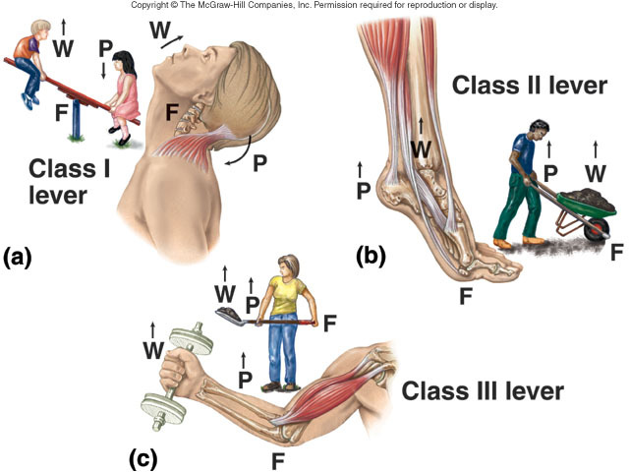
Hey! We aren’t robots:
Mead Landis
Robots are just machines!
“A machine is a tool containing one or more parts that uses energy to perform an intended action”-Wikipedia
Humans aren’t machines?
“This includes human design into the meaning of machine” -Wikipedia
[5][6][7]
Notes:
Robots are just machines, but so are humans.
A machine is anything from simple machines to impossibly intricate systems which can cross energy boundaries from mechanical to chemical to electrical to etc.

Slide 28
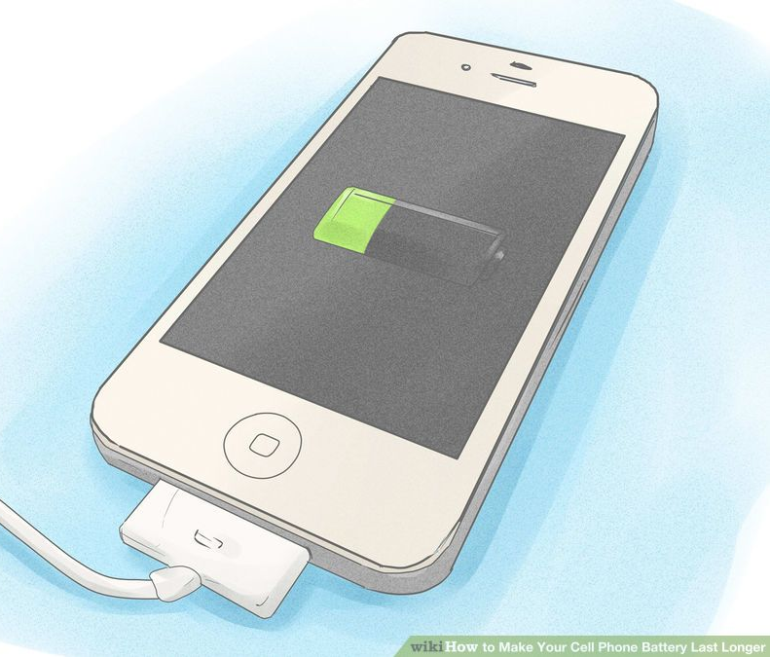
Hey! We aren’t robots:
Mead Landis
Robots are just tools!
Humans use Humans as tools
Robots use humans as tools
[8]
Notes:
Tools are generally things used to accomplish a task, typically while not being consumed in the process. Your phone uses you to charge itself. Roombas use you to empty their dust bins.

Slide 29
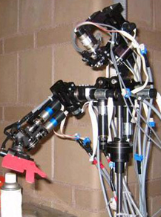
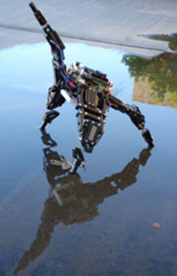
Hey! We aren’t robots:
Mead Landis
Robots aren’t self-aware!
Nico recognizes itself in mirrors
Starfish figured out its own body
[16]
Notes:
While we have tests, it is difficult to truly understand what being self-aware really means.
Nico is self aware from a mental standpoint
Starfish figures out how to move and what it looks like entirely autonomously, its prime directive is to move forward. It reacts and corrects itself for injury.

Slide 30
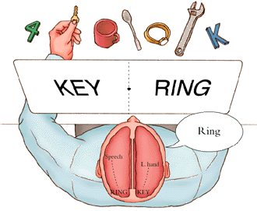
Hey! We aren’t robots:
Mead Landis
Robots aren’t conscious!
You are conscious.
Is your neighbor?
[9][10][11][20]
Notes:
There is no way to know if something other than yourself is conscious. For reference, you actually have two independent sets of self if you are a split-brain patient. Only the left brain is the only one that can speak, leaving right-brain a mute, yet often disagreeable prisoner.

Slide 31
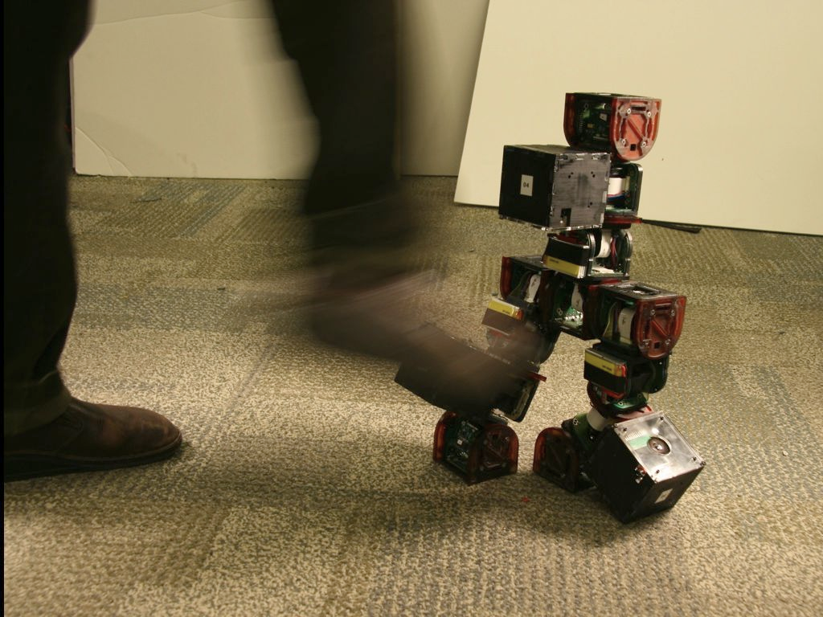
Hey! We aren’t robots:
Mead Landis
Robots can’t heal!
Robots are better at it than you.
[13][19]
Notes:
Modular robots are cabable of reassembling just like your cells. Conveniently they are becoming smaller and more capable by the day.
Not only that, but many robots are actually much better at injury and recovery than you.
Try losing an arm and then tell me about how well you heal.

Slide 32
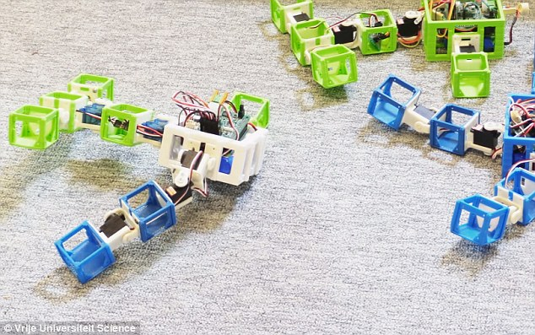
Hey! We aren’t robots:
Mead Landis
Robots can’t reproduce/evolve!
Neither can male humans
Robots can have DNA and Evolution
[12]
Notes:
The Robot Baby project creates robots from the randomized genomes of adult robots that decided to mate when they near each other. In this case the new robots are constructed by a separate entity, however robots that can assemble themselves do exist.

Slide 33
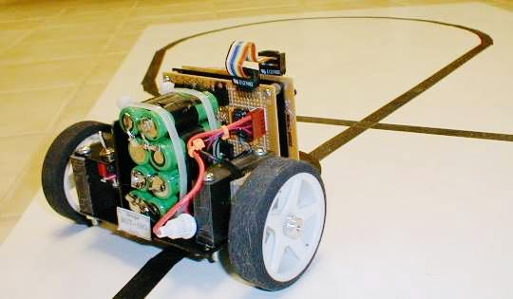
Hey! We aren’t robots:
Mead Landis
Robots are just a complex set of algorithms!
What is a line-following robot’s algorithm?
What is your algorithm for eating?
[14]
Notes:
Humans have basic algorithms as instincts. Robots have basic algorithms like boot-loaders. There is no way to determine an algorithm without seeing the code, and humans do not have a very clean coding language. However both robots have potentially simple or complex code that is comparable, line following and hunger. Both could be digital or analog with some very complex funtions.

Slide 34
Robot Examples for general discussion
Mead Landis
Robots are capable of:
  Lying
  Ruthlessness
  Art
  Music
  Altruism
  Science
  Jealousy
  Bickering/miscommunication
Rat-brained Robot
Modular Robots
[15][16][17][18][19]
Notes:
Robots already exist demonstrating lying, ruthlessness, creativity through art and music, mastery of the scientific method, and self awareness. Further robots have demonstrated negative emotions such as jealousy and
Now onto some open discussion of counter-arguments [ask for counter-points, hopefully explain their flaws]
(until 8 minutes)

Slide 35
Core argument(s)
Mead Landis
All sensing and perception by humans is limited to the physical space and are subsequently incapable of exceeding the capacity of a robot
All human brains, thoughts, and emotions exist in the physical space and are subsequently incapable of exceeding the capacity of a robot
All actions, actuators, and mechanisms of humans and their constituent parts are limited to the physical space and subsequently are incapable of exceeding the capacity of a robot
[20]
Notes:
The issue with practically all counter-arguments comes down to one response that can be helpfully divided and applied to the three major requirements of a robot (Sensing, Computation, and Actuation).
Humans exist in the physical space, and therefore cannot exceed robots in any capacity as robots are defined exhaustively as anything with inputs, computation, and outputs in the physical space.
Ask audience what the core flaw of this core argument is…

Slide 36
Core flaw
Mead Landis
It is impossible for instruments in the physical space to measure outside of the physical space.
Therefore it is impossible to know if humans or robots are more than their physical manifestation
Notes:
The core flaw is our assumption that we are limited to the physical space.
Things outside of the physical realm cannot influence things inside it, otherwise it would be measurable.
This also begs some rather awkward questions such as the illusion of free will.
(in fact study could predict when participants would press a button before they realized they were conscious of the desire [20])

Slide 37
References
Mead Landis
[1] Robot, Merriam Webster, http://www.merriam-webster.com/dictionary/robot, 9/29/2016
[2] Robot, The Free Dictionary, http://www.thefreedictionary.com/robot , 9/29/2016
[3] Robot, Wikipedia, https://en.wikipedia.org/wiki/Robot, 9/29/2016
[4] Vinton G. Cerf, What's a Robot?, ACM, http://cacm.acm.org/magazines/2013/1/158758-whats-a-robot/fulltext, 9/29/2016
[5] Biomechanics of Human Anatomy- Three Classes of Levers, Artistic Anatomy, http://see3dform.blogspot.com/2015/11/biomechanics.html 9/29/2016
[6] Machine, Wikipedia, https://en.wikipedia.org/wiki/Machine 9/29/2016
[7] Machine (mechanical), Wikipedia, https://en.wikipedia.org/wiki/Machine_(mechanical), 9/29/2016
[8] WikiHow, How to Make Your Cell Phone Battery Last Longer, http://www.wikihow.com/Make-Your-Cell-Phone-Battery-Last-Longer, 9/29/2016
[9] Split-Brain, Psych Apprentice, http://psychapprentice.weebly.com/psychology-lexicon/split-brain, 9/29/2016
[10] You Are Two, CGP Grey, https://www.youtube.com/watch?v=wfYbgdo8e-8 , 9/29/2016
[11] What Are You?, Kurzgesagt – In a Nutshell
[12] Now Robots can have KIDS, Daily Mail, http://www.dailymail.co.uk/sciencetech/article-3620314/Now-robots-KIDS-Researchers-create-machines-mate-wifi-create-3D-printed-baby-experts-say-used-colonise-Mars.html, 9/29/2016
[13] Camillo J. Taylor , Modular Robots http://www.cis.upenn.edu/~cjtaylor/RESEARCH/projects/ModularRobots/ModularRobots.html, 9/29/2016
[14] Line Follower Robot Project, Dale’s Homemade Robots, http://www.wa4dsy.net/robot/line/ , 9/29/2016
[15] Aaron Short, XJ Selman, Ivan Farkas, The 5 Most Terrifying Robot Advances in Recent History, http://www.cracked.com/article_20462_the-5-most-terrifying-robot-advances-in-recent-history.html, 9/29/2016
[16] Eric A., Karl Smallwood, Dennis Hong, 6 Shocking Ways Robots Are Already Becoming Human, www.cracked.com/article_19273_6-shocking-ways-robots-are-already-becoming-human.html, 9/29/2016
[17] Josh Hrala, 5 Ways We're Designing Robots to Be Total Assholes, http://www.cracked.com/article_20739_5-ways-were-designing-robots-to-be-total-assholes.html, 9/29/2016
[18] Rise of the rat-brained robots, New Scientist, www.newscientist.com/article/mg19926696-100-rise-of-the-rat-brained-robots, 9/29/2016
[19] BotJunkie, MTRAN3 Modular Robot, https://www.youtube.com/watch?v=4oSavAHf0dg, 9/29/2016
[20] Bite Size Psych, Why psychopaths aren't actually evil - The problem of free will, https://www.youtube.com/watch?v=cpP-nL-GMuk, 9/29/2016

Slide 38
Class 11
The End
Keith A. Pray
Instructor
socialimps.keithpray.net
Notes:
This is the end. Any slides beyond this point are for answering questions that may arise but not needed in the main talk. Some slides may also be unfinished and are not needed but kept just in case.

