Slide 1
Class 3 Ethics
Keith A. Pray
Instructor
socialimps.keithpray.net
Notes:
Here’s the title slide. Excited again, aren’t you? You should be.
How did the first paper go?
What were your topics?
What conclusions did you draw?

Slide 2
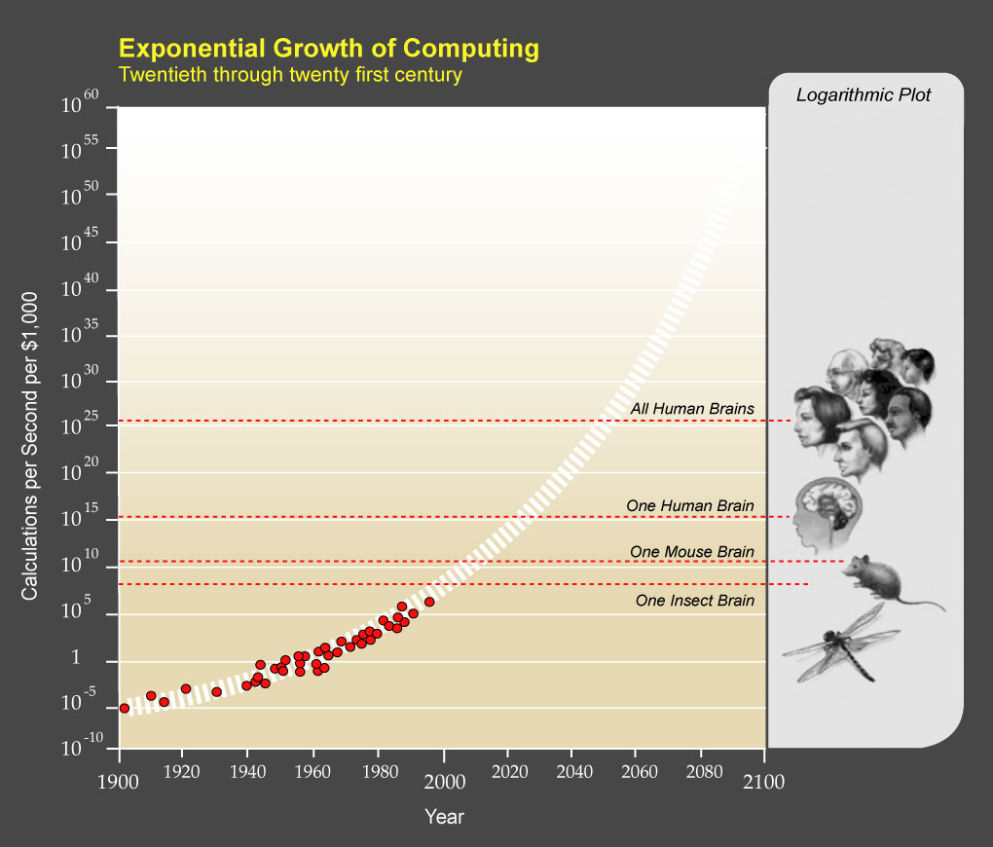
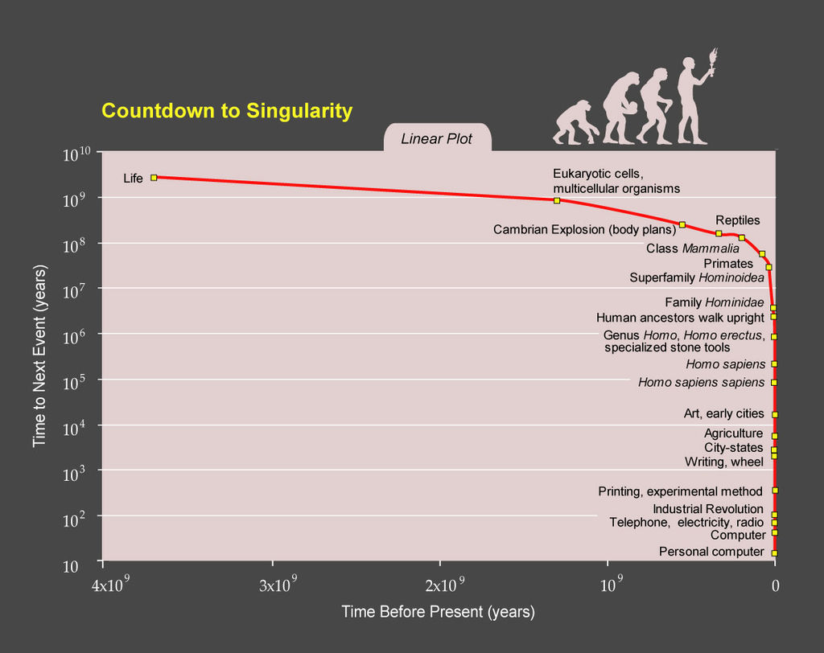
Ray Kurzweil
Notes:
TODO: https://epicrapbattlesofhistory.fandom.com/wiki/Steve_Jobs_vs_Bill_Gates/Rap_Meanings
This puts it a different way:
Show Epic Rap Battles of History: Steve Jobs vs. Bill Gates (If class ok with obscene lyrics) (2:47)
https://www.youtube.com/watch?v=njos57IJf-0
[1] "PPTExponentialGrowthof Computing" by Coutesy of Ray Kurzweil and Kurzweil Technologies, Inc. - en:PPTExponentialGrowthof_Computing.jpg. Licensed under CC BY 1.0 via Wikimedia Commons - http://commons.wikimedia.org/wiki/File:PPTExponentialGrowthof_Computing.jpg#/media/File:PPTExponentialGrowthof_Computing.jpg
[2] "PPTCountdowntoSingularityLinear" by Coutesy of Ray Kurzweil and Kurzweil Technologies, Inc. - en:PPTCountdowntoSingularityLinear.jpg. Licensed under CC BY 1.0 via Wikimedia Commons - http://commons.wikimedia.org/wiki/File:PPTCountdowntoSingularityLinear.jpg#/media/File:PPTCountdowntoSingularityLinear.jpg

Slide 3
Logistics Reminder
Sign up for individual presentations
Great ideas so far!
10 slots still open, 1 disappears Tuesday
10% of your grade
Email all the course staff, you’ll get a quicker response
Read Assignment Slides
Notes:
Email Etiquette – thoughts? Good this class.
Extra credit for identifying extra credit opportunities requires you complete the extra credit assignment
Email all the course staff, you’ll get a quicker response

Slide 4
Overview
Group Project
Review
Ethics
Assignment

Slide 5
Group Project Overview
Movie or Emerging Computing Technology?
Movie: Explore computing technology portrayed, analyze course topics
Computing Technology: How is technology portrayed in mass media? Predict 1, 5, 10 years into the future using analysis of course topics
Project Web Site
Analyze subject from the prospective of each topic covered in class
Critical Thinking, Ethics, and Professional Ethics are analysis tools, not topics
Presentation
Give arguments for most salient conclusions drawn

Slide 6
Overview
Group Project
Review
Ethics
Assignment

Slide 7
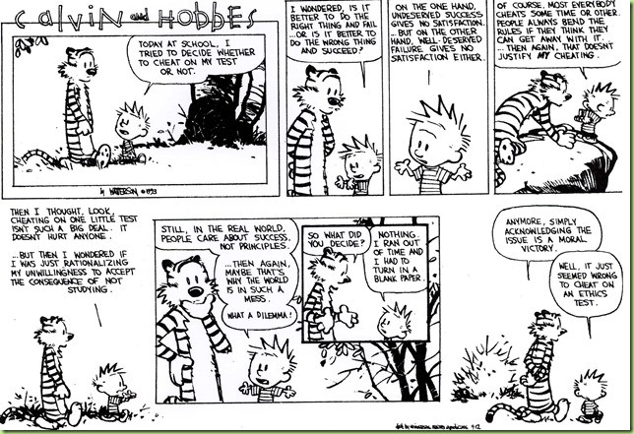

Slide 8
My Reading Notes
pp. 57 Does mention of Hitler invalidate the argument? - Mike Godwin
pp. 58 “Instincts were learned…”?
pp. 66 There’s no expectation the doctor’s practice would suffer?
pp. 80 Insurance companies do it, should they?
pp. 94-95 Do most states (#?) have anti-texting while driving laws now?
pp. 99 Good to see using theories to see how many produce same outcome
pp. 106 “… everyone… become… programmer” – Why is this an ethical issue?
End of Chapter questions I liked: 9, 10, 14, 15

Slide 9
Overview
Group Project
Review
Ethics
Assignment

Slide 10
Clarifying Points
Ethical Actions
Based on belief that people are
Rational
Free to choose
Can be
Mandatory
Prohibited
Acceptable
Rights
Negative
Liberties
Often Absolute
Positive
Claim-rights
Often Limited
Notes:
Actions can be ethically mandatory, prohibited or acceptable.
Positive: someone else has to do something.

Slide 11
Ethics Vocabulary
Deontological Theories
A.K.A. nonconsequentialist
Theory/study of moral obligation
Consequentialist Theories
Social Contract Theory
Virtue Ethics
A.K.A. Character Based Theory
Greek deon = duty
Emphasizes duty and absolute rules to be followed whether they lead to good or bad consequences.
Kant often primary example.
Rules should apply to everyone.
Good rules intrinsically follow logic. Follow reason not emotion to make decisions.
Treat people as an ends, not solely as a means. Respect for persons.
Notes:
Which formulation of the categorical imperative do you prefer?
Kant’s Axe (1:33)
Published on Nov 18, 2014 – BBC Radio 4
Accessed 2016-09-02
www.youtube.com/watch?v=x_uUEaeqFog

Slide 12
Ethics Vocabulary
Deontological Theories
A.K.A. nonconsequentialist
Theory/study of moral obligation
Consequentialist Theories
Social Contract Theory
Virtue Ethics
A.K.A. Character Based Theory
Main example is Utilitarianism.
Increase aggregate utility or happiness. How to measure?
Watch out for theories going to far; violating rights of a few for the “good” of the many.
Notes:
Helpful?:
https://www.happify.com/hd/science-of-happiness-infographic/

Slide 13
Ethics Vocabulary
Deontological Theories
A.K.A. nonconsequentialist
Theory/study of moral obligation
Consequentialist Theories
Social Contract Theory
Virtue Ethics
A.K.A. Character Based Theory
Uses rights as basis
Explains people’s selfishness in absence of common agreement
Analysis of moral issues regarding people and government.
Characterization of actions can change outcome of analysis, does not solve conflicting rights.
Are laws based on ethics?
Are all laws ethical?
Notes:
From Wikipedia (get primary source):
“Consent of the governed" is a political theory stating that a government's legitimacy and moral right to use state power is, or ought to be, derived from the people or society over which that power is exercised.
This theory of "consent" is historically contrasted to the divine right of kings and has often been invoked against the legitimacy of colonialism.
Following John Locke's notion of a nation of "free and equal" citizens, the Founders of the United States believed that consent of the governed was the only legitimate basis upon which one "free and equal" citizen could exercise legal authority over another -- otherwise neither equal could overcome the other.

Slide 14
Ethics Vocabulary
Deontological Theories
A.K.A. nonconsequentialist
Theory/study of moral obligation
Consequentialist Theories
Social Contract Theory
Virtue Ethics
A.K.A. Character Based Theory
Stresses character development and moral education, not formalized rules.
What kind of person should I be?
Depends on homogeneous community standards for morality.
Plato and Aristotle, more recently by Alasdair MacIntyre.
Notes:
Aristotle on 'Flourishing’ (2:00)
https://www.youtube.com/watch?v=j_7deR0idvs
BBC Radio 4
Published 2015-03-30

Slide 15
Group Quiz Scenario 4 in Section 2.1.2
Split into teams of 4
Pick one of:
Kantian
Act Utilitarian
Rule Utilitarian
Social Contract Theory
Virtue Ethics
Does your team recommend release next week ?
Provide justification (argument)

Slide 16
Overview
Group Project
Review
Ethics
Assignment

Slide 17
Assignment
Complete all assigned reading
Work on your individual presentations
Start Group Project work (if possible)

Slide 18
Class 3 The End
Keith A. Pray
Instructor
socialimps.keithpray.net
Notes:
If there is time:
The Game Of Trust - NICKY CASE
https://ncase.me/trust/
This is the end. Any slides beyond this point are for answering questions that may arise but not needed in the main talk. Some slides may also be unfinished and are not needed but kept just in case.

