Slide 1
Torin Danielski, Alden Cutler, Connor Bouffard
Dune: Part One (2021)

Slide 2
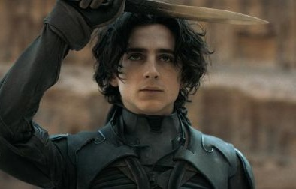
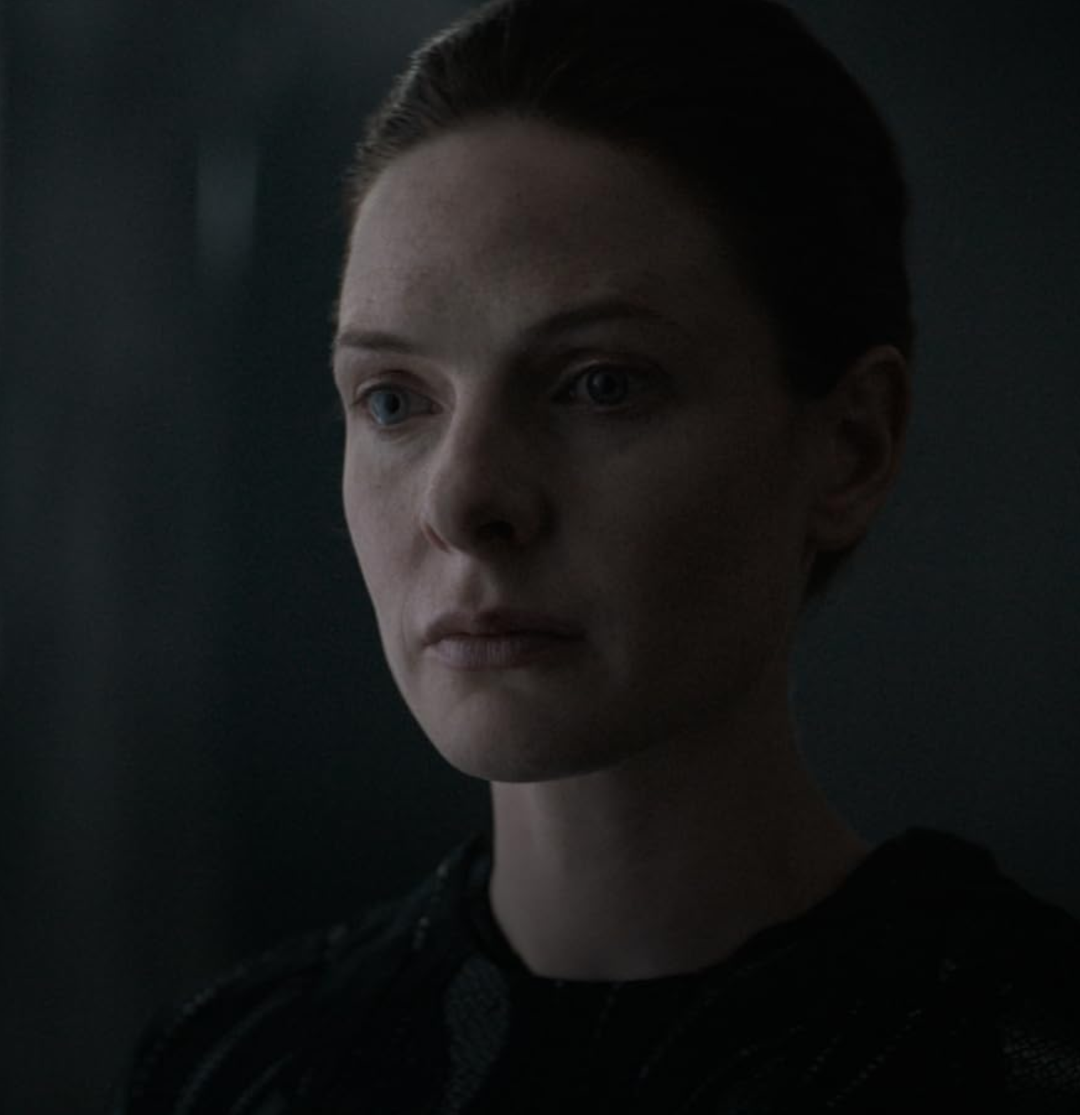
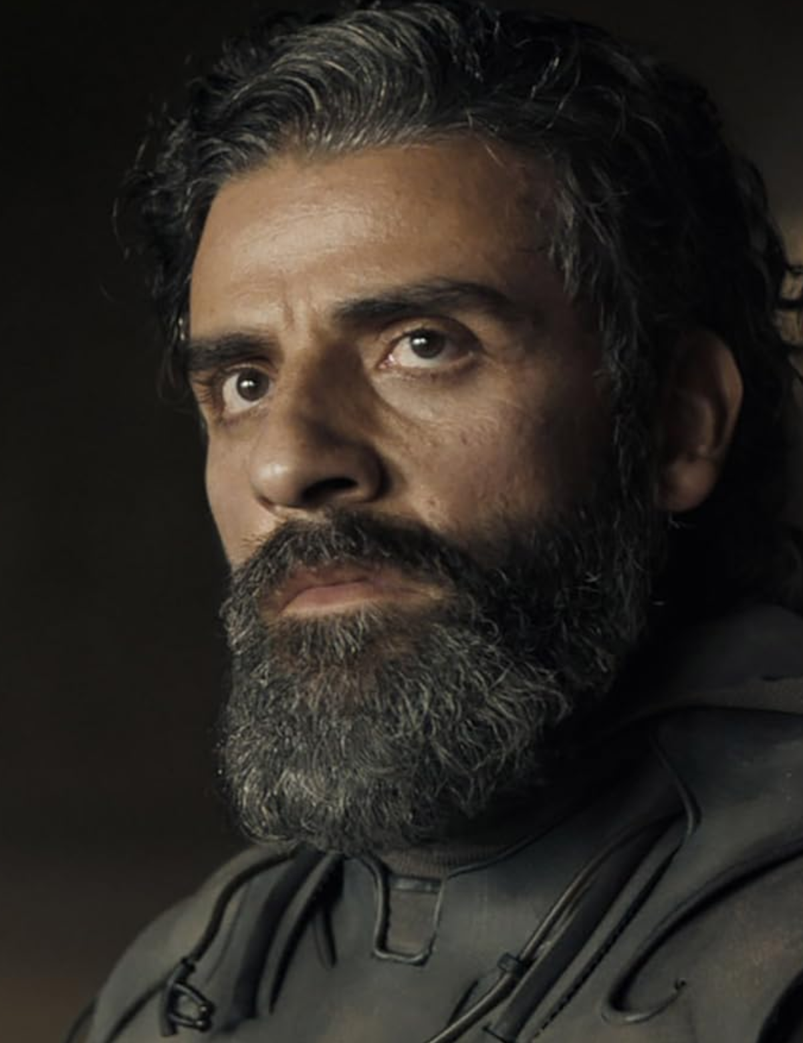
Characters
Paul Atreides
Jessica Atreides
Paul’s Mother
Bene Gesserit
Leto Atreides
Paul’s Father
Duke of Atreides
Notes:
Just to quickly introduce the characters before moving on to the plot summary

Slide 3
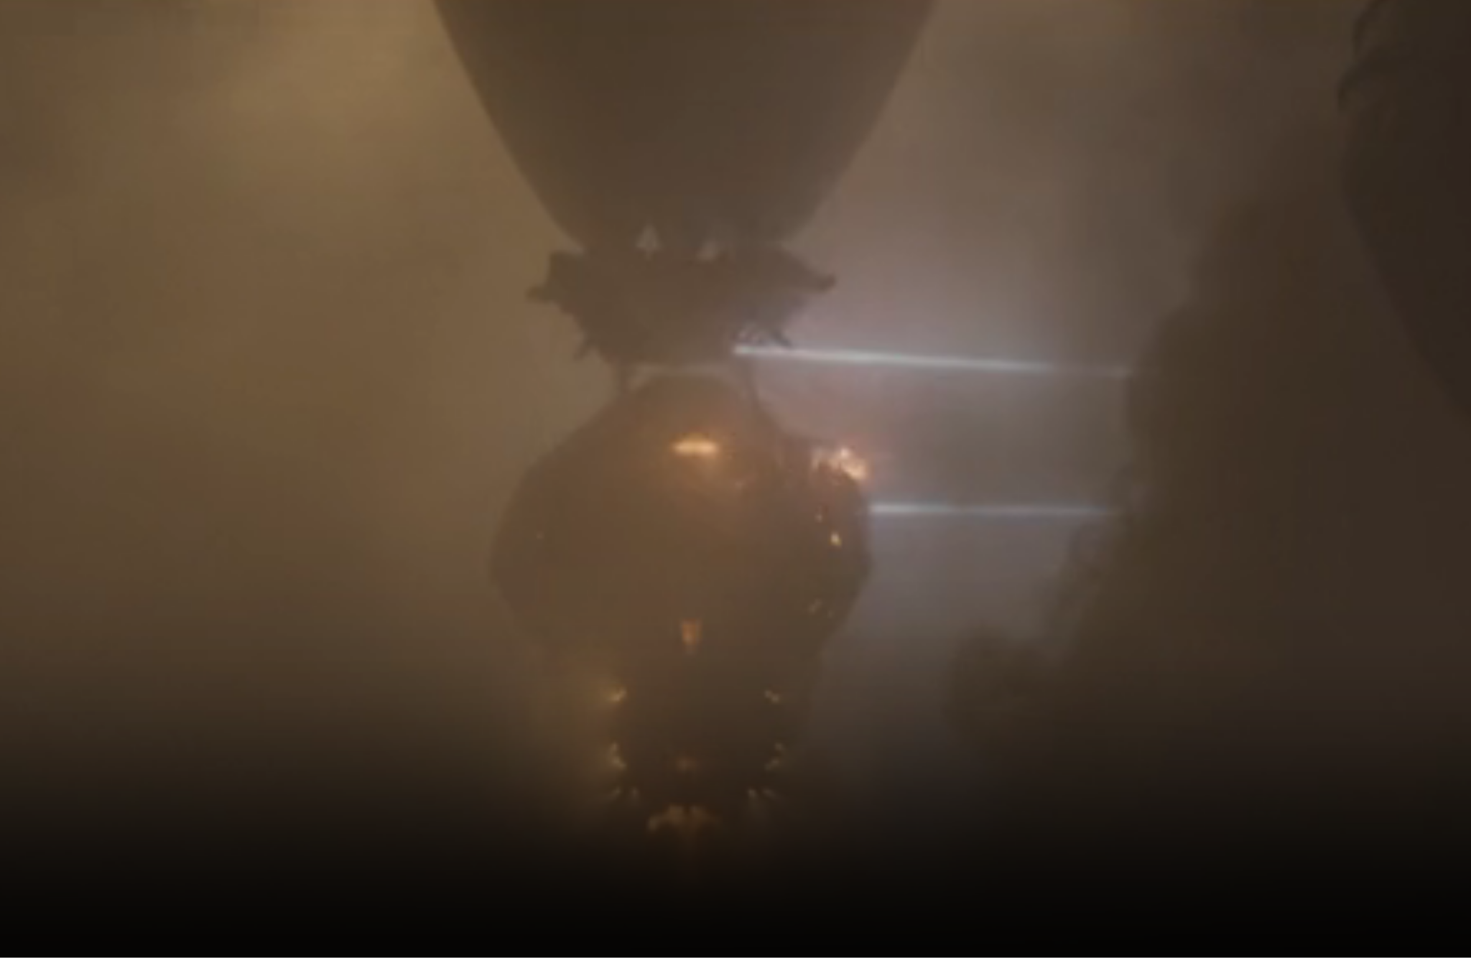
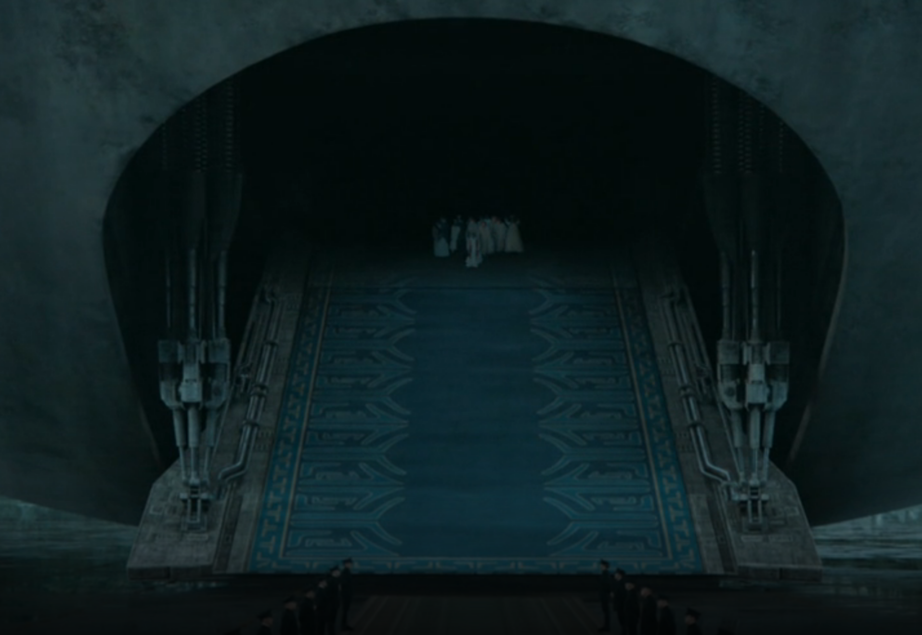
Plot Timeline
Fremen attack Harkonnen spice harvester
Arrakis gifted to Atreides from Harkonnens by the Emperor
Notes:
On Arrakis, Fremen (planet’s natives) attack a spice harvester owned by the Harkonnens
“The Voice” is introduced, which allows the lineage of Bene Gesserit (shadow government with supernatural powers) to make people do things against their will
Arrakis is gifted to House Atreides, the house of our main character (Paul), by the Known Universe's emperor
-----------------------------------
At the start of the movie, we see the Fremen attack a spice harvester, so from the start we see that there’s conflict between the Harkonnens and the Fremen.
We then see the emperor’s delegate proclaim that House Atreides will take control of spice production and Arrakis, the only planet where spice can be produced.

Slide 4
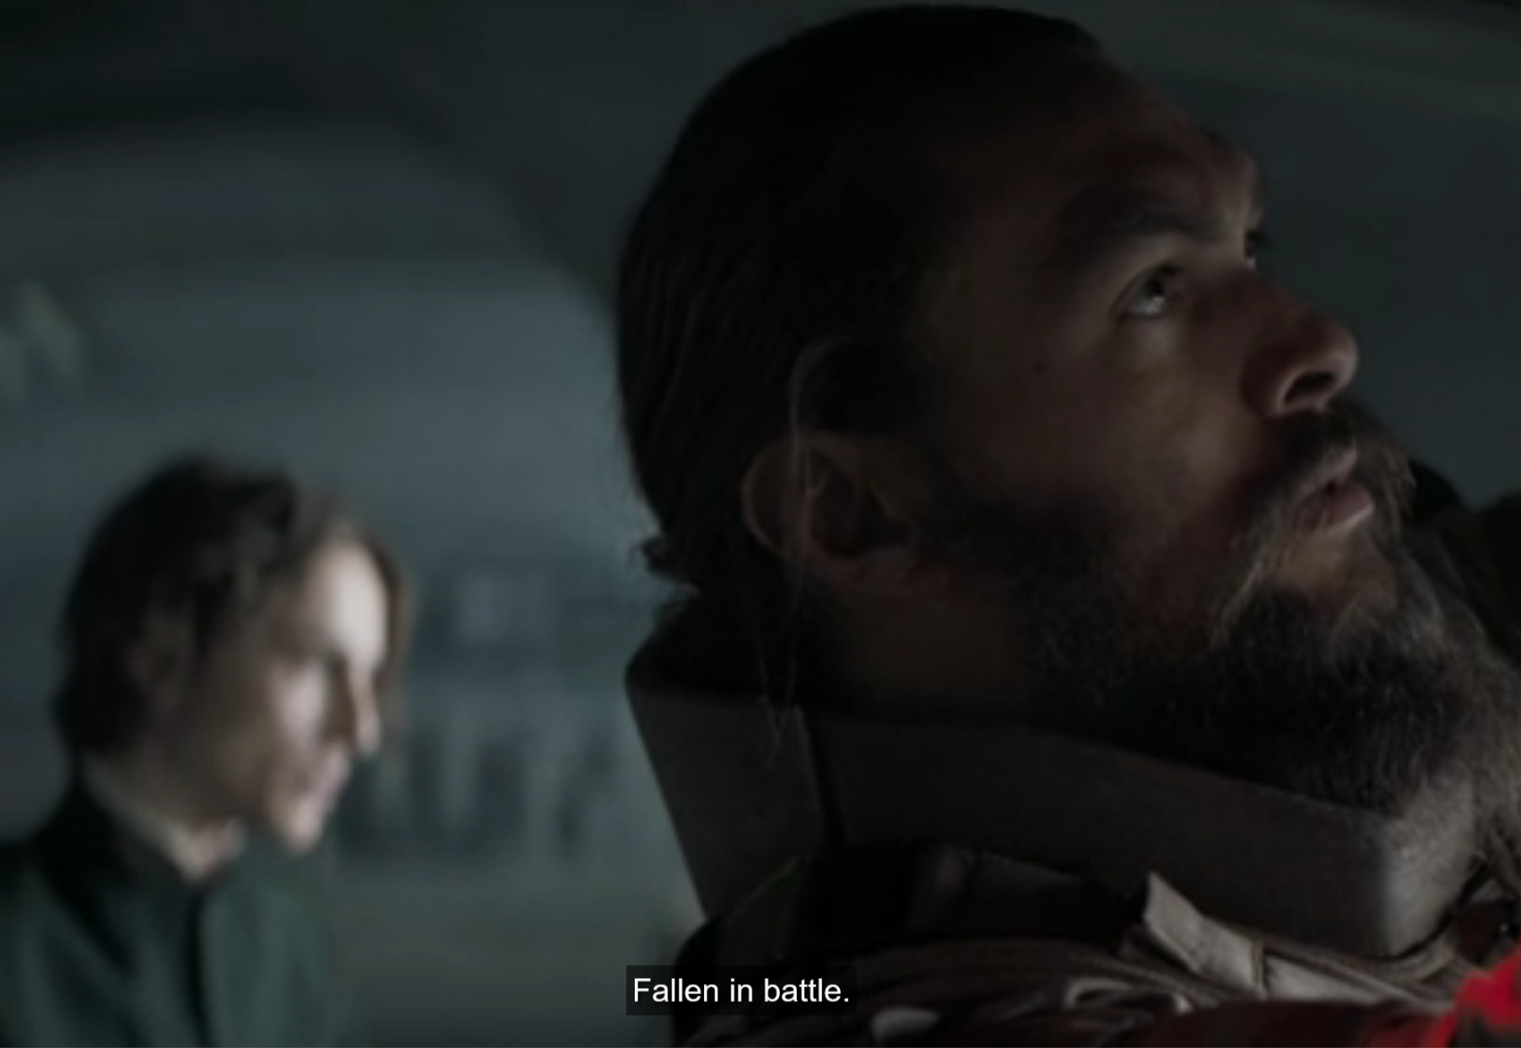
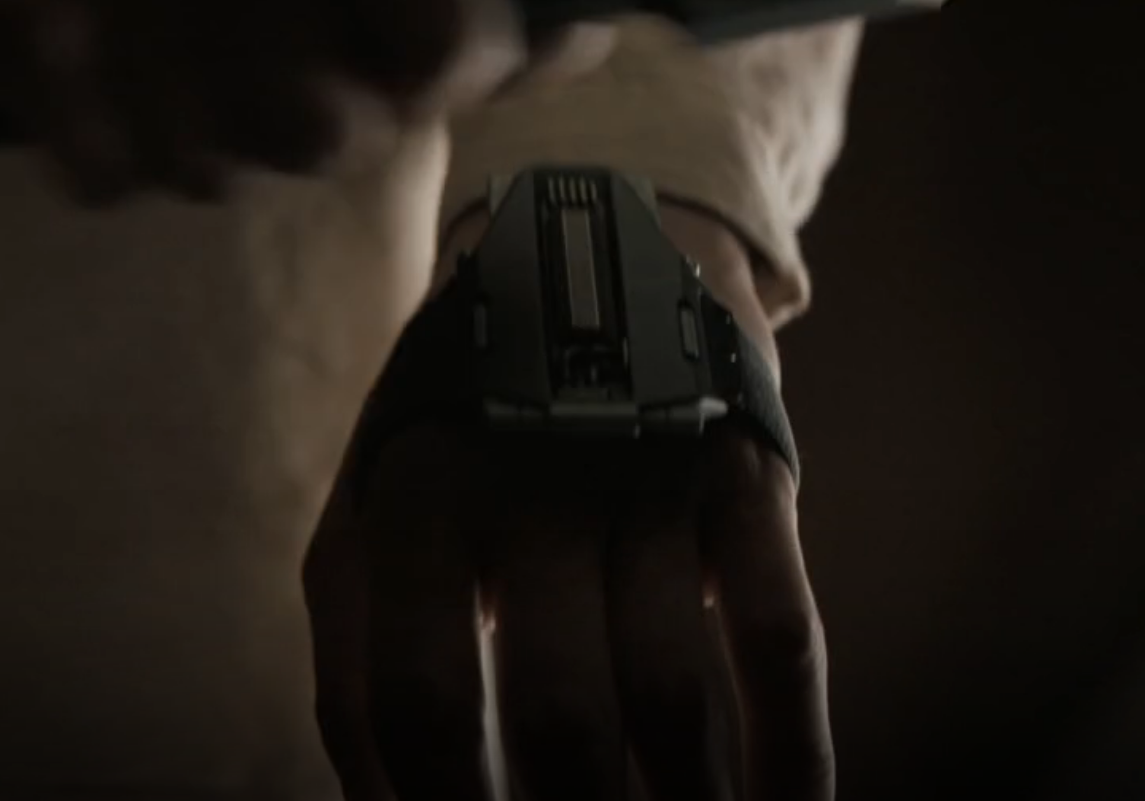
Plot Timeline
Paul tells visions to Duncan
Shields
Notes:
Major plot point is various visions Paul gets. The first of which being Paul seeing Duncan, someone he looks up to, dead in battle.
One of the most important technologies- the shield, is introduced. Can stop fast-moving objects, but not slow-moving (this is for air)

Slide 5
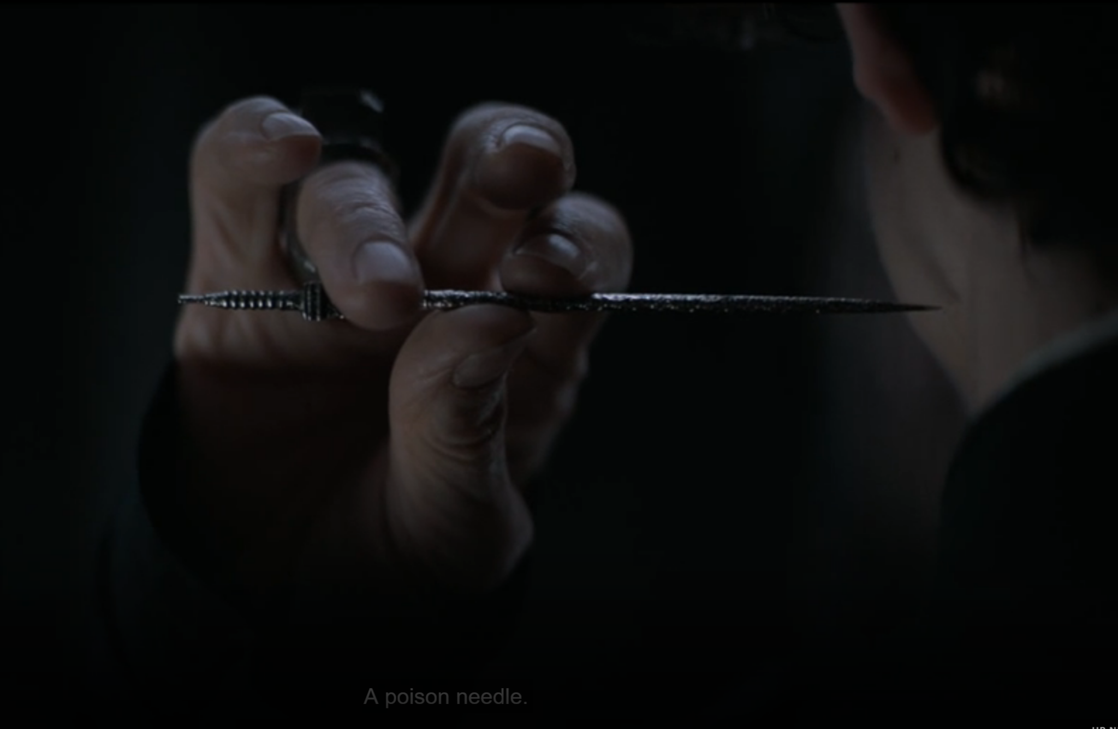
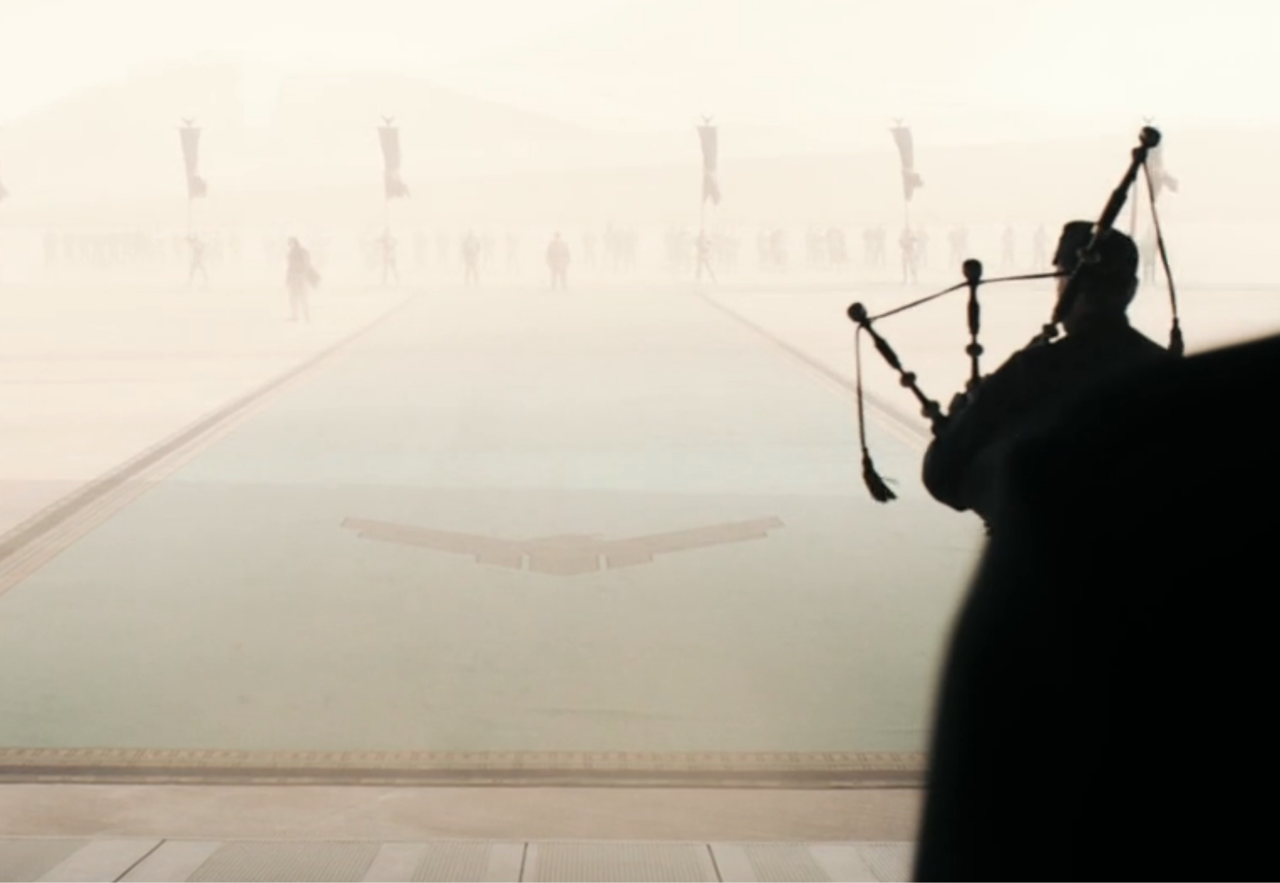
Plot Timeline
Bene Gesserit Test
Landing on Arrakis
Notes:
Bene Gesserit test Paul with immense pain to see if he can overcome his animal instincts. He passes, and se-ers have laid a path on Arrakis
Landing on Arrakis, and are greeted by "Messiah" chants- this is part of the path the se-ers laid

Slide 6
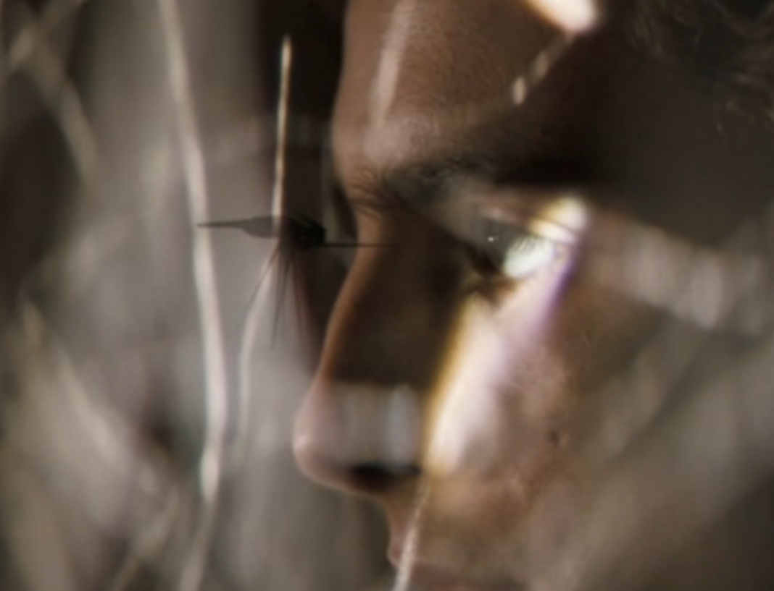
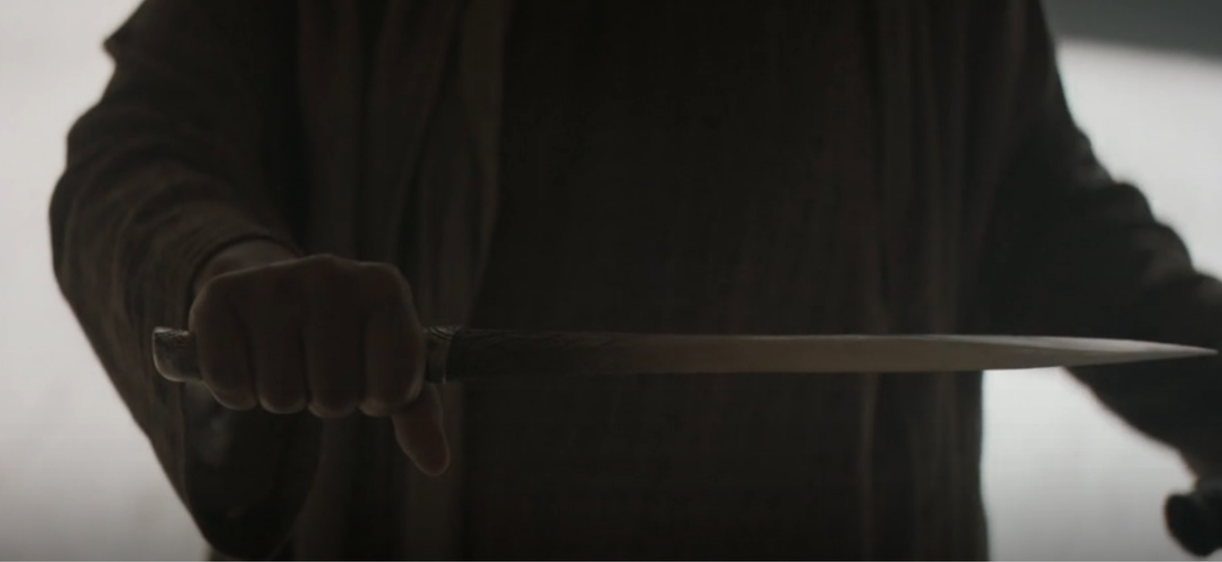
Plot Timeline
Crysknife gifted to Jessica
Hunter Seeker
Notes:
Crysknife, a ceremonial blade, is gifted to Jessica, calling her “The One, the messiah”. (Path laid)
Hunter-seeker nearly kills paul, but it stopped as a maid walks in

Slide 7
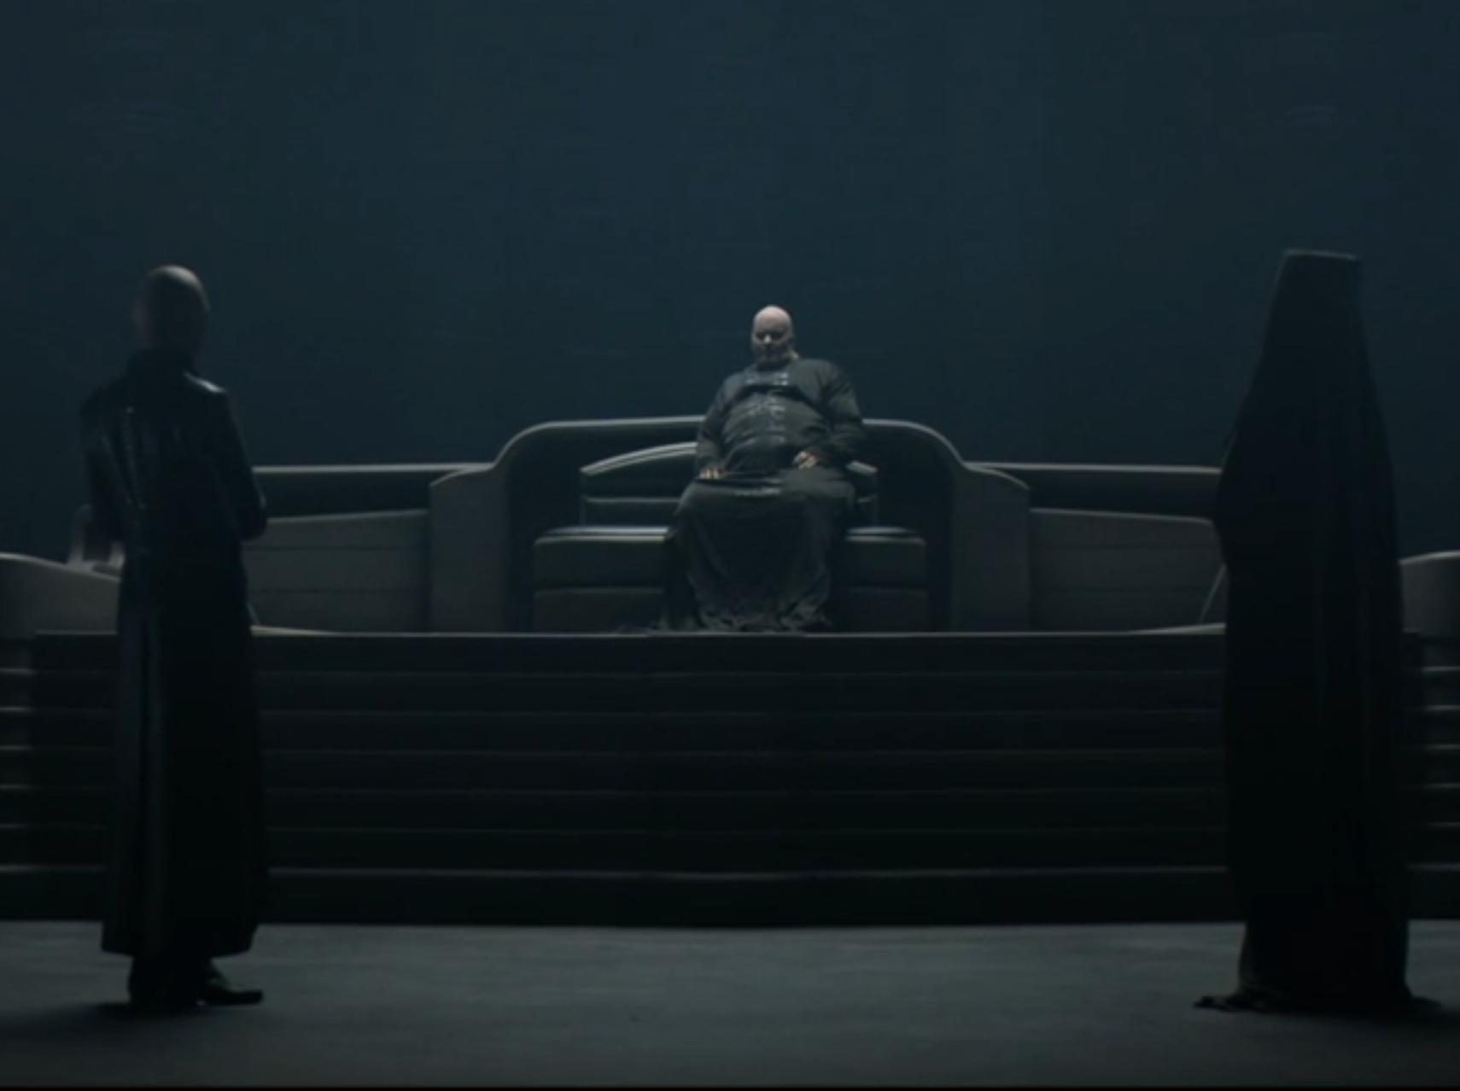
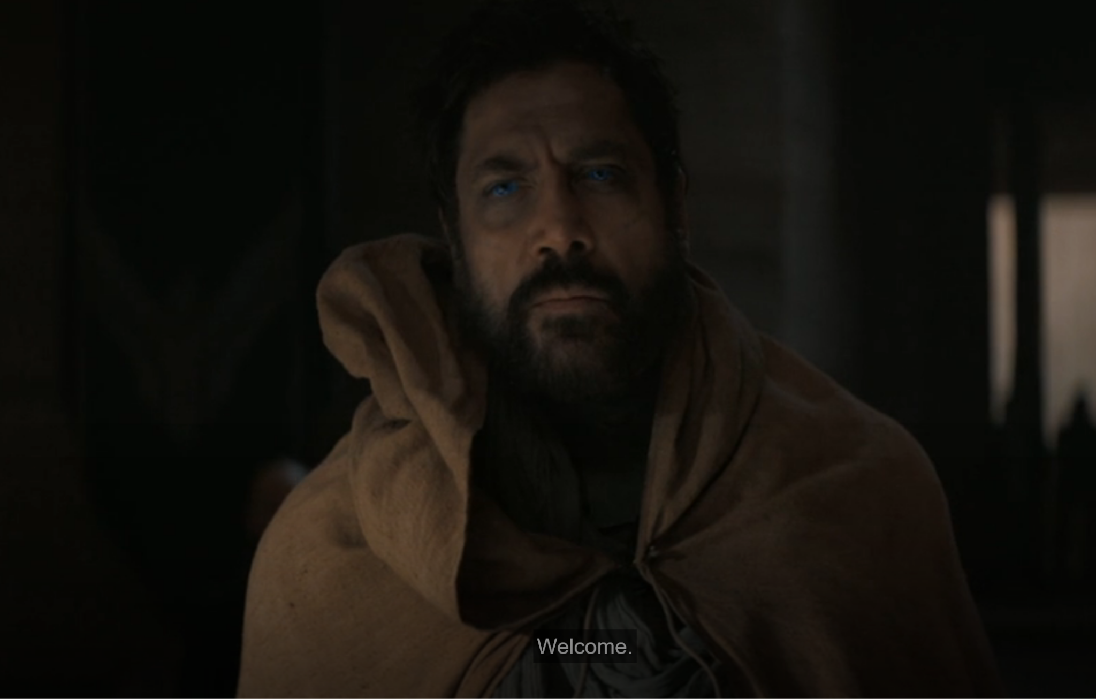
Plot Timeline
Emperor betraying Atreides
Stilgar
Notes:
Emperor betraying Atreides family, giving 2 Sardaukar battalions to help the Harkonnens attack, wiping out house Atreides
Introduced to Stilgar, a leader of one of the Sietches (Fremen city), who spits as a gift. Introduced a main concept of this world- that being the importance of water- spitting isn’t an insult, it’s a gift.

Slide 8
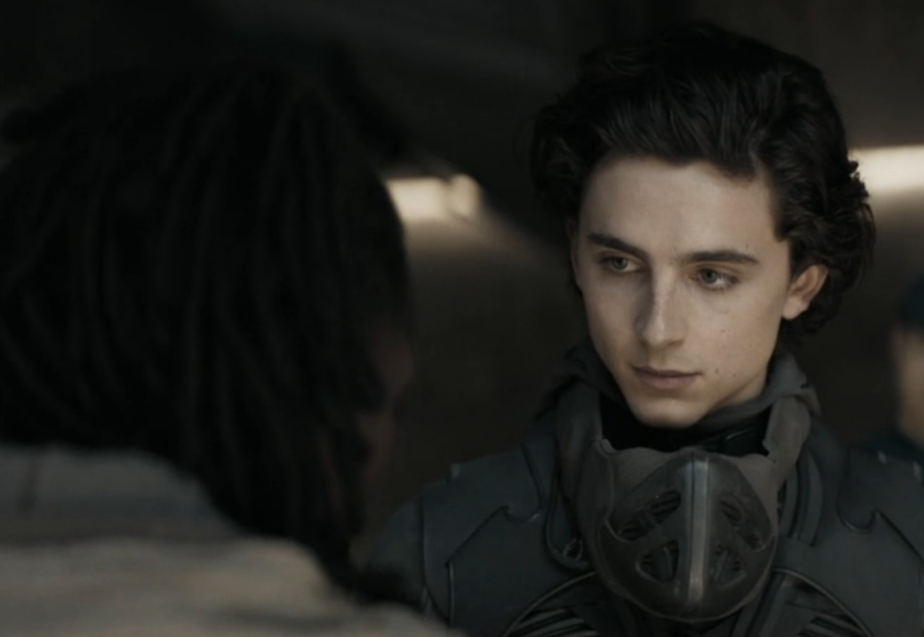
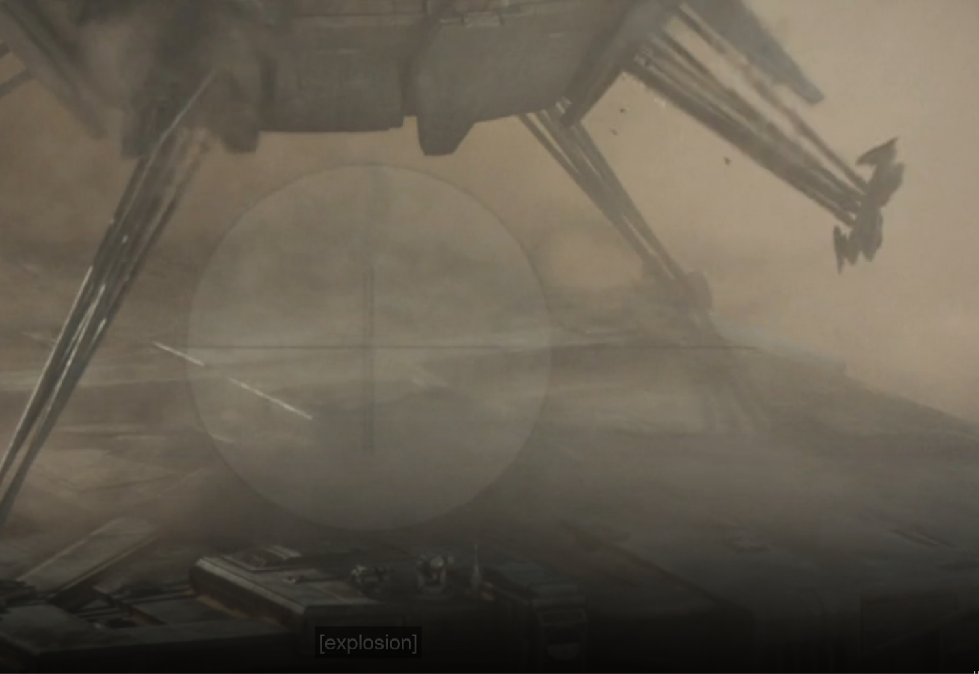
Plot Timeline
"knows the ways as if born into them"
Carry-all fail
Notes:
Introduced to the Imperial Ecologist, overseeing the transfer of Arrakis. Comments on how Paul wears his stillsuit- perfectly, as if he had been wearing one all his life.
"knows the ways as if born into them"
Duke and crew go out to see a spice harvester in action, but a sandworm is approaching and the carry-all, which was coming to rescue it, has a faulty grip. Then commences an emergency evacuation as the sandworm quickly approaches

Slide 9
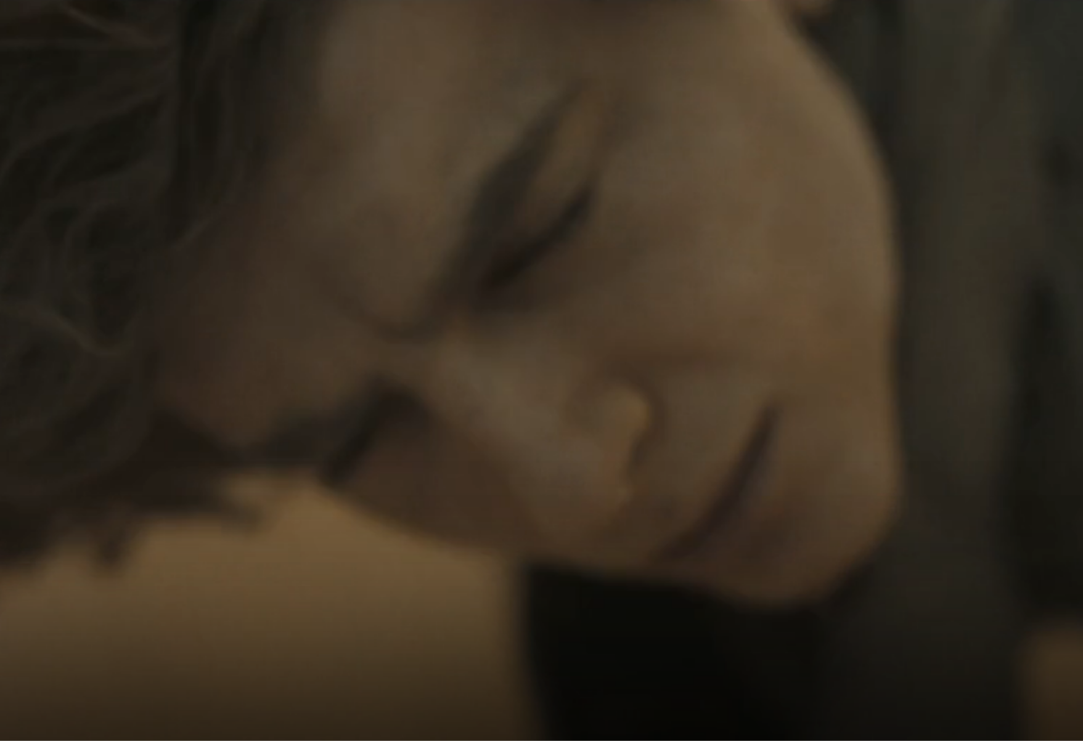
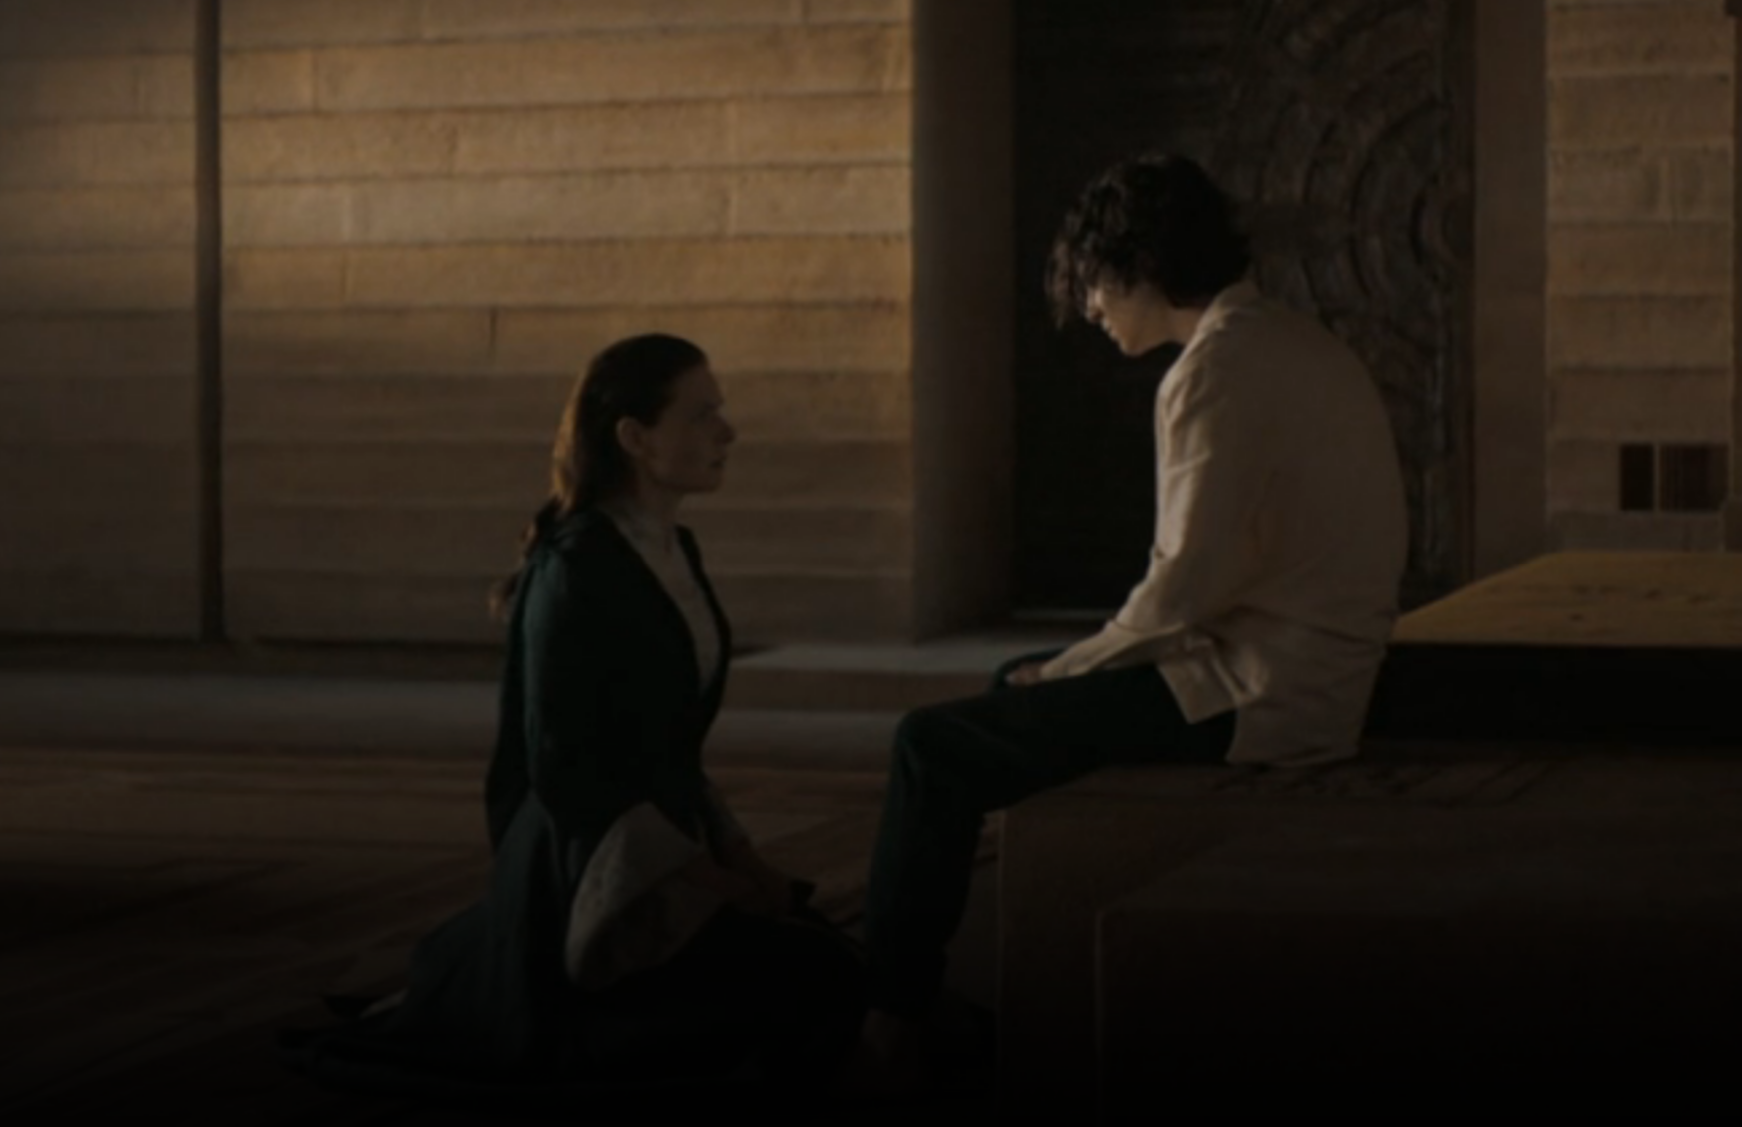
Plot Timeline
Another vision
Notes:
As Paul is guiding the evacuees, he inhales spice and has another vision. Then gets rescued by Gurney, and the spice harvester is swallowed
Paul reveals the aforementioned vision to his mother, saying he knows she’s pregnant, revealing his predictive abilities are improving. “you can’t know that, I barely know that”

Slide 10
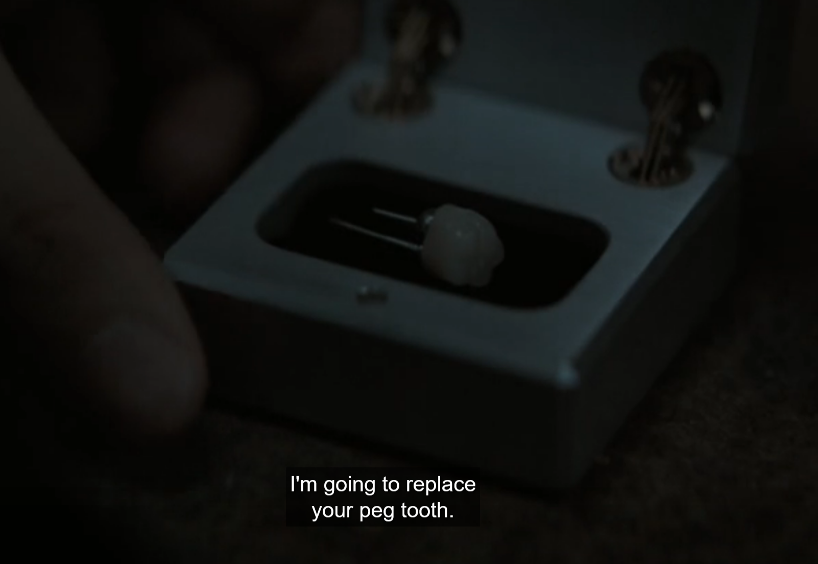
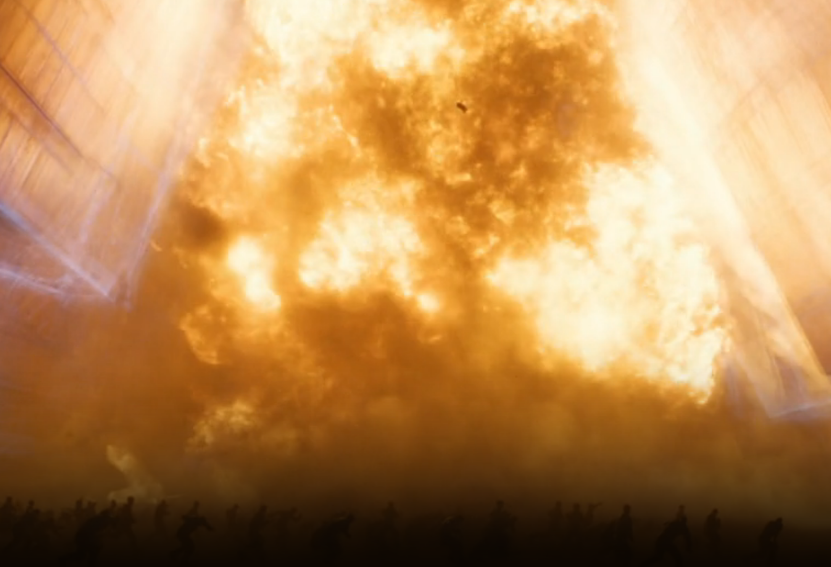
Plot Timeline
Doctor betrayal
Harkonnens Attack
Notes:
The Doctor betrays Atreides for the sake of his captured wife, lowering the city’s shields, and sedating the Duke and Family. He gives the Duke a poison tooth in an attempt to let him take the Baron’s life out with him.
Arrakis is attacked by the Harkonnens with them taking an overwhelming victory. Duncan manages to escape on a Thopter.

Slide 11
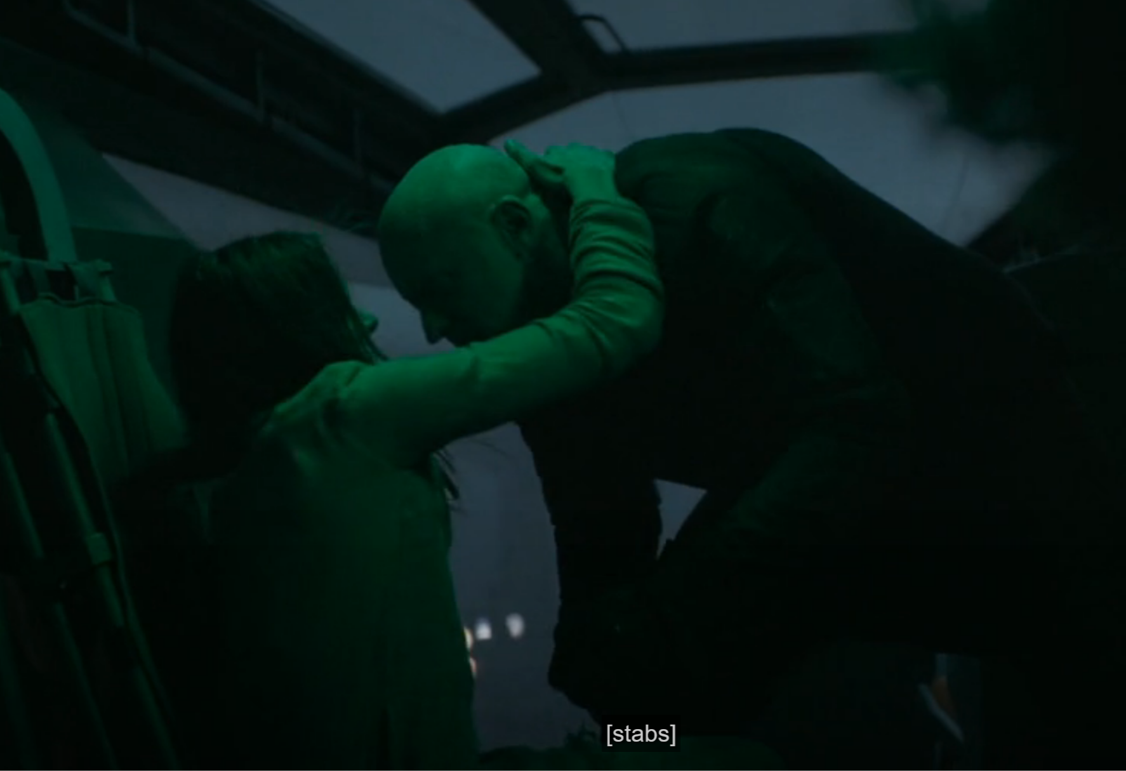
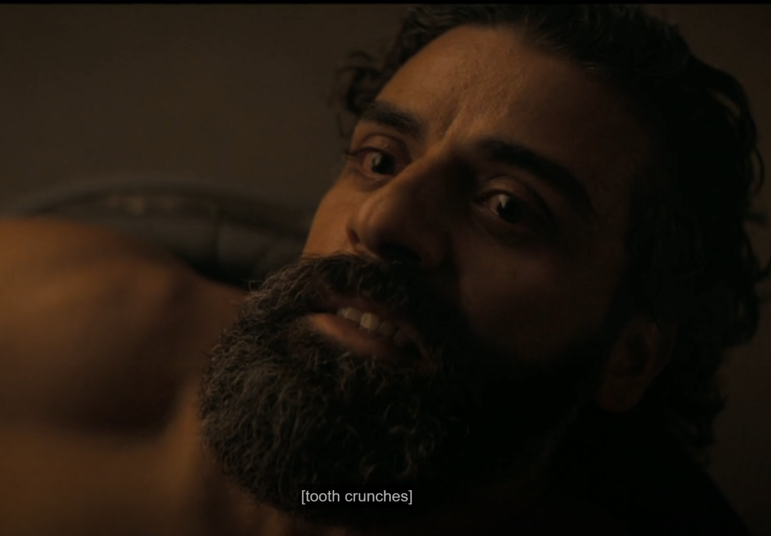
Plot Timeline
Kidnapper killing
Duke’s death
Notes:
After being sedated, Paul and Jessica were kidnapped to be dropped in the desert. But they use the voice to kill their kidnappers and hijack the Thopter- though it's remotely disabled
The Doctor is betrayed and killed by Baron, and the Duke bites down on the poison tooth, killing everyone in the room

Slide 12
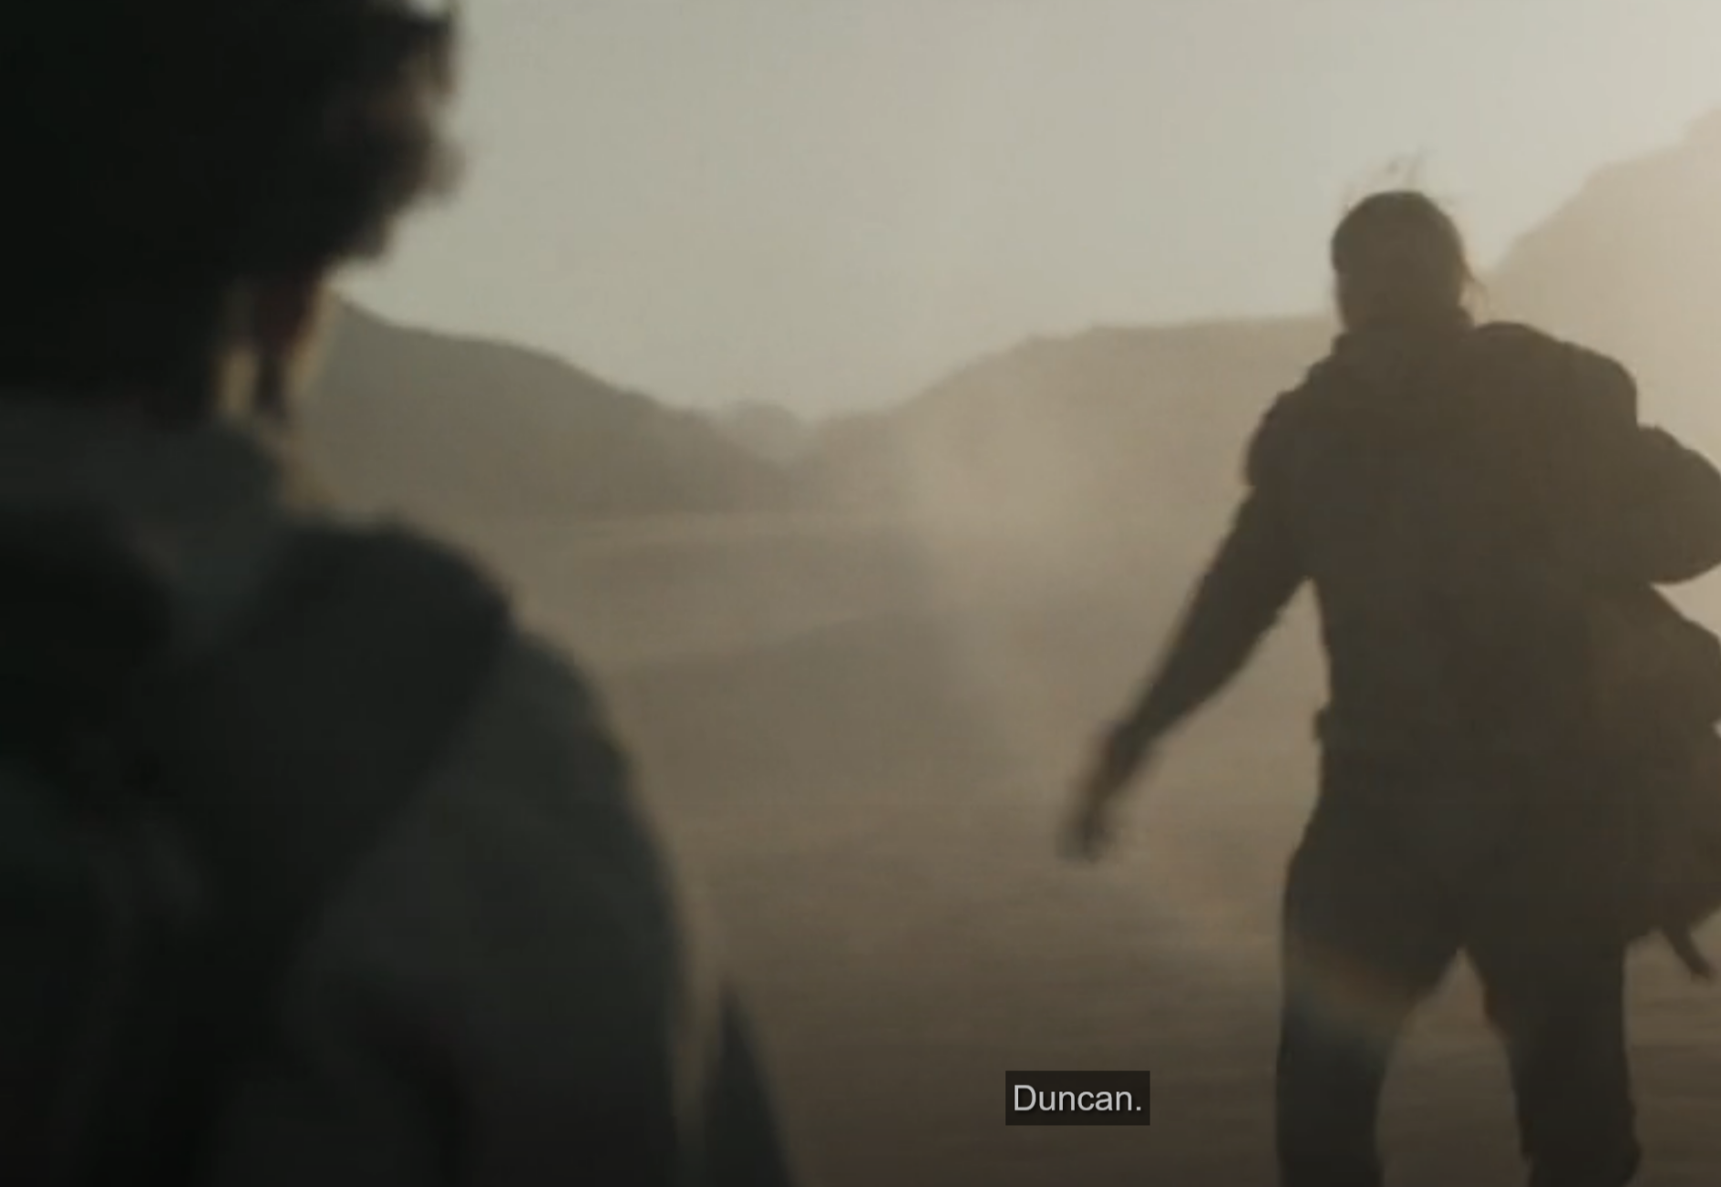
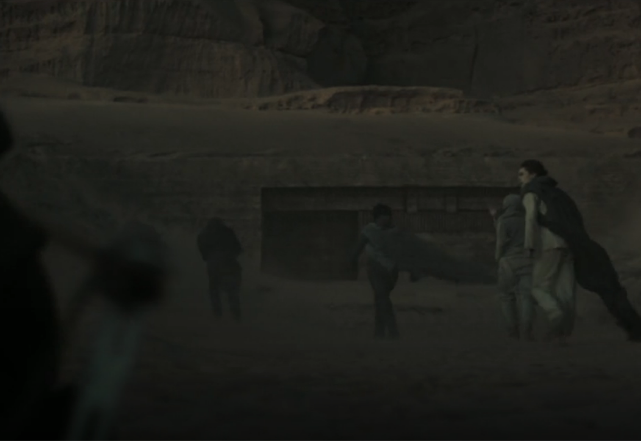
Plot Timeline
Meeting with Duncan
Hide with Fremen
Notes:
Paul and Jessica meet up with Duncan, then the Imperial Ecologist and a few Fremen. From there, they hide in an abandoned ecological center

Slide 13
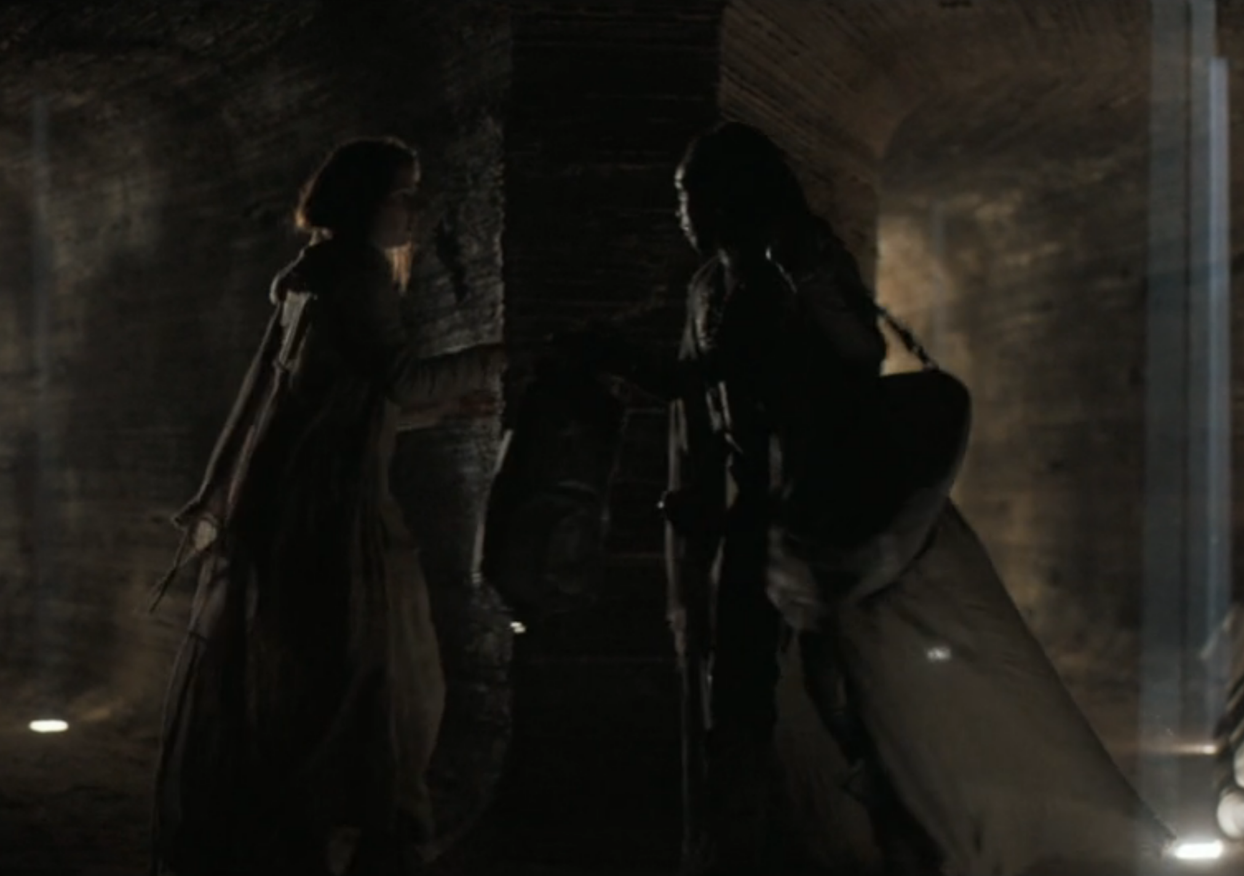
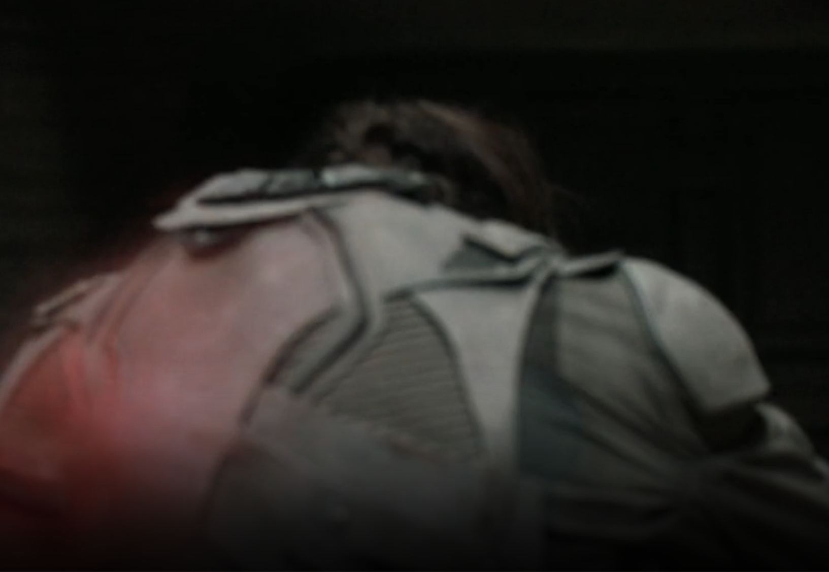
Plot Timeline
Splitting from Imperial Ecologist
Duncan killed
Notes:
The hiding spot is quickly found, with Paul and Jessica splitting from the Imperial Ecologist. Paul and Jessica get on a thopter, and the Imperial Ecologist gets killed by Sardaukar while preparing to ride a sandworm.
Duncan is killed off during this while trying to hold off the pursuers.

Slide 14
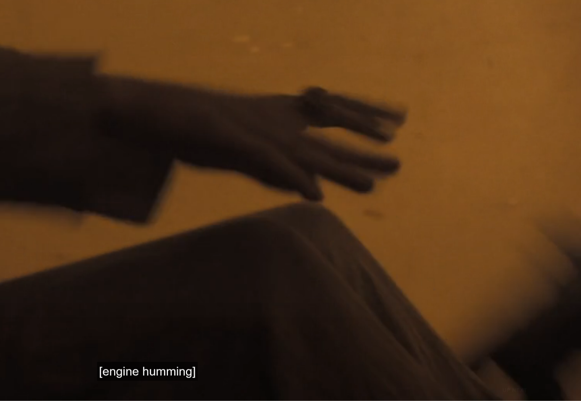
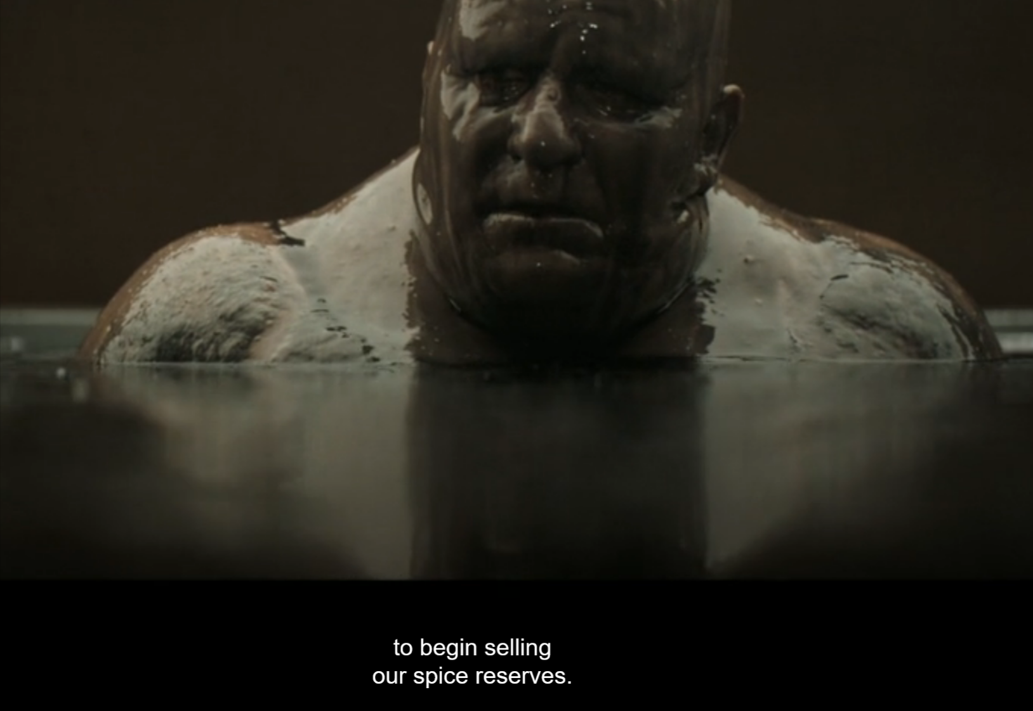
Plot Timeline
Chased into sandstorm
Baron survived
Notes:
Paul and Jessica are chased into a violent sandstorm, where Paul then receives a vision and lets go of the controls.
Here we learn the Baron survived- now selling spice reserves since that attack costed a fortune.
Put into perspective, that’s coming from the leader of the spice-harvesters, who’s controlled the spice production for 80 years. As they say, “He who controls the spice, controls the universe”. Stuff’s expensive

Slide 15
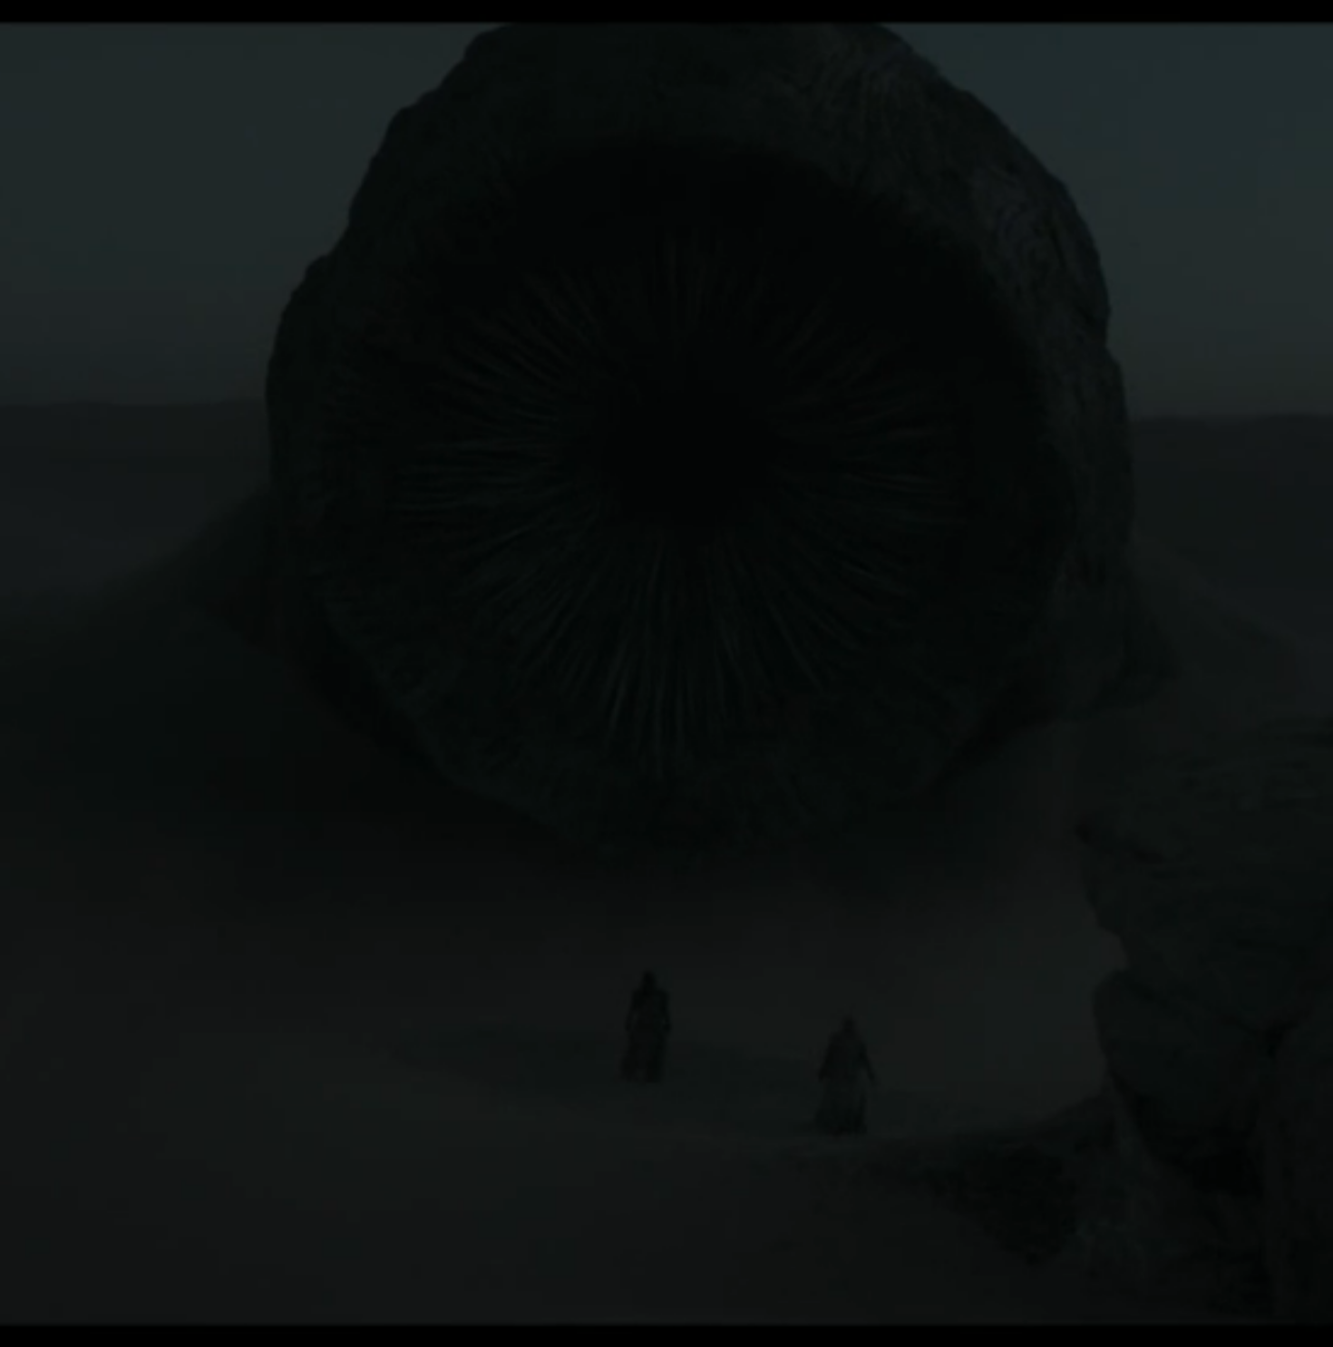
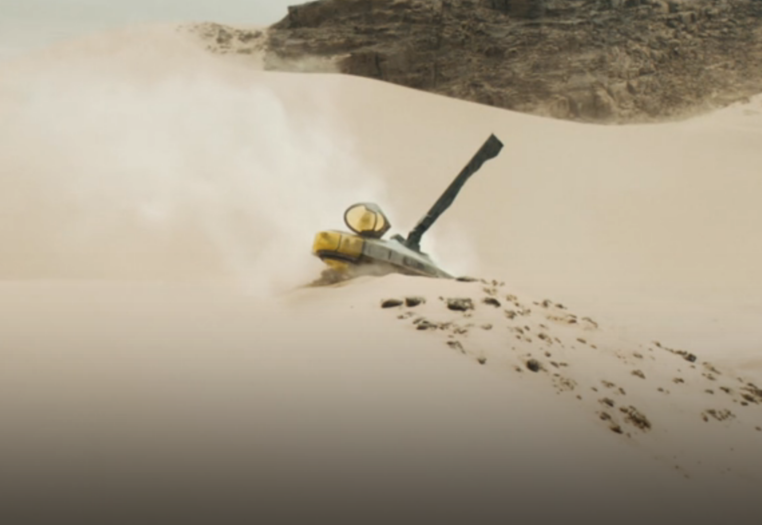
Plot Timeline
Survived
Notes:
Paul and Jessica crash land in worm territory, but survived the sand-storm. They continue on foot doing the sand-walk
Narrowly escape a sand worm, with the sand worm being distracted by a thumper that starts going off.

Slide 16
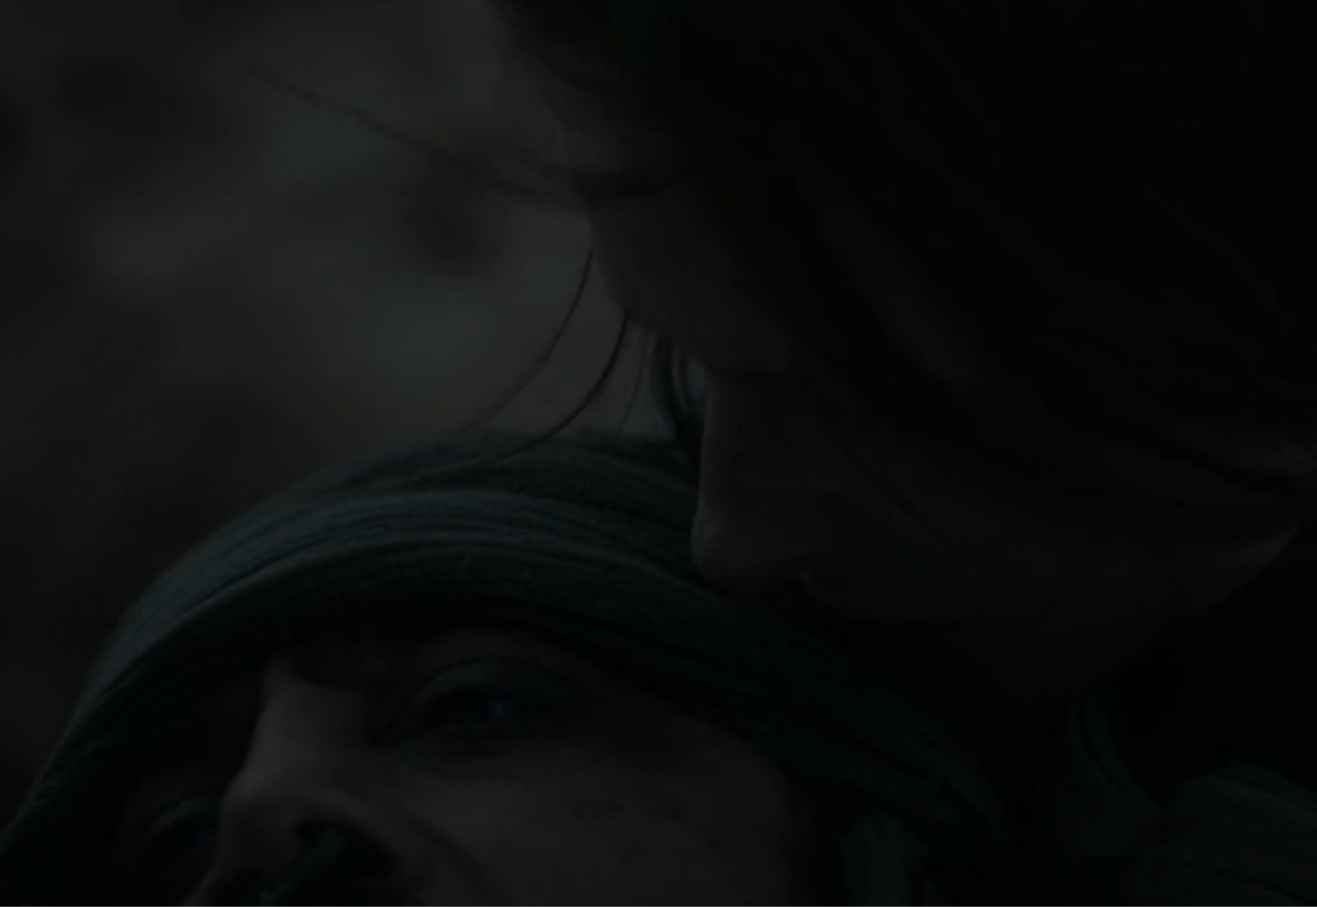
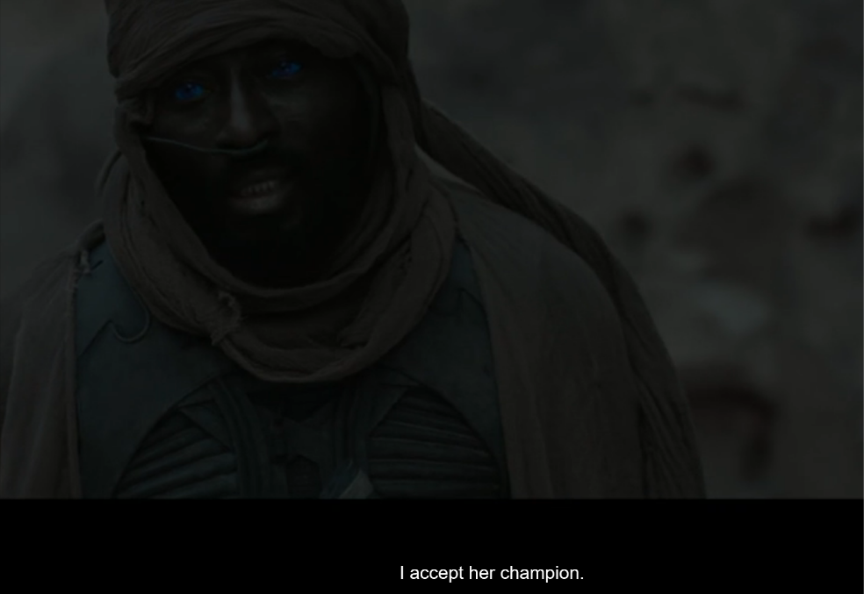
Plot Timeline
Fight with Fremen
Jamis doesn’t accept
Notes:
We coincidentally meet up with Stilgar and his group. They would allow Paul to join them, but not Jessica, so a fight ensues. Paul and Jessica win overwhelmingly, so Stilgar allows them to come with their group.
Jamis, one of the Fremen warriors, refuses this decision- challenging Jessica to an Amtal, a ritual duel to the death. For Bene Gesserit reasons, Paul has to fight as her champion instead of her directly.

Slide 17
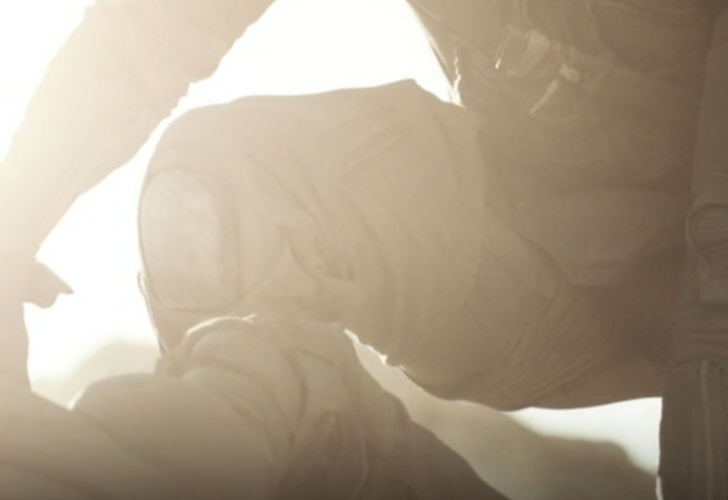
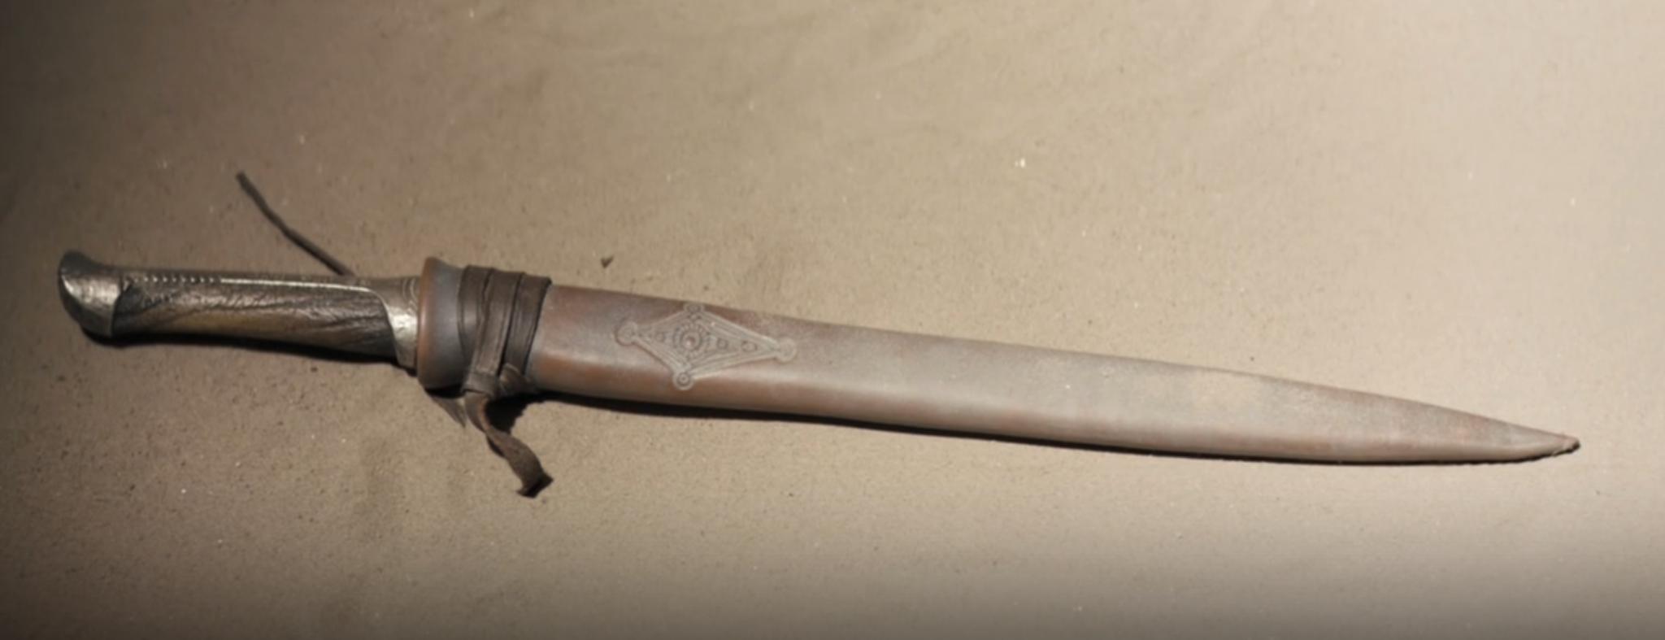
Plot Timeline
Vision of losing
Chani lends Crysknife
Notes:
Vision of losing against Jamis
Chani lends Paul her grandmother's Crysknife made from the tooth of a Shai Halud (great sandworm)

Slide 18
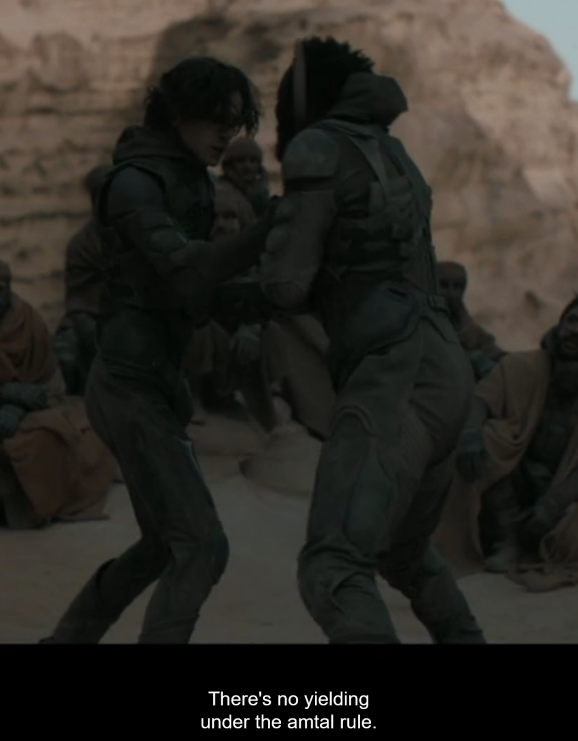
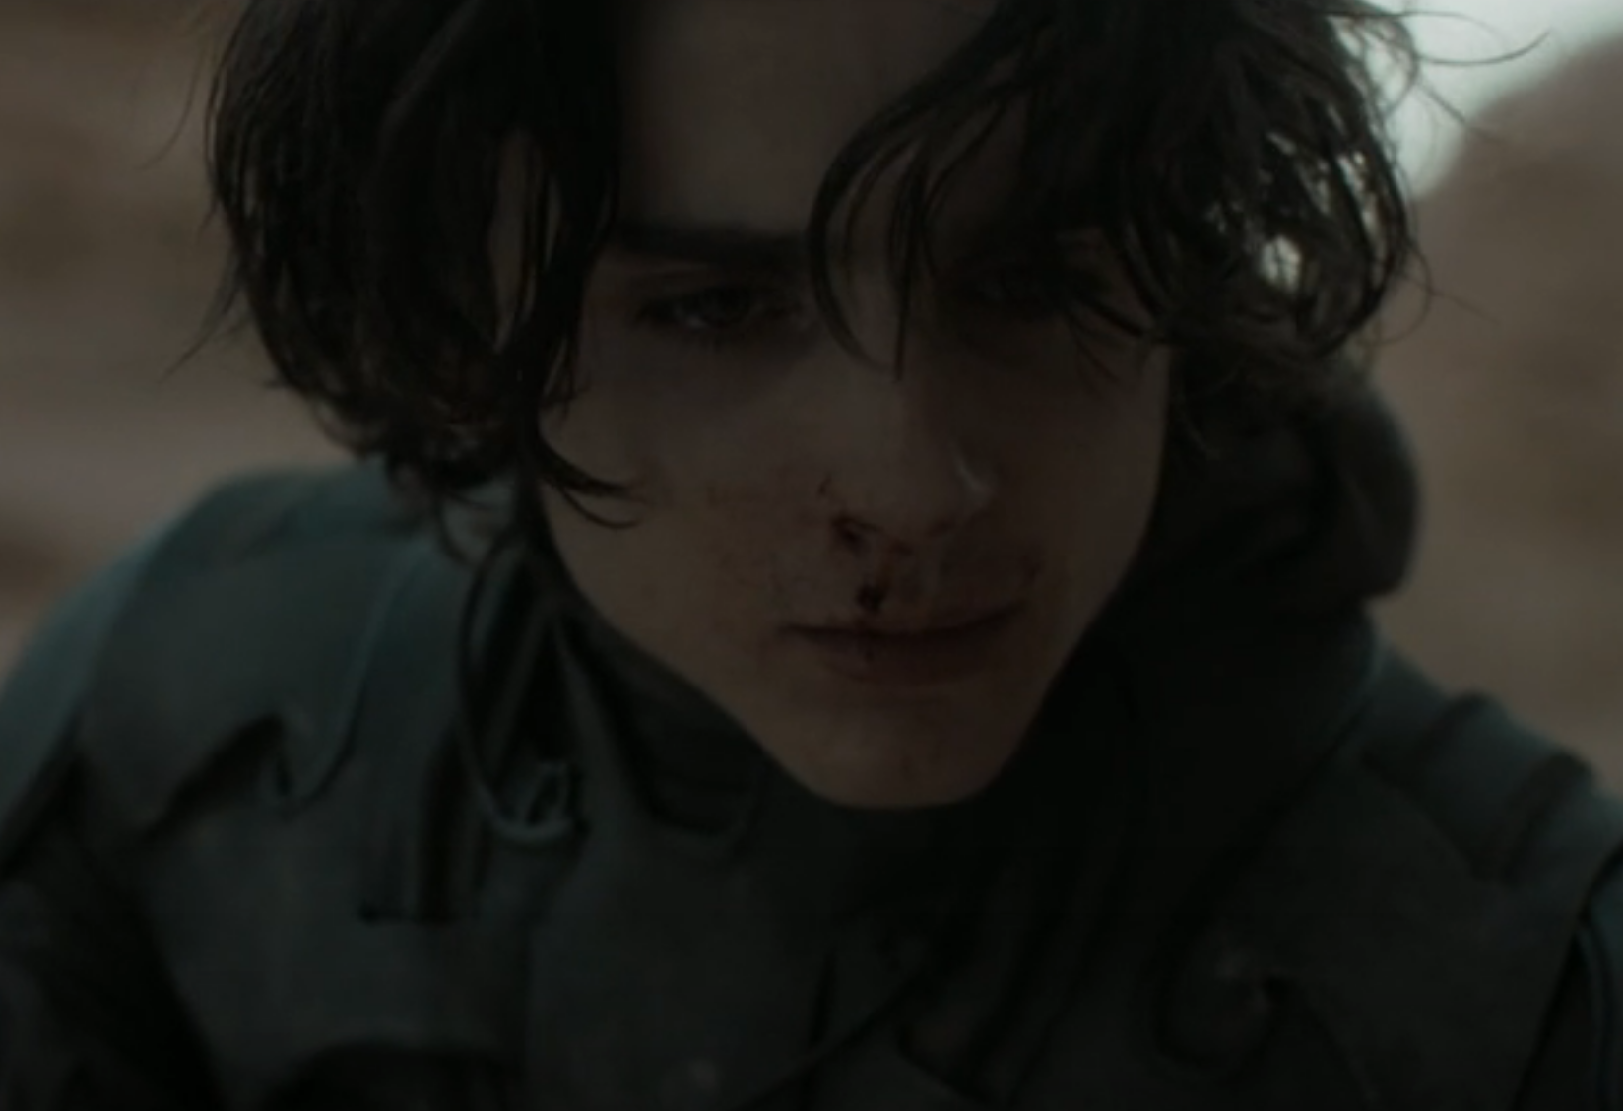
Plot Timeline
Notes:
Paul doesn’t know that the Amtal is to the death, offering mercy seemingly to mock Jamis. The reason Paul was refusing to kill was that he had never done so before.
But he eventually does kill Jamis, where he and Jessica are accepted into the Fremen

Slide 19
Director’s Intent: Computing
General aim was to resurrect feelings he had as a teenager
A fear, and an obstacle to overcome
  Thinking machine apocalypse
  Mentats
Notes:
denis villeneuve (pronounced Deni vihl-neuve)
General aim was to resurrect the feelings he had as a teenager reading the original book
Thinking machines (AI) banned after a catastrophic conflict. AI had seized control of governments, and made humans so dependent on them that the humans were unable and unwilling to rebel.
^ that being another message speaking to the over reliance of people on technology (which segues into the next topic very nicely, overcoming technology with human biology)
Human complacent, unable to do anything on their own.
Humanity couldn’t just stop progressing with the banning of thinking machines, so a greater emphasis was placed on human biology
Mentats have evolved brains that are better than computers.
[1] https://time.com/6589871/denis-villeneuve-dune-part-two-interview/
[2] https://www.nytimes.com/2024/02/21/movies/dune-timothee-chalamet-villeneuve.html
[3] https://www.youtube.com/watch?v=GoAA0sYkLI0
Denis Villeneuve, the director of Dune: Part One (2021), had a very clear intent with regards to computing being portrayed as a fear, to be avoided, and something human biology can overcome.
With the AI apocalypse almost coming to fruition, thinking machines and any similar technologies were completely banned [1]. Though to continue progressing as a civilization without these technologies, a large focus was put on the human mind itself, “They are trying to increase the human capacities biologically, instead of having external machines” [2]. This being a consistent theme throughout- the evolution of humanity, and the potential of humans in general, such as in the pain box scene [3]. Nothing encapsulating this better than Mentats, human supercomputers whose biology has surpassed the possibilities of computing.

Slide 20
Societal Conclusions
Notes:
This leads directly into the 3 societal conclusions that we drew from the movie.

Slide 21
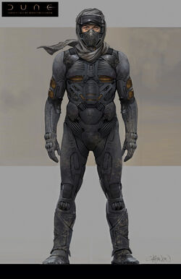
1. Powerful technology and resources disrupt power structures.
In Dune:
  Spice melange
  Still-suits
In real-life:
  Decentralized finance
  Renewable energy
Notes:
The first conclusion that we drew from the movie was that powerful technology and resources disrupt power structures. Probably the best example of this is the spice melange. As Baron Harkonnen says, “Whoever controls the spice, controls the universe.” We see this play out in the movie when the Emperor commands House Atreides to take control of Arrakis and spice production. This act causes the Harkonnens to lose a major source of power and wealth, and is the main reason why the Harkonnens invade Arrakis. In Dune, spice is power, so whoever controls the spice has power.
Another example of this in the Dune universe is the stillsuits that the Fremen use to survive in the desert.
The stillsuits give the Fremen a significant advantage in terms of survival and mobility on Arrakis, enabling them to thrive in an environment that is hostile to outsiders who lack such technology.
This ability of the Fremen, to survive and operate independently on Arrakis, undermines the control and dominance that external forces, such as the Harkonnens or the Imperium, attempt to exert over the planet and its resources.
In real life, we see examples of this like decentralized finance, such as bitcoin. Government-issued currencies can be tracked (you’ve probably heard the phrase “follow the money”), but since Bitcoin is decentralized, it’s a lot harder to track it. This is why a lot of (for lack of a better word) shady services ask for payment in Bitcoin. It disrupts the power structure that law enforcement has over people by making purchasing illegal things on the internet significantly easier, while also making it significantly harder to track.
Another example is new forms of renewable energy and energy storage, because it disrupts the “traditional” model of a centralized utility, like how you pay the city for your electricity can in a way be substituted for solar panels, freeing up extra income and getting rid of any dependency on local government contractors for things like electricity.
There are a million different examples, but we don’t really have time to go through all of them, so I’d like to move onto our second conclusion.

Slide 22
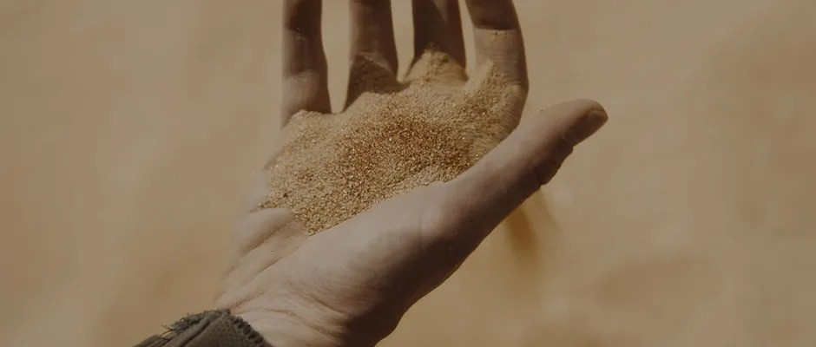
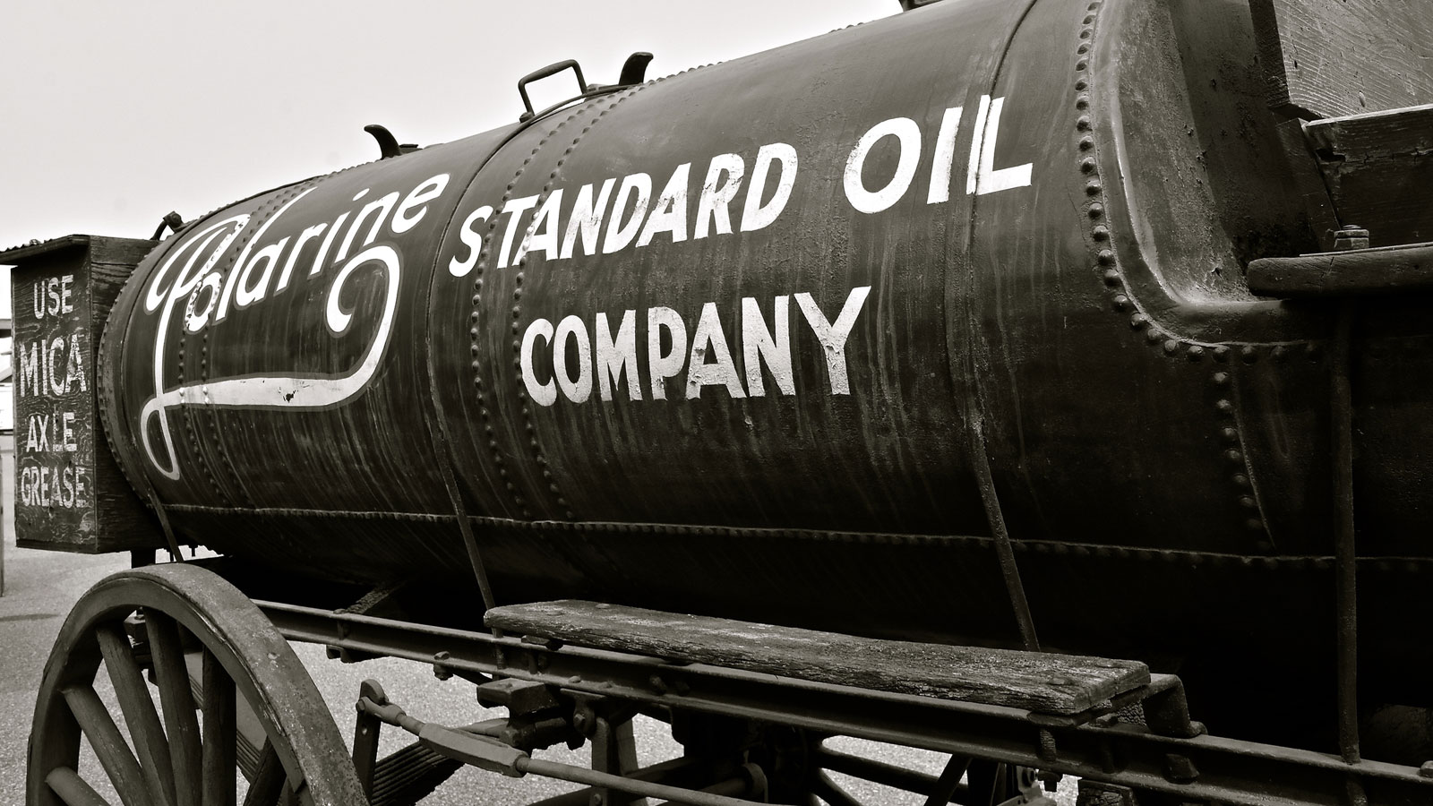
2. Decentralizing and diversifying technology is important.
In Dune:
  Spice melange
In real-life:
  Monopolies
Notes:
Kind of similar to our first point, decentralizing and diversifying technology is important.
If one entity, be it a person, country, or in the case of Dune, a faction, clan, or House. holds exclusivity over a powerful technology or resource, it can lead to a lot of issues. All the conflict in Dune: Part One occurs because the spice can only be found on this one planet, so whoever has control over this planet essentially has a monopoly on spice. In real life, history has shown that monopolies like this are detrimental to our society.
We saw this play out in the late 1800s with the case of Standard Oil, when John D. Rockefeller’s company controlled almost every aspect of oil production, transportation, refining, and marketing. The Supreme Court eventually ruled that it was an illegal monopoly, but in the time that Standard Oil operated, it made Rockefeller the first ever billionaire, concentrating an almost unimaginable amount of wealth for the time in the hands of a single person. (https://en.wikipedia.org/wiki/Standard_Oil, https://guides.loc.gov/chronicling-america-standard-oil-monopoly)
Monopolies control the market in which they do business, meaning that they have no competitors. When a company has no competitors, consumers have no choice but to buy from the monopoly. The company has no check on its power to raise prices or lower the quality of its product or service. (https://www.investopedia.com/insights/history-of-us-monopolies/)

Slide 23
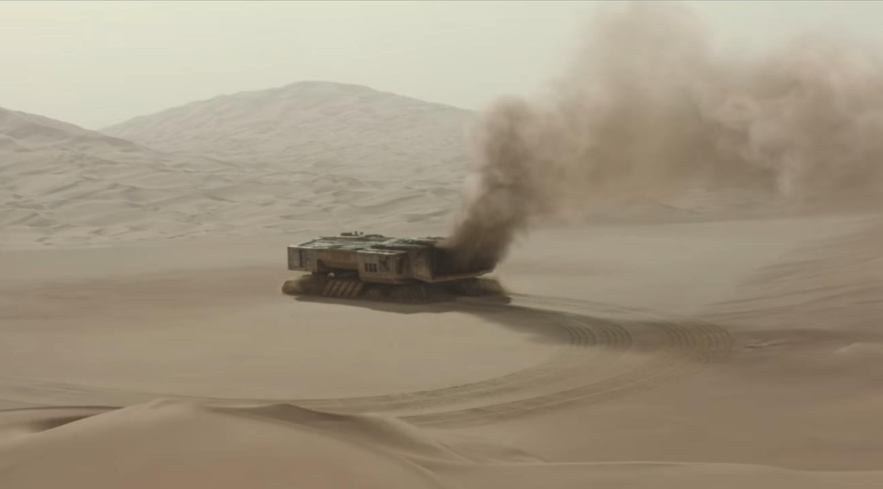
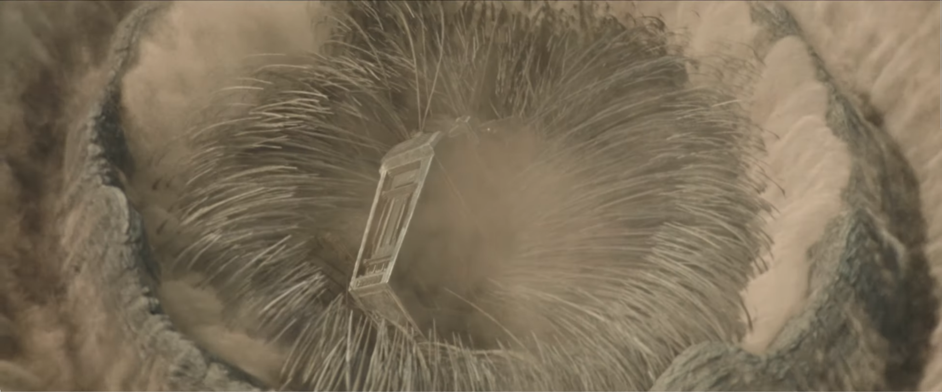
3. Overreliance on technology is dangerous.
Butlerian Jihad
Spice harvester scene
Notes:
Our third point echoes what a lot of other groups have found, that over-reliance on technology is dangerous.
In the Dune universe, this is taken pretty literally. It’s not really explained much in the movie, but if you’ve read the books, you’ve probably heard of the Butlerian Jihad. Basically, around 10,000 years before the Dune movie is set, an AI had enslaved humanity. The human race’s overreliance on computers and AI technology led to their enslavement. The humans revolted and started a long and very bloody crusade against all computers and anything that could be classified as a “thinking machine” (https://dune.fandom.com/wiki/Butlerian_Jihad). This is why all computers and AI are banned under penalty of death in the Dune universe.
-Mention Mentats again
Something that they do show in the movie however is the scene where the spice harvester gets eaten.
(if I can’t show the scene then say this) In this scene, Duke Leto Atreides and Paul are visiting one of the spice harvesters to see how the operation works when a sandworm is spotted. A carry-all is dispatched to pick up the harvester and take it out of harm’s way.
All of the workers sound very relaxed and not concerned at all, believing that the carry-all will simply carry them to safety. As Liet-Kynes says in this scene, “They’ll keep harvesting up until the last second”.
This is the dangerous part, the fact that they are so reliant on the carry-all that they don’t even sound concerned when the carry-all is late: “Does anyone have a visual on the carry-all yet?”.
That then leads into the moment when the carry-all malfunctions and isn’t able to pick up the spice harvester.
All of the workers then have to evacuate and are lucky to escape with their lives, while the spice harvester is eaten by the sandworm.
Scene: https://www.youtube.com/watch?v=nWY3mRWCzdw

Slide 24
Recap
Powerful technologies disrupt power structures
Decentralizing and diversifying technology is important
Overreliance on technology is dangerous

Slide 25
References
[1] https://time.com/6589871/denis-villeneuve-dune-part-two-interview/
[2] https://www.nytimes.com/2024/02/21/movies/dune-timothee-chalamet-villeneuve.html
[3] https://www.youtube.com/watch?v=GoAA0sYkLI0
[4] https://en.wikipedia.org/wiki/Standard_Oil
[5] https://guides.loc.gov/chronicling-america-standard-oil-monopoly
[6] https://www.investopedia.com/insights/history-of-us-monopolies/
[7] https://dune.fandom.com/wiki/Butlerian_Jihad
[8] https://www.youtube.com/watch?v=nWY3mRWCzdw

Slide 26
Any questions?

