Slide 1
Class 10
Professional Ethics
Keith A. Pray
SocialImps.com

Slide 2
Overview
Review
Debate
Assignment
Students Present
Notes:
ADD QUIZ AS BACKUP IF CLASS DISCUSSION NOT LONG ENOUGH

Slide 3
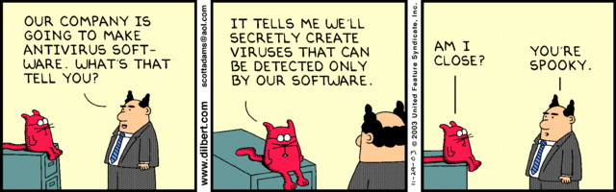
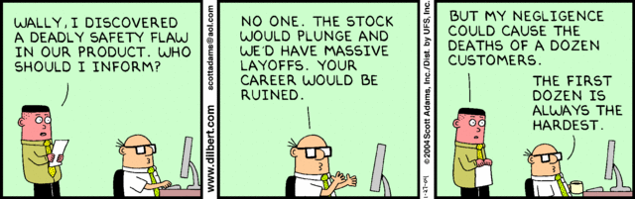
Notes:
Ask how many people in ACM or IEEE

Slide 4
My Reading Notes
p. 413 Forgery proof IDs possible? ”Papers.” common dystopian theme.
p. 418 ACM Code of Ethics and Professional Conduct published 2018 vs 1997
pp. 422-423 3.09 = 5.05
p. 454 “3. Would decision hold up to public scrutiny?”– social contract, not virtue ethics?
p. 430 Are not web logs usually public?
p. 431 “…Chuck had these files…” implies guilt. → “…files on Chuck’s computer…” seems better. Antiworm scenario very similar to p. 76. Check if [5] 2003 source about Blaster worm.
p. 432 Consent of telecommunications companies… or their clients?
p. 433 will != consequences
p. 434 Saving public taxes $15K not considered
p. 435 DEI claims source [7] 2001, need newer
p. 436 Source [11] 2018, computing demographics now?
p. 437 Org pressure, macho culture, harassment source [1]8 2008, newer source needed.
p. 438 Additional advice: Ask for help, share context and possible biases. How to ensure everyone’s voice is heard in class?
p. 440 $3 million over how many employees?
p. 441 Many whistle blower definitions do not require internal reporting attempts.
p. 445 Org failure what I generally see.
p. 446 “return to using principle-based…” source from 2003, needs update. This happened a while ago, perhaps not everywhere.
p. 447 pension quote source from 1983, tough to get a pension now, consider finding newer
No mention of Snowden but for Question 24.
p. 451 # 21 not really computing
Questions I liked: 23, 25, 29, 30
Notes:
An error of commission is one where the person responds where they should not. This is compared to an error of omission, where the person fails to respond when they should.

Slide 5
Debate Ground Rules
Develop FPS Based on Current War?
Before Debate
  10 minutes to converse with your team
  Share argument points, counter points, and responses
  Share experiences, especially in different countries, cultures, situations
  Decide who will:
    Go first
    Respond to which points from opposing side
During Debate
  1 turn per person until everyone on your team has spoken
  Try to keep remarks to 30 seconds
Notes:
Release Game or Not Debate
Chapter 9 In-class Exercises # 24.
Should we (the company) produce the game?
Use the SWE Code Of Ethics as the basis for your argument.
If Remote:
Add “(YES)” or “(NO)” to the end of your name in Zoom to show your side

Slide 6
Assignment
1 Page Paper
  What should computerized automation be applied to next?
Finish all reading
Group Project
  Add analysis to website addressing remaining topics
  Group Presentation Draft
    Submit as Power Point on Canvas
    Post Power Point file (.pptx) on group website for download
      Do not make viewer export it from another tool
Notes:
1 Page Paper Ideas:
For Good - How will you use your computing related education to do good in the world?
Dark Net - Is the Dark Net good or bad?
Does computerized automation help the economy or society?
What should computerized automated be applied to next?
If productivity has increased so much, why are we working so hard? Should we?
What job skills will survive computerized automation?

Slide 7
Overview
Review
Debate
Assignment
Students Present
Notes:
Show WPI and/or corporate code of ethics.

Slide 8
The AI Ethics of tech giants: can self regulation be trusted?
Joseph DiPietro

Slide 9
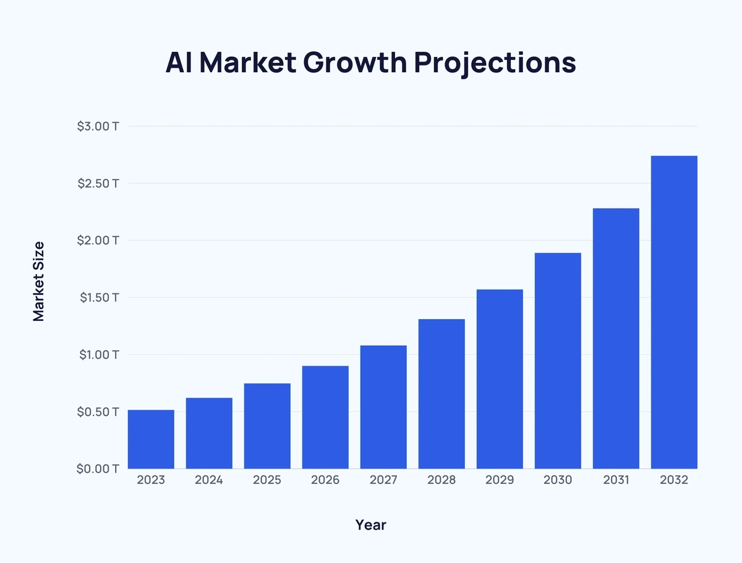
Conclusion
Joseph DiPietro
Self-regulation: Companies set and follow their own ethical guidelines without external enforcement
Companies developing AI can not be trusted to self-regulate
[1]
<Graphic as big as will fit>
Notes:
AI self-regulation involves companies voluntarily setting and following their own ethical and safety standards for AI development and deployment, without external enforcement.
Regulation matters because AI technologies influence critical aspects of society, including employment, healthcare, and information dissemination. Without proper oversight, there's a risk of harm, bias, and erosion of public trust.
Companies developing AI cannot be solely trusted to self-regulate. External oversight is necessary to ensure ethical and safe AI practices.

Slide 10
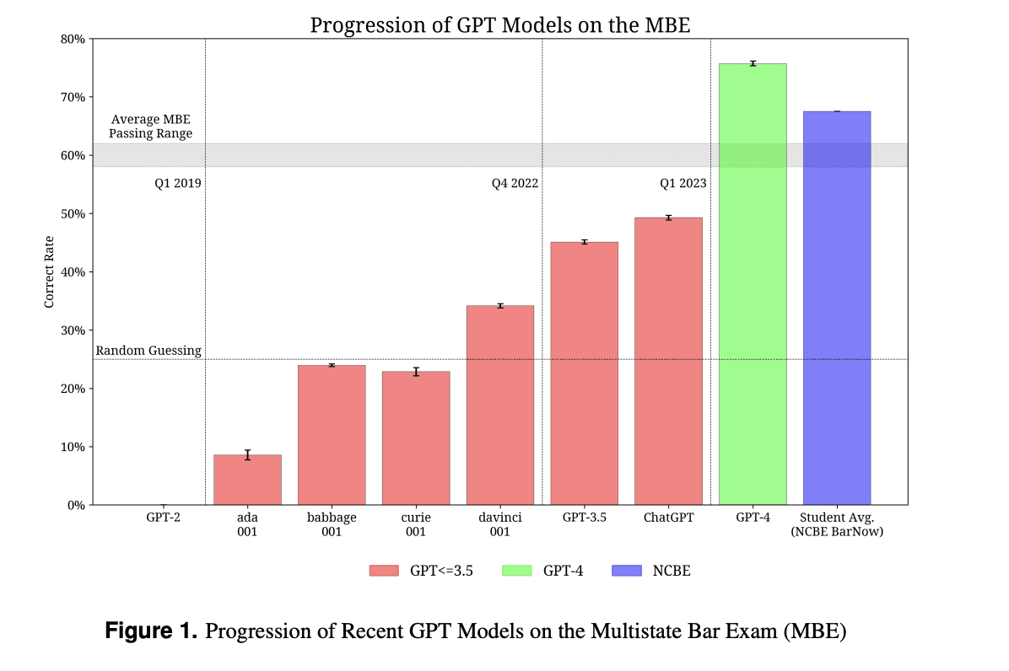
Argument for self regulation
Joseph DiPietro
Rapid innovation and adaptation [2]
  Accelerated development
  Flexible standards
  Market responsiveness
Companies posses deep technical knowledge [3]
  Expertise driven policy
  Proactive risk management
  Continuous improvement
[4]
Notes:
- Self-regulation allows companies to innovate rapidly, as they are not hindered by the often slow pace of governmental regulatory processes.​
- By setting their own ethical standards, organizations can ensure that their AI solutions are both effective and aligned with their specific operational contexts.​
- This flexibility can be crucial in the evolving AI landscape, where the ability to adapt quickly can be a significant competitive advantage.
- Companies developing AI technologies are best positioned to understand the potential risks and ethical considerations associated with their use.​
- Their deep technical knowledge enables them to create and implement policies that are both practical and effective in mitigating risks.​
- This expertise also facilitates continuous monitoring and improvement of AI systems, ensuring they remain aligned with ethical standards over time.

Slide 11
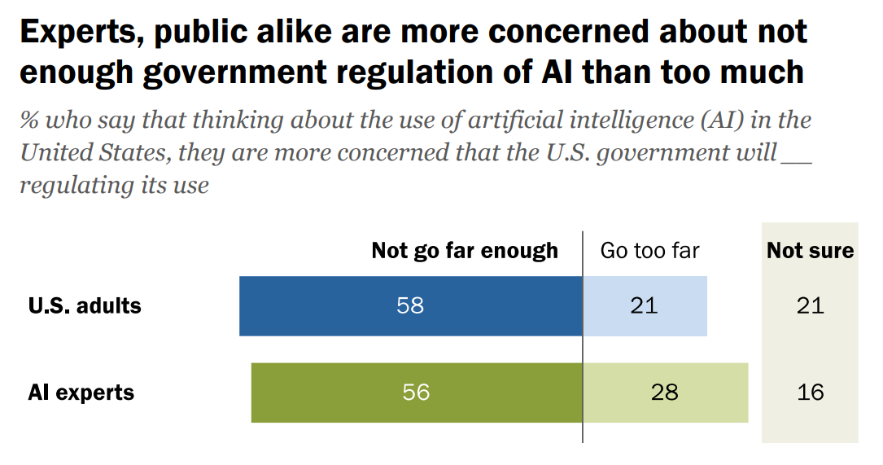
shortcomings
Joseph DiPietro
Profit motivation may overshadow ethics
  Aggressive fair use lobbying
  Innovation over creator rights
Lack of transparency
  Opaque data usage
  Insufficient attribution
Limited accountability [5]
  Absence of legal frameworks
  Challenges in enforcement
[6]
Notes:
- Many companies promote ethical AI, but the push to dominate the market often overrides long-term responsibility.
- Profit plays a big role. OpenAI and Google support broad "fair use" to train on copyrighted content without paying for it.
- They argue that too much regulation would slow innovation, but it often comes at the cost of artists and creators losing control of their work.
- There’s little transparency around how models are trained. Most people don’t know if their content was used.
- Attribution is lacking. Even when AI mimics someone’s work, the original source is rarely credited.
- Accountability is also weak. Laws aren’t clear, and enforcement is difficult and expensive.
- Lawsuits like the New York Times case against OpenAI are starting to push back, but the legal system is still catching up.
- Overall, this shows that voluntary self-regulation often fails, especially when ethical goals and business goals don’t align.

Slide 12

Example: Microsoft
Joseph DiPietro
Responsible AI Framework [7]
  Vulnerability assessment
  Multi-team oversight
  Data security
Laid off important AI ethics team [8]
  Ethics framework enforcement
  Detailed risks of OpenAI collaboration
Controversial military contracts [9]
Notes:
- Microsoft publicly promotes a strong Responsible AI framework, highlighted in a 25-page document outlining its standards for safety, transparency, fairness, and data security.
The company actively monitors 10 types of AI vulnerabilities and employs multi-team governance.
- In 2023, Microsoft laid off its entire AI Ethics and Society team. The very group tasked with integrating these values into product development.
This decision casts doubt on their commitment to ethical AI enforcement, especially given their growing investments in AI-driven products.
Internal dissent has grown around Microsoft's collaboration with OpenAI. Some employees on that ethics team voiced concerns about risks, but leadership allegedly prioritized competitiveness over caution.
More recently, Microsoft faced backlash for supplying AI tools to the Israeli military during the Gaza conflict, with critics, including former employees, accusing the company of fueling harm through its technology
These examples suggest that even with a polished Responsible AI framework, real-world decisions may still be driven by business interests, not ethical ones.

Slide 13
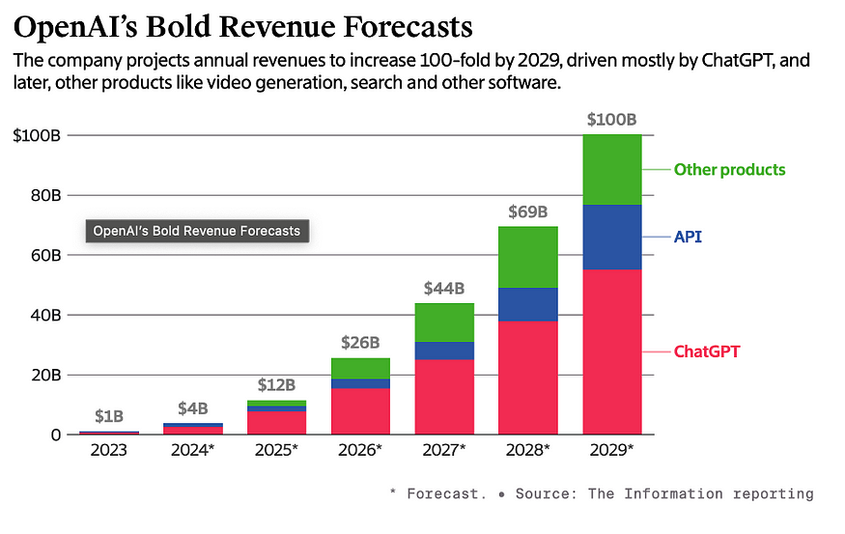
Example: OpenAI
Joseph DiPietro
Rapid innovation and development of GPT
Training on copyrighted material without explicit consent [10]
  Facing lawsuits from authors and the NYT
  Data hunger outweighing ethical concern
Now a for-profit company [11]
  Founded as a non-profit to benefit humanity
  Profit drives data collection
[12]
<Graphic as big as will fit>
Notes:
OpenAI has led the charge in AI development with its GPT models, advancing rapidly in just a few years
.But it’s now facing lawsuits, including one from The New York Times, for using copyrighted content without permission to train its models
These legal challenges highlight a bigger issue: OpenAI’s growing need for massive data outweighs ethical concerns around consent and ownership.
Originally a nonprofit, OpenAI became a for-profit company in 2019, taking on major investors like Microsoft.
That shift has increased pressure to grow quickly and collect more data, sometimes at the expense of ethics.
- This is another case in which a company struggles to self-regulate when financial incentives conflict with ethical goals.

Slide 14
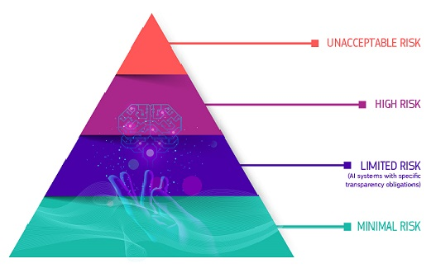
Alternative regulation propositions
Joseph DiPietro
Governmental regulation: The EU AI Act [13]
  Risk based assessment of AI applications
  Transparency about AI interaction
  Accountability, especially for high-risk applications
Dynamic Governance Model: Hybrid Approach [14]
  Public and private collaboration
  Independent audits
  Flexible Oversight
  Shared responsibility
[13]
Notes:
- One major approach to AI oversight is government regulation, like the European Union’s AI Act.
- It sorts AI systems into categories based on risk and applies stricter rules to the ones that could affect things like jobs, safety, or rights.
- The EU Act also requires transparency, like telling people when they’re interacting with AI, and it sets up independent watchdogs to enforce the rules.
- But government policy can be slow to keep up. That’s where the Dynamic Governance Model comes in. This model brings together tech companies, government agencies, and experts to create shared rules and standards.
- It relies on independent audits, outside reviewers who check that companies are building safe and fair AI.
- And it’s designed to adapt over time, so the rules can change as the technology evolves.
Both models show that self-regulation isn’t enough. We need outside accountability, whether from governments, independent auditors, or a mix of both, to make sure AI is safe, fair, and trustworthy.
EU AI Act risk examples:
Unacceptable: Social scoring, emotional evaluation in school/work
High: CV-Sorting job applications, AI in judicial settings
Limited: Chatbots, deepfakes
Minimal/None: Spam Filters, AI in videogames

Slide 15
References
Joseph DiPietro
[1] Fabio Duarte, AI Market Size Statistics (Exploding Topics, November 7, 2024), https://explodingtopics.com/blog/ai-market-size-stats April 21, 2025
[2] George Schoenstein, Seize the Opportunity: Embrace Self-Regulation To Harness the Full Potential of AI (Forbes, July 20, 2023), https://www.forbes.com/councils/forbescommunicationscouncil/2023/07/20/seize-the-opportunity-embrace-self-regulation-to-harness-the-full-potential-of-ai/ April 21, 2025
[3] Adam Stone, Self-Regulation is Key to Future of Ethical Enterprise AI (Nutanix, February 24, 2025), https://www.nutanix.com/theforecastbynutanix/news/why-self-regulation-is-important-to-ethical-enterprise-ai April 21, 2025
[4] Ankit Mehra, A Deep Dive into GPT Models: Evolution & Performance Comparison (KD Nuggets, May 25, 2023), https://www.kdnuggets.com/2023/05/deep-dive-gpt-models.html April 21, 2025
[5] Virginie Berger, The AI Copyright Battle: Why OpenAI and Google are Pushing for Fair Use (Forbes, March 15, 2025), https://www.forbes.com/sites/virginieberger/2025/03/15/the-ai-copyright-battle-why-openai-and-google-are-pushing-for-fair-use/ April 21, 2025
[6] Colleen McClain, Brian Kennedy, Jeffrey Gottfried, Monica Anderson and Giancarlo
Pasquini, How the U.S. Public and AI Experts View Artificial Intelligence (Pew Research Center, April 3, 2025), https://www.pewresearch.org/wp-content/uploads/sites/20/2025/04/pi_2025.04.03_us-public-and-ai-experts_report.pdf April 21, 2025
[7] Gladys Rama, Microsoft Offers Assurances in ‘Trustworthy AI’ Manifesto (Redmond, February 8, 2024), https://redmondmag.com/Articles/2024/02/08/Microsoft-Trustworthy-AI-Assurances.aspx April 21, 2025
[8] Zoe Schiffer, Casey Newton, Microsoft lays off team that taught employees how to make AI tools responsibly (The Verge, March 13, 2023), https://www.theverge.com/2023/3/13/23638823/microsoft-ethics-society-team-responsible-ai-layoffs April 21, 2025
[9] Harry Davies, Yuval Abraham, Microsoft deepened ties with Israeli military to provide tech support during Gaza war (The Guardian, January 23, 2025), https://www.theguardian.com/world/2025/jan/23/israeli-military-gaza-war-microsoft April 21, 2025
[10] Blake Brittain, OpenAI copyright lawsuits from authors, New York Times consolidated in Manhattan (Reuters, April 3, 2025), https://www.reuters.com/legal/litigation/openai-copyright-lawsuits-authors-new-york-times-consolidated-manhattan-2025-04-03/ April 21, 2025
[11] Matt O’Brien, OpenAI picks labor icon Dolores Huerta and other philanthropy advisers as it moves toward for-profit (AP News, April 16, 2025), https://apnews.com/article/openai-dolores-huerta-artificial-intelligence-nonprofit-5be2ce2185fb382a45e940426cd936d3 April 21, 2025
[12] Dave Ginsburg, AI Top-of-Mind for 10.14.24 — OpenAI’s Revenue Projections (Medium, October 14, 2024) https://medium.com/a-i-society/ai-top-of-mind-for-10-14-24-openais-revenue-projections-33cbd2b12f89 April 21, 2025
[13] AI Act (European Commission, February 18, 2025), https://digital-strategy.ec.europa.eu/en/policies/regulatory-framework-ai April 21, 2025
[14] Paulo Carvão, Yam Atir, Salvina Ancheva, A Dynamic Governance Model for AI (Lawfare, March 13, 2025), https://www.lawfaremedia.org/article/a-dynamic-governance-model-for-ai April 21, 2025

Slide 16
The future of Ai and robotics
Adrian Cervera

Slide 17
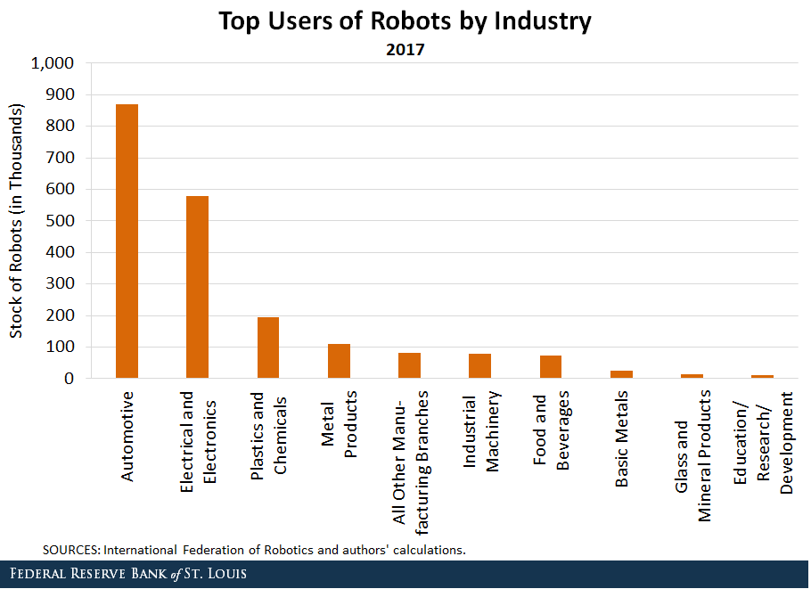
Why do we create robots?
Adrian Cervera
"*Dull, Dirty, Dangerous"
For the last few decades, automation has become dominant in
  Manufacturing
  Retail/Service
  IT & Software development
Drones & Surveillance in Combat Zones
Space & Underwater Exploration
[1]
Notes:
Slide 1: Why do we create robots?
They are simple machines that perform tasks
“Dirty, Dull, Dangerous” - Professor Kenneth Stafford, Retired, RBE
Chart by Fed Reserve Bank of St. Louis

Slide 18
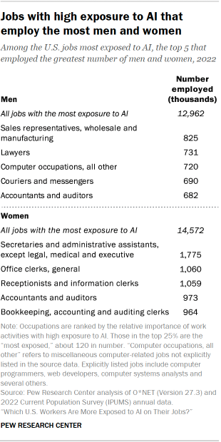
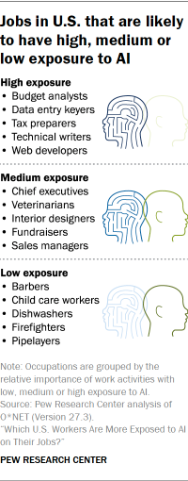
Robots will evolve with software
Adrian Cervera
[2]
Automation through AI will dominate
  Law
  Office and Management
  Data Science and Analysis
  Business
  Healthcare
However, some argue that there is a field where humans will always dominate: Emotional Services
Notes:
Slide 2: As software evolves, new tasks/roles will be taken up by robots
Automation has already started to dominate in
Law
Office/Management
Data Science/Analysis
Business
Healthcare
Humans will dominate in Emotional Services

Slide 19
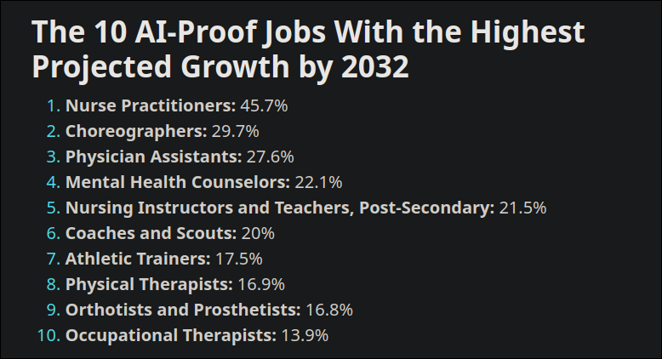
Adrian Cervera
However, some argue that there is a field where humans will always dominate: Emotional Services
[3]
Notes:
Slide 3: Emotional Services
Nurse Practitioners
Choreographers
Coaches and Scouts

Slide 20
But will that always be the case?
Adrian Cervera
Most people recognize the element of humanity in artistic/emotional expression
We treat robots differently because we see them as algorithms and machines.
There is an increase in the potential for robots to be used as companions to humans
What separates us from robots?
*Consciousness and Sentience
Notes:
Slide 4: So why do these fields stand out?
Humanity in artistic/emotional expression
Robots currently are just algorithms and machines
Integrations with Generative AI and LLMs
None of us would consider LLMs to be remotely human. Why?
Because AI currently lacks consciousness and sentience

Slide 21
But what if robots had these characteristics?
Adrian Cervera
We can break down consciousness into 3 aspects [4]:
Self-awareness
Having emotions and feelings
Think consciously (understand its arguments and thoughts)
We might never truly know. We ascribe consciousness to other people because we are like them. We take our OWN conscious and apply it onto others. To an extent, we do the same with animals
Notes:
Slide 5: Its not totally impossible
Definitions
Sentience is part of consciousness
Consciousness has 3 parts
Self-awareness
Having emotions and feelings
Understanding one’s thoughts
I think it is entirely possible to use algorithms to emulate all these behaviors
Emulation is close enough, because we cannot perceive the consciousness of others
We project our own consciousness onto others

Slide 22


Slide 23
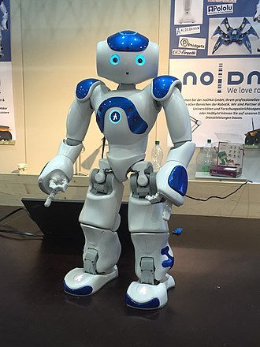
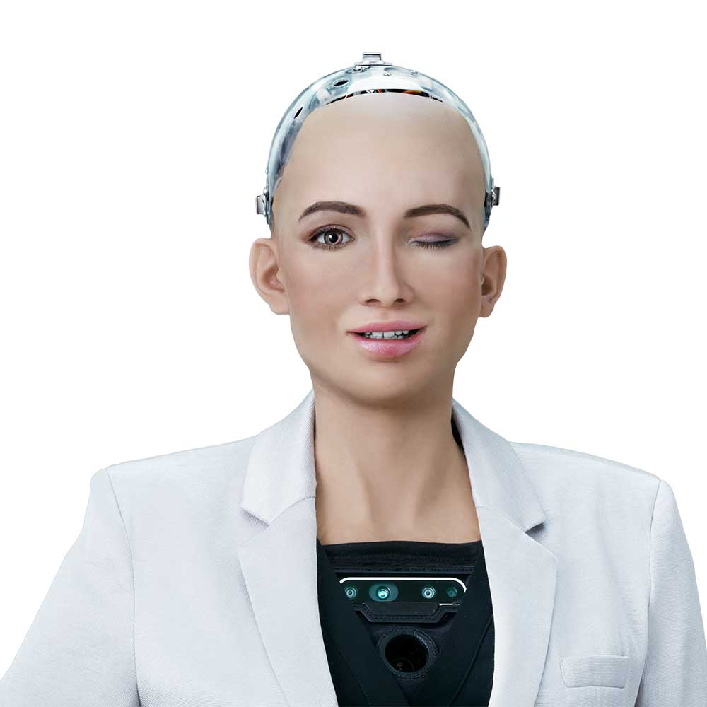
Can we apply ethics onto non-humans?
Adrian Cervera
Yes. We've done it before. That's why animal cruelty laws exist.
Social Robots: "Physically Embodied, autonomous agent that communicates and interacts with humans on a social level [5]"
  Kismet (MIT)
  NAO (Aldebaran) [Right]
  Sophia (Hanson Robotics) [Left]
These robots are capable of
Learning, decision making,
exhibiting behavior, and
interacting with humans.
Notes:
Slide 6: Social Robots
NAO (pronounced as "NOW")
Because social robots emulate personality, we tend to indirectly form relationships and project our consciousness onto them.
Fun fact: Sophia was granted Saudi Arabian citizenship in 2017

Slide 24
How should we treat social robots?
Adrian Cervera
Some argue that robots have differing roles in society and we should treat each one according to its roles. [5]
However, this approach is not consistent with how we treat humans
The "social roles" approach works because we all agree that current robots do not have the characteristics of consciousness
But that could change.
Could we ever reach a point where we have to define/separate real and artificial consciousness?
Notes:
<speaker notes>

Slide 25
My opinions
Adrian Cervera
We shouldn't even have this discussion in the first place. Its an entirely avoidable ethical dilemma.
According to the "3Ds" principle, engineering consciousness into robots serves no purpose
There should never be a substitute for genuine human interaction, and trying to do may worsen already existing mental health problems.
Notes:
<speaker notes>

Slide 26
References
Adrian Cervera
[1] Maximiliano A. Dvorkin, Asha Bharadwaj, "Which Countries and Industries Use the Most Robots?" (Federal Reserve Bank of St. Louis, November 7th, 2019) https://www.stlouisfed.org/on-the-economy/2019/november/robots-affecting-local-labor-markets (April 20th, 2025)
[2] Rakesh Kochhar, "Which U.S. Workers are More Exposed to AI on Their Jobs?" (Pew Research Center, July 26th, 2023) https://www.pewresearch.org/social-trends/2023/07/26/which-u-s-workers-are-more-exposed-to-ai-on-their-jobs/ (April 20th, 2025)
[3] U.S. Career Institute, "Top 65 Jobs Safest from AI & Robot Automation" (U.S. Career Institute, February 2023) https://www.uscareerinstitute.edu/blog/65-jobs-with-the-lowest-risk-of-automation-by-ai-and-robots (April 21st, 2025)
[4] Elizabeth Hildt, "Artificial Intelligence: Does Consciousness Matter?" (Frontiers In: Psychology, July 1st, 2019) https://www.frontiersin.org/journals/psychology/articles/10.3389/fpsyg.2019.01535/full (April 18th, 2025)
[5] Brian King, "Could a Robot be Conscious?" (Philosophy Now, April 2018) https://philosophynow.org/issues/125/Could_a_Robot_be_Conscious (April 18th, 2025)
[6]
[8] The Economist, "A Study Finds Nearly Half of Jobs are Vulnerable to Automation" (The Economist, April 24th, 2018) https://www.economist.com/graphic-detail/2018/04/24/a-study-finds-nearly-half-of-jobs-are-vulnerable-to-automation (April 20th, 2025)
[8] Marcus Lu, "Ranking Industries by Their Potential for AI Automation" (Visual Capitalist, June 27th, 2023) https://www.visualcapitalist.com/sp/ranking-industries-by-their-potential-for-ai-automation/ (April 20th, 2025)

Slide 27
Your Face in ads
Grant Watson
Notes:
Introduce yourself and presentation, keep short and sweet or intro with Walgreens ad story and pose question:
is it safe to use facial recognition based advertising?

Slide 28
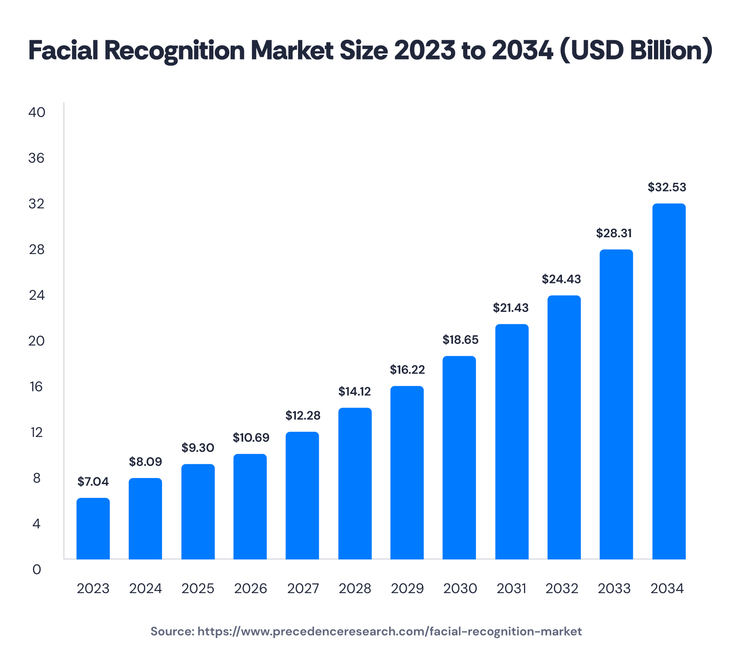
What is facial recognition?
Grant Watson
Typically defined in a security context (DHS)
  Face ID on devices
  TSA
  Marriott began testing
The facial recognition market is ever expanding (Incode)
  Market cap expected to triple by 2034
  Increasing at an exponential rate
Facial recognition is being used unethically used to advertise
Notes:
The department of homeland security considers facial recognition only in the context of security, describing it as “a contemporary security solution that automatically identifies and verifies the identity of an individual from a digital image or video frame.”. While defined under security, facial recognition can be found in many places.
Some uses are face ID on phones and other devices to protect accounts, TSA uses facial recognition to verify a traveler’s identity , Hotels like the Marriott began testing a facial recognition-based check-in system to streamline the check-in process.
The facial recognition industry is expanding at an exponential rate, which raises the question, why is so much money going into the technology? Most security uses are ”nice to have” add ons to a product or service. Is there a use of facial recognition that generates income by itself? Mention advertising

Slide 29
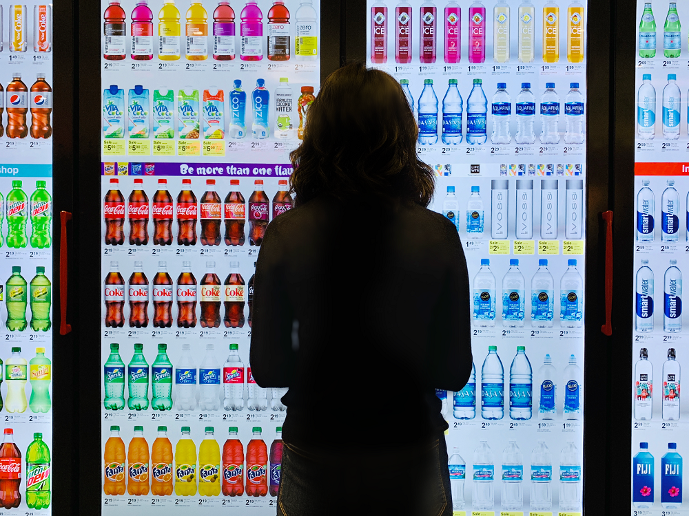
How is facial recognition used in advertising?
Grant Watson
Changes ads based on demographics scanned by facial recognition software
Creates dynamic advertisements to cater to the viewers preferences
  Similar to targeted advertisements online
  Ethically concerns
Notes:
According to business News Daily, facial recognition advertising is “the use of sensors that recognize a customer’s face and change how an ad appears to them in real time.”
What this means is that ads can be targeted based on the demographics of the viewer. This already happens through online mediums by collecting user data and feeding targeted advertising to increase the yield rate of the advertisement. Even without any biometric aspects, there is still moral concern that is raised by collecting user’s data and using it to target ads. The line between what is private and public on the internet is blurry and often disputed. This in turn raises questions about the efficacy of doing the same with facial recognition.
This “adaptive advertisement” style can be implemented by using facial technology to scan for age, outdoor conditions, and even emotion, a specialized algorithm can determine what advertisement to display on a close by screen. While this technology seems cutting edge, companies like Walgreens are already implementing it today, using it to deliver targeted ads within their stores. With

Slide 30
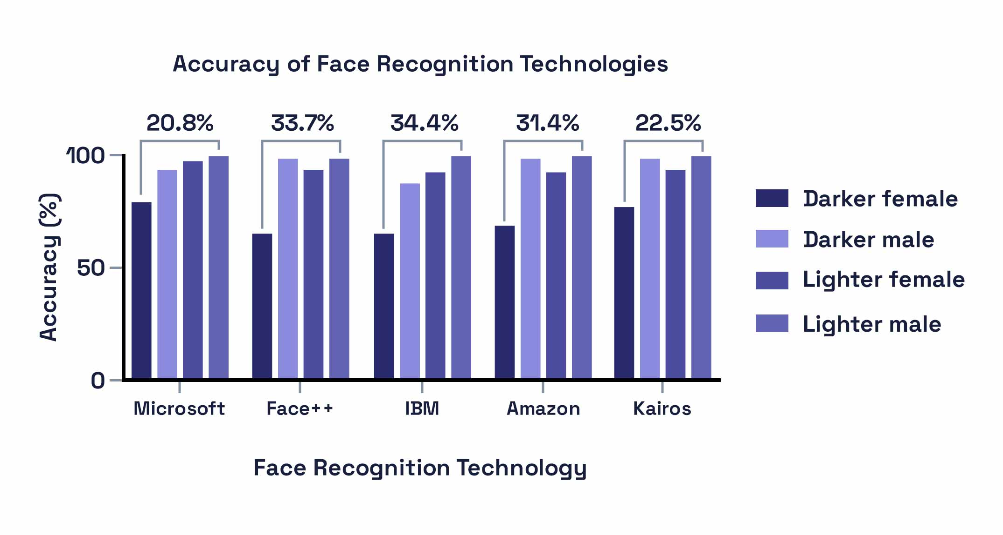
Privacy and bias
Grant Watson
Ads targeted based on viewer’s looks
Anonymity is not possible
Lack of human intelligence can cause errors
Facial recognitions accuracy varies with race and gender
(Kuligowski, 2023)
Notes:
With the introduction of any automated system, there are going to be errors that arise. One of the main issues with facial recognition advertising comes from the fact it draws from people’s looks to determine potential products they would purchase. While it can determine demographics and find products that are statistically likely to appeal to the viewer, it will not be perfect. If a woman walks up to a Walgreens refrigerator screen, it is likely to show a low-calorie frozen meal over something like a Red bull, which could be what she is looking for. While the viewer will likely not be harmed or affected by these misrepresentations, bias can show through the system and reinforce societal norms even if they are incorrect.
With any camera system, it is also impossible to remain anonymous. While the company who made the screens claims to not retain any data, it is still processed within the system, meaning those with mal intent could potentially gain access to the system.
Critical thinking is often important when determining who will want to buy what. If an AI model is tuned on data, who’s to say the data will be accurate? Does the lack of person to person interaction negatively affect the system’s ability to read what a person wants? Without a traditional salesperson running the advertisements, the effectiveness of the ads are left to the data fed into the neural network. What this also means however is the system can pick up on signs that may not be apparent to the common person.
The facial recognition software is able to read emotion as well as demographics. Based on the exact conditions produces an ad whose effectiveness is a product of the data the AI was trained on.

Slide 31
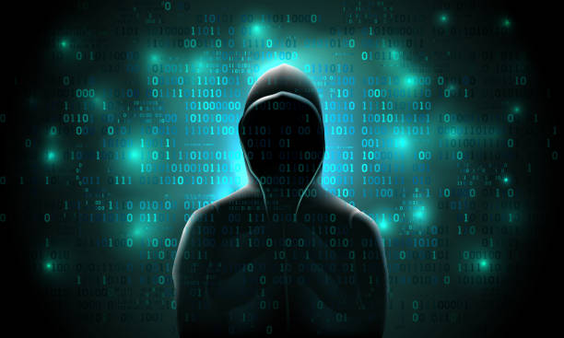
Security concerns
Grant Watson
72.7% of all organization were victim to ransomware attacks in 2023 (Fox, 2023)
  Your face and biometrics could go with it
New automated and connected systems left in public leave an easy target
Notes:
Before we wrap up, I want to leave you with a serious consideration: security. In 2023 alone, 72.7% of organizations experienced ransomware attacks. That’s not just data breaches that’s full-scale lockouts, with sensitive information held hostage.
Now imagine facial recognition systems embedded in advertising, collecting biometric data like your face, iris patterns, even emotional reactions, all sitting in public spaces, constantly connected to the internet.
If those systems are breached and the odds say they will be, that data is gone. And unlike a credit card, you can't change your face.
These systems, by nature, are public-facing and automated. That makes them not just a convenience, but an easy target. A digital billboard could become an entry point into a corporate network or worse, into your identity.
So while facial recognition advertising might seem cutting-edge, we have to ask: is it worth the risk? The cost of innovation shouldn't be our privacy or our security.

Slide 32
References
Grant Watson
- DHS, Facial Recognition Technology, (4/10/2025), DHS.gov, (4/12/25)
- Thales, Facial Recognition in Action, Thalesgroup.com, (4/12/25)
TSA, Facial Recognition Technology, tsa.gov, (4/12/25)
- Incode, Facial Recognition: How to Train Models and Keep Improving Over Time, (12/5/2024), incode.com, (4/12/25)
- Kuligowski Kiely, Facial Recognition Advertising: The New Way to Target Ads to Customers, (10/20/23), businessnewsdaily.com, (4/12/25)
- Fox Jacob, Top Cyber Security Statistics for 2024, (12/8/23), cobalt.io, (4/12/25)

Slide 33
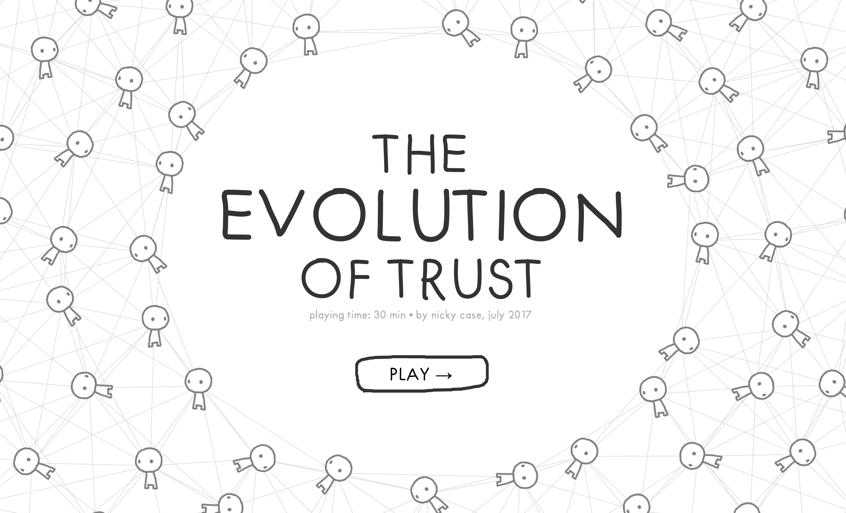
Class 10
The End
Keith A. Pray
SocialImps.com
Notes:
TODO: Add Snowden interview video link and thumbnail
The Game Of Trust - NICKY CASE
https://ncase.me/trust/
This is the end. Any slides beyond this point are for answering questions that may arise but not needed in the main talk. Some slides may also be unfinished and are not needed but kept just in case.

Slide 34
Remote With Zoom
Sign in with First and Last Name
Stay muted unless you are going to speak
To speak use the raise your hand feature
To answer yes/no questions use the “yes” ”no” buttons
Turn your camera on
Wait until the end of student presentations to ask questions
  Write them down so you don’t forget

