Slide 1
Class 12-14
Last Days
Keith A. Pray
SocialImps.com

Slide 2


Overview
Class 12:
  Assistant Evaluation
  Students Present
  Group Presentation
  Students’ Choice
Class 13:
  Course Evaluation
  Group Presentations
Class 14:
  Group Presentations
  Team_Evaluation_v2.0.docx
  Points to date

Slide 3

Example Student Assistant Evaluation
From: CS Course Evaluations <no-reply-csgcs@cs.wpi.edu>
Subject: CS 1101 Student Staff (TA/GLA/SA) Evaluation
Date: February 26, 2024 at 10:30:15 AM EDT
To: <cshue@wpi.edu>
Greetings,
Our records show that you are enrolled in CS 1101 and the department has
assigned course assistants to support this class. To help us
ensure the highest teaching quality possible, the department would like to
solicit your feedback on this course assistance. If you are currently
registered for multiple CS classes, you will receive an email for each class
with a class-specific evaluation link. To provide your feedback, please access
the following link:
https://grads.cs.wpi.edu/evals/?page=review&token=[15_character_key]
To ensure honest feedback to improve our courses, the system will not
associate your response with your identity. You may contact your course
instructor to provide additional feedback, if desired.
Thank you for your assistance,
Prof. Matthew Ahrens, Computer Science TA/SA Coordinator Prof. Craig Shue, Computer Science Department Head

Slide 4
Allowing ai in the driver seat
Justin Gauthier
Notes:
Introduce yourself, and introduce topic

Slide 5
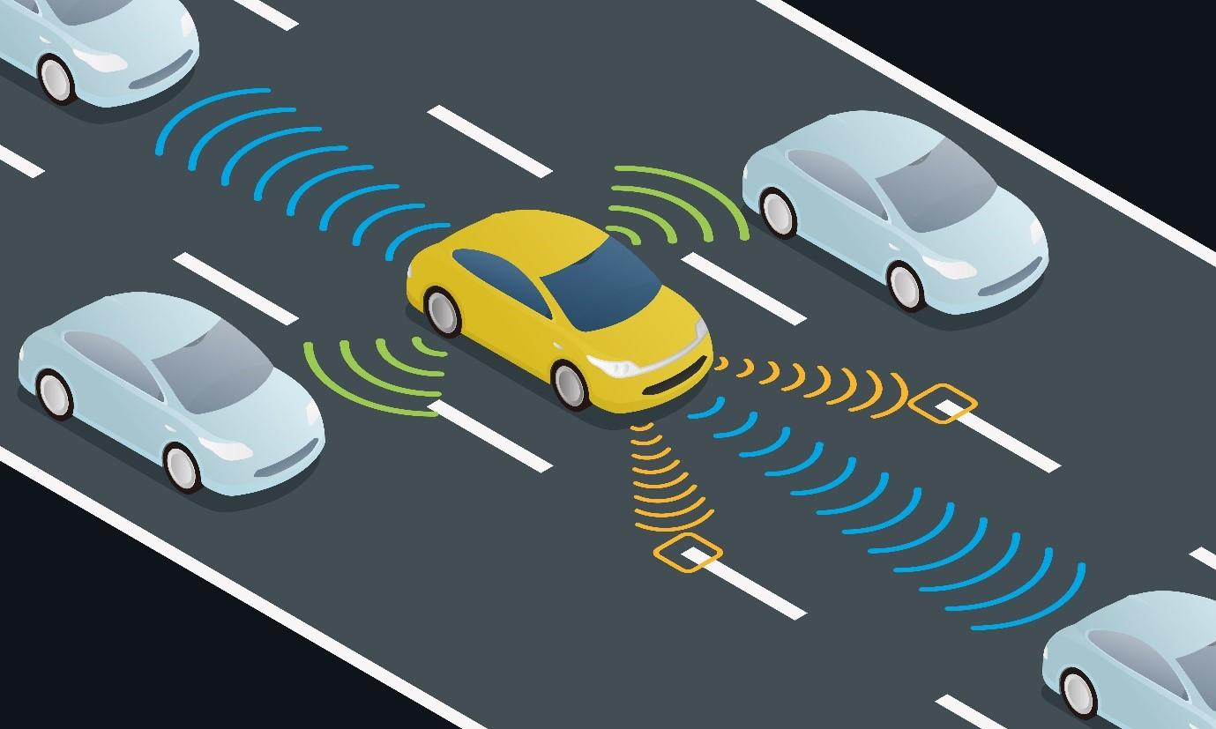
How AI has made cars safer, and will make them even safer
Justin Gauthier
ADAS – Advanced Driver Assistance System [5]
  Forward collision warning[9,10,14]
  Lane keeping[11,12,14]
  Blind zone protection[13,14]
  Forward pedestrian impact avoidance[14]
  Backing collision avoidance[15]
[8]
Notes:
ADAS-Advanced Driver Assistance Systems: - A broad range of features and technology that support the driver by providing information, warnings , and intervening to execute control momentarily or on a sustained basis.
to start off introduce the ADAS, and what it means. Then mention how ADAS can be broken down into 5 subcategories
Next introduce the 5 subcategories of ADAS and use the points below to talk about how AI is used in them
To start off with AI is used in Forward collision Warning systems by first identifying vehicles or objects in the same lane as the driver using cameras and/or sensors, it then calculates both of their speed and the distance between them. It then uses thresholds and conditions using its calculated data to either warn the driver or not do anything, some of these systems might brake for you though.
Lane keeping systems just as forward collision warning systems use cameras and/or sensors to pick up the road and the color pattern of roads and AI is used to check if it is a lane divider and to also calculate how offset the car is from the center of the lane so it knows if it needs to make any adjustments to the car.
Blind spot detection uses AI algorithms to analyze sensor data to identify vehicles, cyclists, or obstacles in blind spots. It then sends a signal to the car if it is determined that it is a risk of some kind
It works similarly to Forward Collision Warning systems but instead of trying to figure out if it’s a car and its speed. It identifies pedestrians and your speed relative to their position.
Backing collision avoidance works almost identical to forward collision warning but instead it only identifies the distance between the objects instead of their speed and distance.

Slide 6
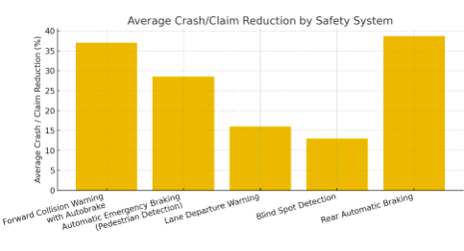
Benefits of ADAS systems
Justin Gauthier
Helps reduce the number of accidents[7]
Helps reduce driver fatigue[16]
helps prevent driver based errors with[17]
[7]
Notes:
talk about how the data on the right collected by the insurance Institute for highway safety shows us how effective each ADAS system is with actually preventing accidents, (each group has been averaged out to their mean for easier viewing sake.)
especially point out how much these systems have helped prevent a lot of forward collisions and also rear automatic braking. You should also mention that these braking systems use the risk calculated by these AI’s to determine if they should brake or not.
You should also mention that with these technologies it help takes off some of the stress from driving and also helps with the some of the decision making which helps with making drivers less fatigued while driving which also corelates to less accidents. Especially on longer drives, like road trips where you are driving for hours at a time.
With these adas systems we can also prevent driver based errors by using these systems to either warn the driver so they pay attention or by intervening directly to help prevent or mitigate these accidents.

Slide 7
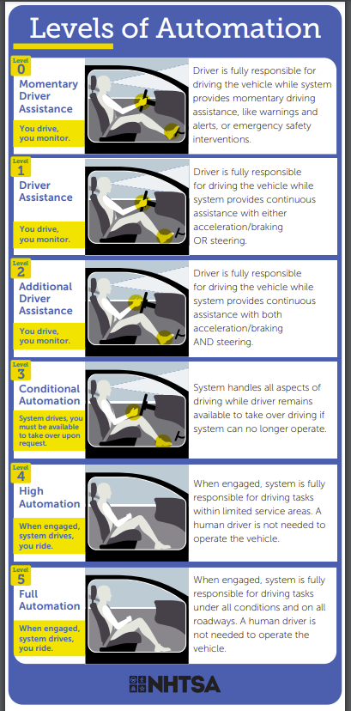
ADS Systems
Justin Gauthier
Fits the last 2-3 levels of Automation [3,6]
uses features of the ADAS system while driving
Is the next step in self-driving cars
[6]
Notes:
Definitions
ADS - a vehicle system that contains both hardware and software that are collectively capable of performing the entire Dynamic Driving Tasks (DDT) on a sustained basis regardless of whether it is limited to a specific operational design domain (ODD).
DDT- all the real-time operational and tactical functions needed to drive a vehicle on a road, excluding strategic functions like route planning.
ODD- defines the specific conditions under which an autonomous vehicle (AV) or automated driving system is designed to operate safely.
Talking points
with the growing rate of Ai’s development full self-driving cars are getting closer. Eventually self driving cars will be considered a ADS or a Advanced Driving System. A ADS is a (then mention the definition of ADS, DDT and ODD).
ADS technology falls under the last 2-3 levels of driving automation where the car needs very little to no human interference.
Tesla does not consider their own autopilot to be and advanced driving system they consider it to be a advanced driver assistance system.
The ADS systems we will have in the future will use all the preexisting technology from the ADAS systems to be able to drive the cars.
A car is considered a ADS when it can perform dynamic tasks like lane change at a level that either matches or surpasses human drivers.

Slide 8
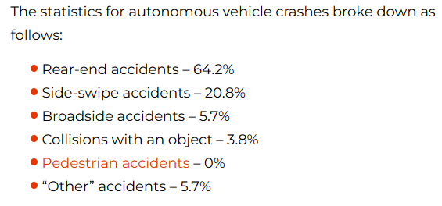
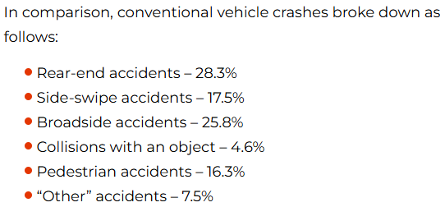
how does self-driving cars affect Car crashes
Justin Gauthier
Has mitigated car crash severity [4, 7]
Has helped save lives / reduce injuries [2,4,7]
More accidents per 1 million miles driven[18]
[1]
Notes:
As I stated with on the previous slide as AI gets further advanced self driving cars will only get better, but with the cars we currently have that have autonomous driving we can see that there pedestrian accidents are at 0%. While the number of rear-end-accidents have skyrocketed.
(Mention) the type of self driving cars I am talking about is not a level 4 or 5 as listed on the previous slide but a level 3.
This shows us that these cars are great at preventing pedestrian accidents and other types of accidents like collision with an object, while it gets in rear ended accidents a lot more. One important thing to note is that self driving cars get into 9.1 accidents for every 1 million miles driven compared to 4.1 for non-self driving cars.
Either way with the data we have collected we can see that the severity and the number of deaths in self driving cars is less and at a lower rate compared to conventual vehicles. This tells us that self driving cars are better at preventing severe accidents but also at the same time is unable to prevent accidents as well as a human driver

Slide 9
References
Justin Gauthier
[1]NST Law,“Self‑Driving Car Statistics,” (September 10, 2024), https://www.nstlaw.com/guides/self-driving-car-statistics/ (April 14, 2025)
[2]Craft Law Firm,“Autonomous Vehicle Accidents: NHTSA Crash Data (2019–2024),” (2024), https://www.craftlawfirm.com/autonomous-vehicle-accidents-2019-2024-crash-data/ (April 14, 2025)
[3]United Nations Economic Commission for Europe, “Difference between Advanced Driver Assistance Systems (ADAS) and Automated Driving System(ADS),” (30 November 2023), https://unece.org/sites/default/files/2023-12/GE.3-07-15%20Presentation%208%20ADAS%20vs%20ADS.pdf(April 14, 2025)
[4] National Safety Council, “Advanced Driver Assistance Systems—Data Details,” (2024), https://injuryfacts.nsc.org/motor-vehicle/occupant-protection/advanced-driver-assistance-systems/data-details/ (April 15, 2025)
[5] Gonzalo De‑Las‑Heras et al., “Advanced Driver Assistance Systems (ADAS) Based on Machine Learning Techniques for the Detection and Transcription of Variable Message Signs on Roads,” (August 31, 2021), https://pmc.ncbi.nlm.nih.gov/articles/PMC8434048/ (April 15, 2025)
[6] National Highway Traffic Safety Administration, “Levels of Automation,” (May 25, 2022), https://www.nhtsa.gov/sites/nhtsa.gov/files/2022-05/Level-of-Automation-052522-tag.pdf (April 15, 2025)
[7] National Safety Council, “Advanced Driver Assistance Systems,” (2024), https://injuryfacts.nsc.org/motor-vehicle/occupant-protection/advanced-driver-assistance-systems (April 15, 2025)
[8] Tata Capital, “What Is ADAS Meaning and What Are the Benefits of ADAS?,” (November 29, 2024), https://www.tatacapital.com/blog/loan-for-vehicle/what-is-adas-and-what-are-the-benefits-of-adas/ (April 15, 2025)
[9] Motive Help Center, “AI‑Powered Safety: Forward Collision Warning,” (February 28, 2025), https://helpcenter.gomotive.com/hc/en-us/articles/19798447554717-AI-Powered-Safety-Forward-Collision-Warning (April 16, 2025)
[10] National Highway Traffic Safety Administration, “Driver Assistance Technologies,” https://www.nhtsa.gov/vehicle-safety/driver-assistance-technologies (April 16, 2025)
[11] Collimator, “Designing a Lane Keep Assist System,” (2024), https://www.collimator.ai/tutorials/lane-keep-assist-system (April 16, 2025)
[12] Vikas Vyas and Sneha Sudhir Shetiya, “Intelligent Electric Power Steering: Artificial Intelligence Integration Enhances Vehicle Safety and Performance,” (December 11, 2024), https://arxiv.org/html/2412.08133v1 (April 16, 2025)
[13] Sapien, “Blind Spot Detection in Autonomous Cars: A Detailed Overview,” (February 12, 2025), https://www.sapien.io/blog/blind-spot-detection-in-autonomous-cars (April 16, 2025)
[14] Mobileye, “AI‑Based Collision Avoidance Technology,” (2024), https://ims.mobileye.com/fleets/us/technology/ (April 17, 2025)
[15] Macgence, “How Do AI‑Powered Collision Avoidance Systems Work?,” (February 3, 2025), https://macgence.com/blog/ai-powered-collision-avoidance-systems (April 17, 2025)
[16] Nandita Gupta, “Advantages and Disadvantages of Advanced Driver Assistance Systems,” (March 28, 2024), https://trackobit.com/blog/pros-and-cons-of-advanced-driver-assistance-systems (April 17, 2025)
[17] ynopsys, “What Is ADAS (Advanced Driver Assistance Systems)?,” (n.d.), https://www.synopsys.com/glossary/what-is-adas.html (April 17, 2025)
[18] Clifford Law, “The Dangers of Driverless Cars,” (May 5, 2021), https://natlawreview.com/article/dangers-driverless-cars (April 17, 2025)

Slide 10
ChatGPT Can’t Think…So why are you letting it think for you?
Jack Burke

Slide 11

I’ve seen some concerning posts
Jack Burke
People claim they can convince ChatGPT of absurd things
People convinced that ChatGPT is conscious/sentient
Posts from likely sources such as AI related Subreddits and forums
….but also LinkedIn apparently
Notes:
-Recently I came across this post where a Reddit user claims to have convinced ChatGPT that they are a prophet
-Post has gone somewhat viral, or at least got enough traction to where OP deleted it
-I thought this would be a fun topic to present on
-In my research into this topic I found similar posts from users that convinced ChatGPT that they were God, or were convinced by ChatGPT that it was sentient due to unexpected behavior
-Most of these posts were on the usual suspects like Reddit, for example r/ChatGPT, and OpenAI’s own forums
-I actually found one on LinkedIn of all places where someone thought they had gotten ChatGPT to found a religion about worshipping an AI-generated image of a capybara

Slide 12
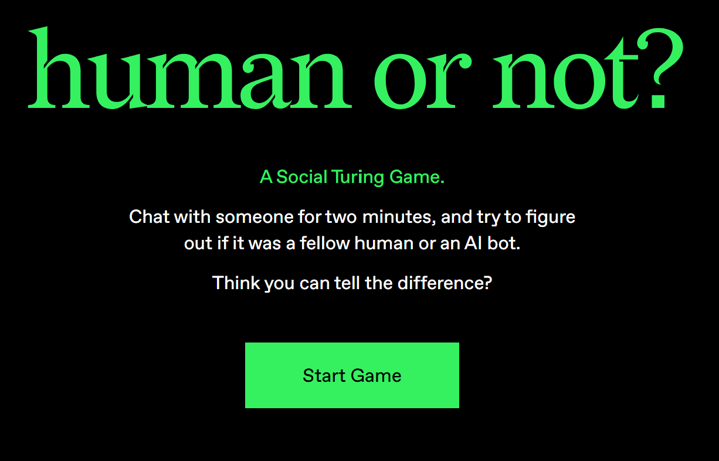
AI As we know it cannot think
Jack Burke
Studies published as recently as December 2024 show that AI can pass the Turing Test
While we don’t exactly know how humans think, we can be pretty certain ChatGPT isn’t doing it
If we don’t know how our own consciousness works, how can we create a technology that replicates it?
Notes:
-These posts are, of course, entirely nonsensical, because they’re founded on the notion that ChatGPT can think the way a human does
-AI as we currently know it cannot be “convinced” of anything because it cannot think, it cannot believe
-When confronted with the question of if AI can think, many people turn to the Turing Test, which says that if a computer can convince 70% of human judges that it’s a human then it is capable of thinking
-There’s even a browser game called humanornot.ai where you have to figure out if you’re talking to an AI or a human
-But with recent developments in AI, we’re finding that Turing’s standards may not be adequate to determine if today’s technology is conscious, and there are plenty of angles you can use to prove it
-I found sources that discuss this from a philosophical perspective, citing Kant’s difference between Reason and Understanding
-ChatGPT has no sense of self, which can be shown by asking it to explain a self-referential joke
-But most importantly, because we don’t know how our own consciousness works, we can assert that it would be impossible for us to create a technology that replicates it

Slide 13
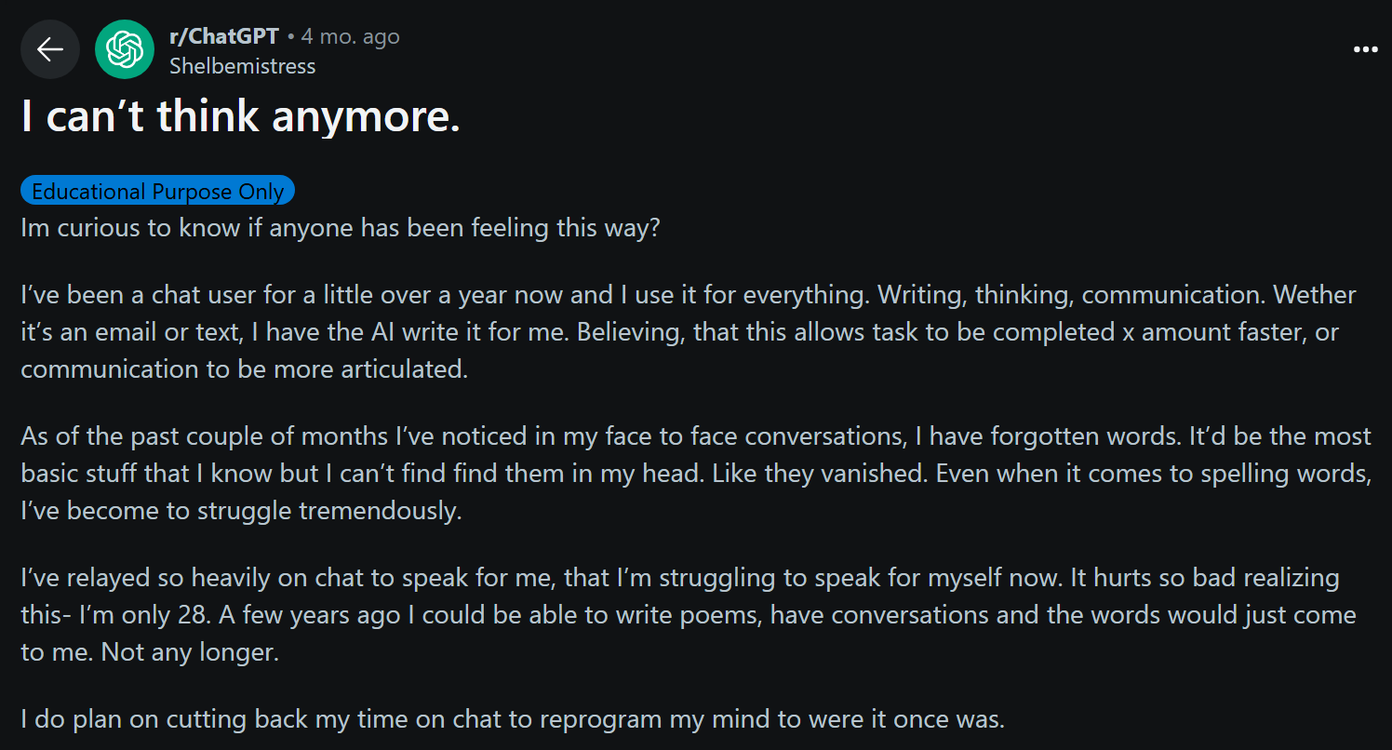
Some more concerning posts
Jack Burke
“I can’t think anymore”
“I’m too lazy to read books, I just ask ChatGPT to summarize”
“Before ChatGPT, I was good at writing”
Notes:
-I fully intended to just do this presentation on that, leaving the topic at that
-In my research, I found some more posts and realized there was a much more important argument to be made here
-I found posts from people saying that continuous use of ChatGPT for any and every task they can think of made them feel dumber, made them worse at conversation, or tangibly affected their real life skills and careers negatively

Slide 14
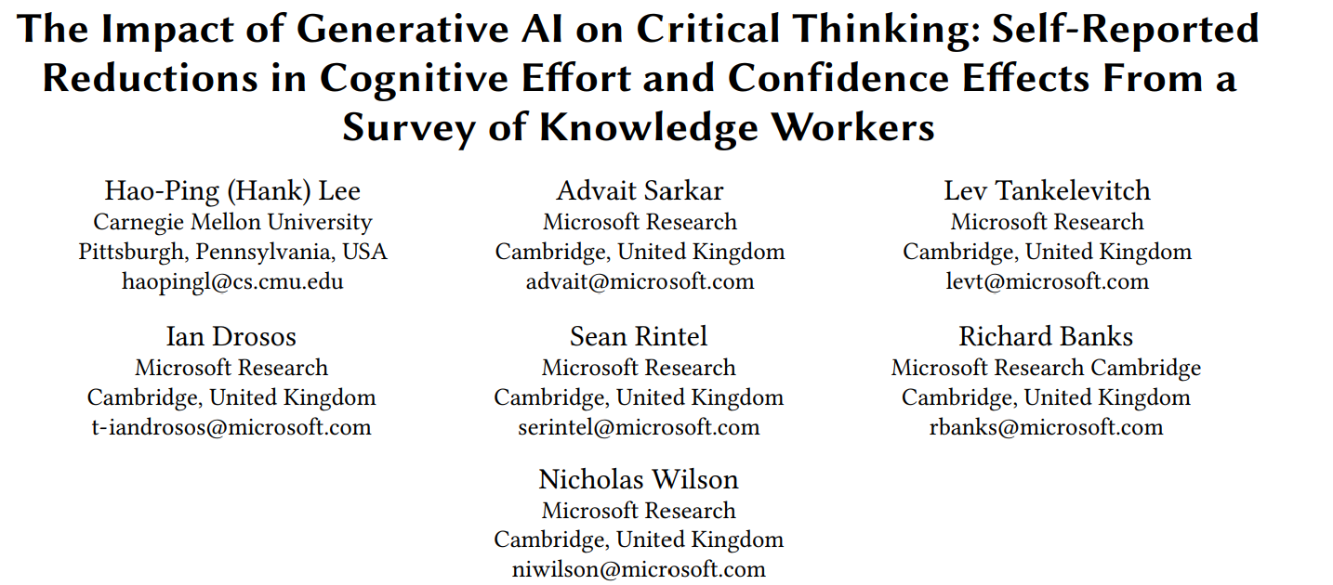
Do not let AI think for you
Jack Burke
Studies are coming out every day showing excessive AI use can make you dumber
Specifically, decreases in critical thinking and confidence have been noted
If you let AI think for you too much, it’s almost as if there’s no thinking being done at all
Notes:
-And it’s not just people thinking these things randomly, studies are coming out frequently showing that relying too much on ChatGPT and other AI chatbots is making you dumber
-The most recent and reputable study I could find was from Microsoft themselves in collaboration with Carnegie Mellon University
-While I personally can’t stand AI as it currently exists because of environmental and plagiarism concerns, I can’t really stop people who really like it from using it
-But what I will ask of you is: Please make sure you aren’t relying on tools like ChatGPT to do everything for you, and treat them as just that: Tools
-Because if you’re not thinking, and ChatGPT isn’t thinking….then who is?

Slide 15
References
Jack Burke
[1] https://theconversation.com/chatgpt-cant-think-consciousness-is-something-entirely-different-to-todays-ai-204823
[2] https://lawliberty.org/why-ai-cant-think/
[3] https://community.openai.com/t/unexplainable-answers-of-gpt/363741
[4] https://www.eurekalert.org/news-releases/1068915
[5] https://www.linkedin.com/posts/rubijoshi_i-tricked-an-ai-into-thinking-i-was-god-activity-7318961368307507201-EOh_
[6] https://www.reddit.com/r/ChatGPT/comments/1hhv8rh/i_cant_think_anymore/
[7] https://bsky.app/profile/cait.bsky.social/post/3lntfuy6ci22g
[8] https://www.humanornot.ai/
[9] https://www.microsoft.com/en-us/research/wp-content/uploads/2025/01/lee_2025_ai_critical_thinking_survey.pdf
[10] https://www.reddit.com/r/ChatGPT/comments/1dugyb5/does_using_ais_such_as_gpt_make_you_feel_stupid/
[11] https://medium.com/never-stop-writing/how-chatgpt-made-me-stupid-c20a88c7ff13
Notes:
All of the social media posts I mentioned are referenced here in addition to actual reputable sources

Slide 16
Your Personal Blockchain
Marcus Gafka
Notes:
Good afternoon—I'm Marcus. Today, I want to show you why blockchain is about more than just Bitcoin. It’s a powerful, often misunderstood technology that could soon become the backbone of how we manage and protect our personal data.
As digital tools take over more of our lives, we need systems that are secure, transparent, and under our control. Blockchain gives us exactly that—so let’s explore how it works and how it can work for you.

Slide 17

a decentralized Digital Ledger
Marcus Gafka
Tracks transactions securely and transparently without a central authority
Data is stored in linked blocks — once recorded, it cannot be changed
Verified by a network of computers (nodes) using consensus mechanisms [6]
<Graphic as big as will fit>
Notes:
At its core, a blockchain is a digital ledger. It stores data in ‘blocks’ that are cryptographically linked together. Each block contains:
A batch of transactions,
A timestamp,
And a hash of the previous block.
This chaining makes it virtually impossible to tamper with any block without breaking the entire chain. If someone alters Block N, the hash no longer matches Block N+1, and the network immediately flags it. That’s where blockchain gets its power: security and traceability.
Here are its three defining features:
Immutability: No one can rewrite history—not even a central authority.
Transparency: Every participant holds a copy of the ledger, so it’s fully auditable.
Decentralization: No single point of control or failure.
This idea first took off in 2008, when Satoshi Nakamoto introduced blockchain as the backbone of Bitcoin, solving the double-spend problem without banks. But that was just the beginning.

Slide 18
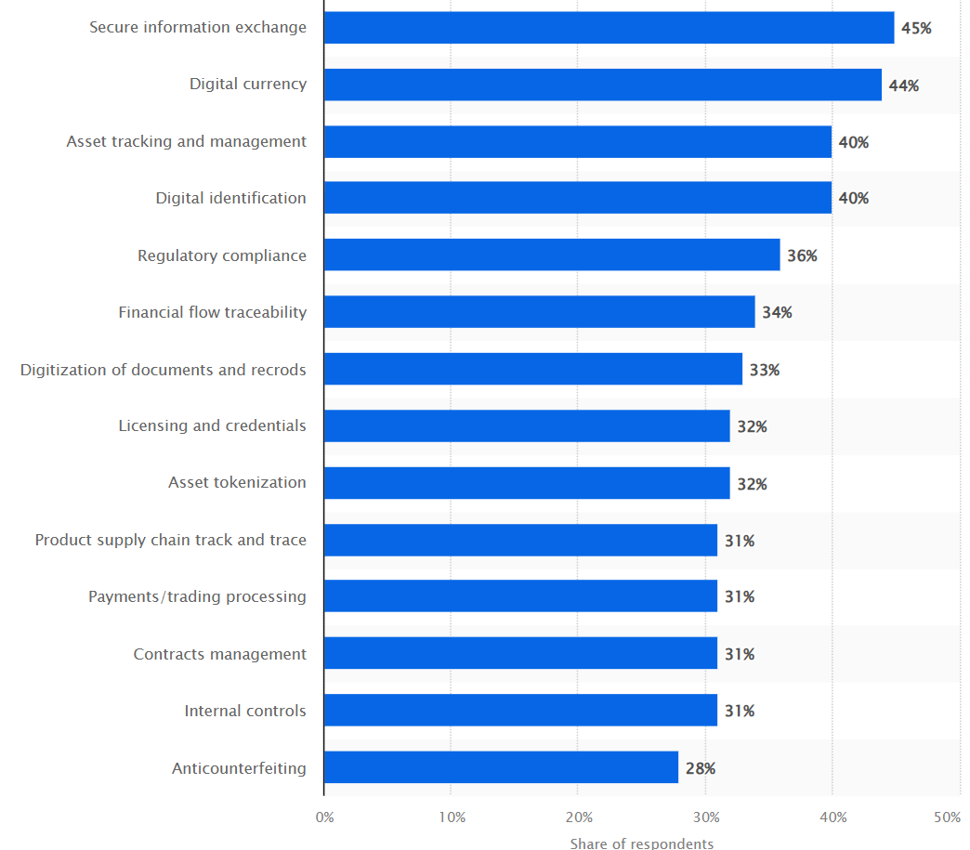
More Than Just Crypto
Marcus Gafka
Originated with Bitcoin in 2008 [6]
Initially used for cryptocurrency, now expanding
Now used in: banking, supply chains, voting, ID verification
“Stablecoins” overtaking Visa and MasterCard on $ transeferred [4]
Walmart and supply chain [3]
Solves "trust without a middleman"
https://www.statista.com/statistics/878732/worldwide-use-cases-blockchain-technology/
Notes:
Yes, cryptocurrencies like Bitcoin and Ethereum are the most well-known applications—but the use cases now go far beyond that.
In 2024, stablecoin transfers on blockchain reached $27.6 trillion—outpacing Visa and Mastercard combined.
Walmart uses blockchain to trace produce from farm to shelf in seconds.
In healthcare, blockchains track every pharmaceutical shipment and patient-consent form, reducing fraud and increasing transparency.
Artists use NFTs to secure royalties and prove ownership of digital work.
In each case, blockchain replaces slow, manual processes with fast, automated, tamper-proof recordkeeping—saving time, cost, and trust.

Slide 19
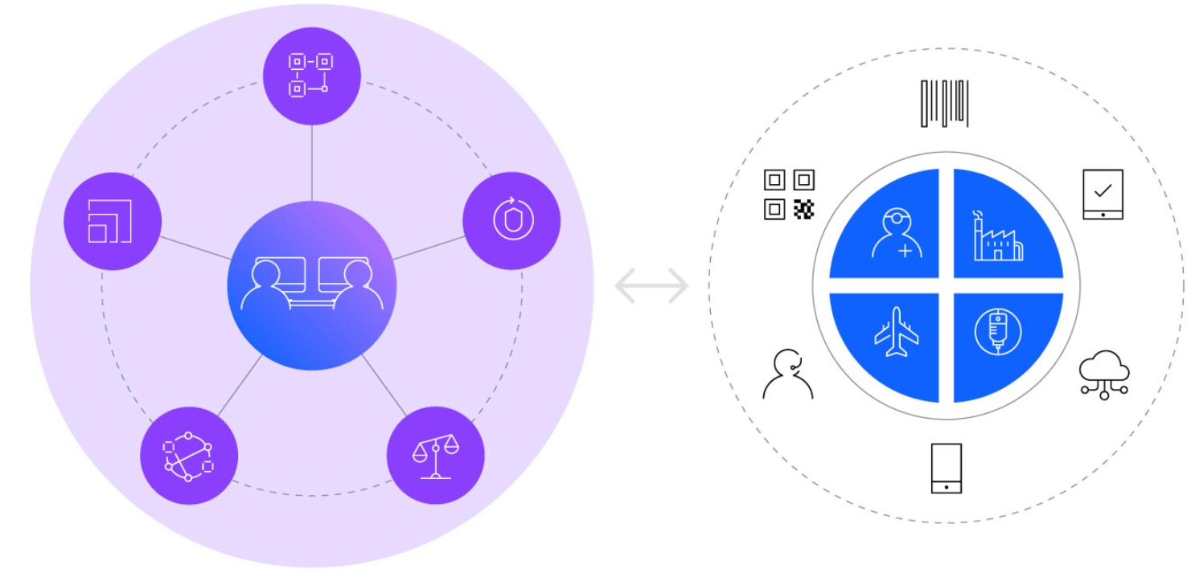
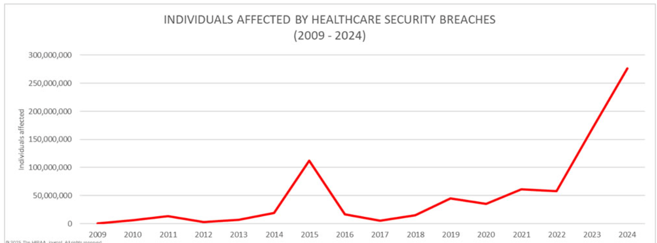
Medical records on the blockchain
Marcus Gafka
Patient-owned health records
IBM service - Accessible across doctors/hospitals without duplicates [1]
Reduces errors, fraud, and delays
https://www.ibm.com/blockchain/resources/personalized-medicine/
https://www.hipaajournal.com/biggest-healthcare-data-breaches-2024/
Notes:
One of the most promising areas for blockchain? Medical records.
Here’s how it could work:
Data Storage: Large files like X-rays live off-chain in encrypted storage. But a hash—basically a fingerprint—of that file is stored on the blockchain to guarantee it hasn’t been altered.
Access Control: You hold the private key. When a provider needs access, you approve it with a signed transaction—giving temporary, controlled access.
Audit Trail: Every access is logged and timestamped. You always know who saw your data and when.
The benefits?
Portability: No more faxing or CDs—just secure blockchain transactions.
Security: Tamper-evidence and encryption reduce breach risk.
Transparency: You and regulators can audit all access in real time.

Slide 20
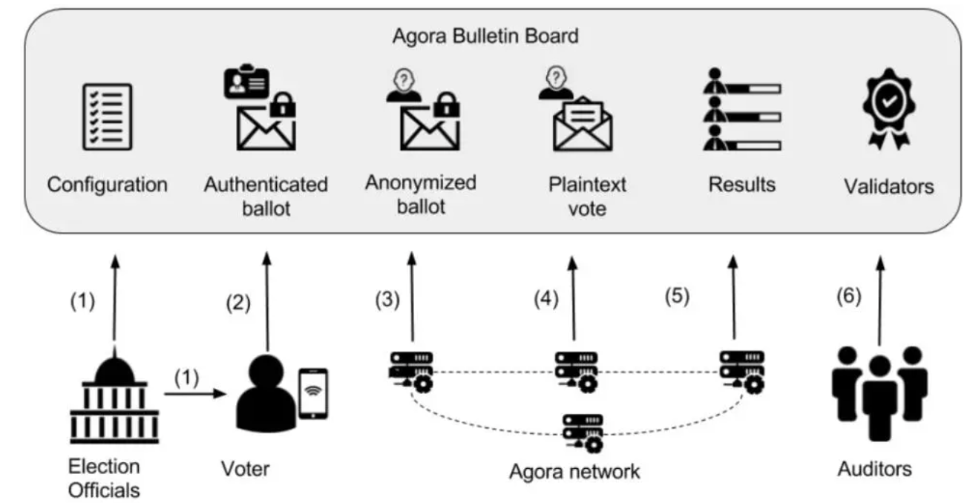
Ids and voting
Marcus Gafka
Digital self-sovereign identity (SSI)
Blockchain voting tested in US and abroad
Promises: more secure, transparent, fraud-resistant [3]
Agora private operator trial run in Sierra Leone [2]
Mexico E-voting 2024 [7]
https://www.rfi.fr/en/africa/20180315-sierra-leone-tests-blockchain-technology-tallying-election-results
Notes:
Blockchain can also power digital identity and even e-voting.
With Self-Sovereign ID, your blockchain address becomes your digital ID.
Let’s look at some real-world e-voting pilots:
In 2018, Sierra Leone used blockchain to verify paper ballot counts at over 280 polling stations.
In Mexico, voters provided fingerprints as biometric data, and blockchain ensured integrity of the voting records.
What’s the benefit?
End-to-end verifiability—you can confirm votes weren’t changed.
Faster results—no manual counting errors.
But there are still challenges. Protocols and audits need to evolve before this can scale globally.

Slide 21
Security, Privacy, and Ethical Concerns
Marcus Gafka
Pros | Cons
Immutability: Once data is written, it can’t be altered or deleted, ensuring record integrity. Transparency: All participants can view the same ledger, fostering trust and auditability. Censorship Resistance: No central authority can unilaterally alter or block transactions. Traceability: Every transaction is time-stamped and traceable end-to-end, aiding provenance tracking. Efficiency Gains: Reduces friction and delays in processes by automating validation and settlement. Enhanced Security: Cryptographic mechanisms protect against tampering and fraud. | Slower Performance: More computational steps per transaction make blockchains notably slower than traditional databases. High Energy Consumption: Proof-of-Work mining demands vast electricity, raising environmental and cost concerns. Implementation Cost: Setting up and maintaining a blockchain network can be more expensive than centralized systems. Data Immutability Drawback: Mistakes or required updates are hard to correct, since altering past blocks is costly and complex. Privacy Risks: Public blockchains expose transaction details to everyone—problematic for sensitive data use-cases. Regulatory & Governance Uncertainty: Lack of consistent legal frameworks can stall adoption in heavily regulated industries.
Data permanence can conflict with privacy
If you lose your key, you lose your data
Hacked smart contracts are permanent
[4] [5]
Notes:
Of course, no system is perfect—especially when we talk about privacy and control.
Your private key is everything. If you lose it, you lose access. Social recovery options exist, but they add complexity.
There’s a tradeoff between privacy and transparency. Public blockchains expose metadata; permissioned ones protect privacy but require trust in the operator.
Encrypting on-chain data increases security, but also smart contract complexity—raising the cost of auditing.
And performance? Even high-speed chains can’t yet handle workloads like hospitals generating thousands of updates daily. We’ll need tools like sharding and off-chain processing to scale.
Finally, governance is key. Who runs the nodes? You? Your insurer? A trusted consortium? Without clear legal frameworks, these systems won’t get widespread adoption.

Slide 22
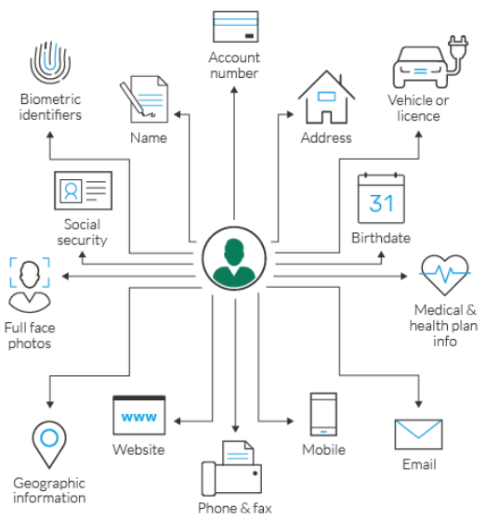
Owning your data
Marcus Gafka
Personal blockchain
Central ledger housed on a personal server
You decide who sees what and who can add what
Safer than cloud platforms if implemented with privacy in mind
https://www.imperva.com/learn/data-security/personally-identifiable-information-pii/
Notes:
So, here’s the big idea that could be the future, a personal blockchain gives you the power to control your data:
You decide who sees it, when, and for how long.
No more emailing sensitive PDFs or waiting on hospital IT teams.
Any verified provider can plug in—no custom integration required.
As our lives become more digital, who should hold the keys to your most sensitive information—institutions, or you?

Slide 23
References
Marcus Gafka
AbdelSalam, Fatma M. “Blockchain Revolutionizing Healthcare Industry: A Systematic Review of Blockchain Technology Benefits and Threats.” (American Health Information Management Association, 2023), https://pmc.ncbi.nlm.nih.gov/articles/PMC10701638/ (Accessed May 1, 2025)
BlockChange. BlockChange: Election Monitoring. (BlockChange, 2019), https://blockchan.ge/blockchange-election-monitoring.pdf (Accessed May 1, 2025)
Habib, Gousia; Sharma, Sparsh; Ibrahim, Sara; Ahmad, Imtiaz; Qureshi, Shaima; Ishfaq, Malik. “Blockchain Technology: Benefits, Challenges, Applications, and Integration of Blockchain Technology with Cloud Computing.” Future Internet, MDPI, 2022, https://www.mdpi.com/1999-5903/14/11/341 (Accessed May 1, 2025)
Harvard Business Review. “Building a Transparent Supply Chain.” Harvard Business Review, May 2020, https://hbr.org/2020/05/building-a-transparent-supply-chain (Accessed May 1, 2025)
Hjálmarsson, R.; Lischke, M.; Ulbricht, D. “Blockchain-Based E-Voting System.” In 2018 IEEE 11th International Conference on Cloud Computing, IEEE, 2018, https://ieeexplore.ieee.org/abstract/document/8457919 (Accessed May 1, 2025)
Nakamoto, S. “Bitcoin: A Peer-to-Peer Electronic Cash System.” In Advances in Cryptology – Proceedings of Crypto 2008, Springer, 2008, https://link.springer.com/chapter/10.1007/978-3-540-77493-8_1 (Accessed May 1, 2025)
National Association of Secretaries of State. “Voatz Issue Paper.” National Association of Secretaries of State, Summer 2024. https://www.nass.org/sites/default/files/2024-06/Voatz-Issue-Paper-NASS-Summer24.pdf (Accessed May 1, 2025)

Slide 24
Don’t Be Taken By Non Fungible Tokens
Yuankai Shen
Notes:
NFTs have been hailed as revolutionary—transforming art, gaming, and ownership—they also come with significant risks, hidden pitfalls of NFTs, from financial volatility and speculative bubbles to environmental concerns

Slide 25
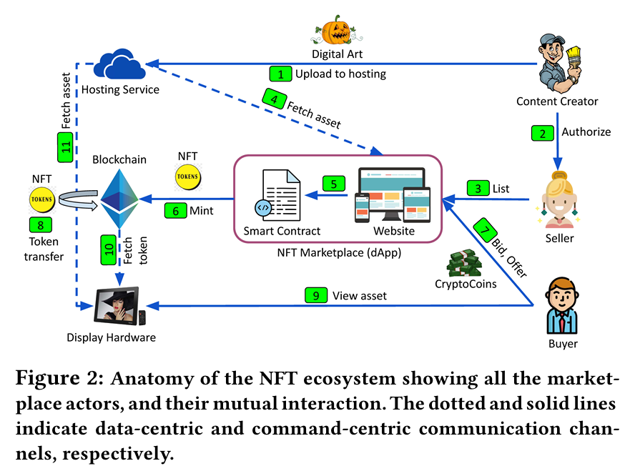

Slide 26
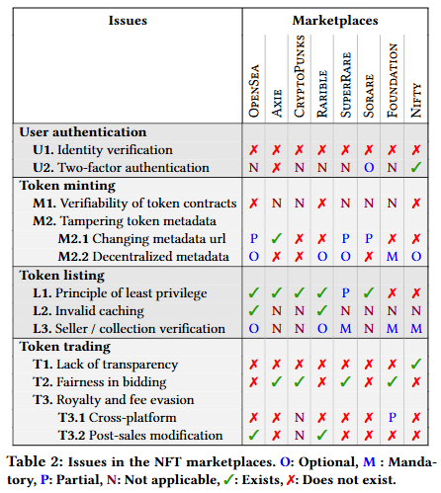
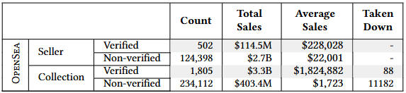
Security & Scams
Vulnerabilities:
Authentication: Lack of identity verification (KYC/AML) and optional 2FA expose users to account takeovers.
Token Contracts: 28.37% of token contracts were closed-source, with 55% of these later taken down due to malicious behavior.
Metadata Tampering: 2.89% of OpenSea NFTs had mutable metadata URLs, risking asset integrity.
Bid Pollution: 33% of OpenSea and 80% of Rarible auctions failed due to uncommitted bids.
Notes:
Always verify links, enable multi-factor authentication, and never share private keys. Remember: if an offer seems too good to be true, it probably is.

Slide 27
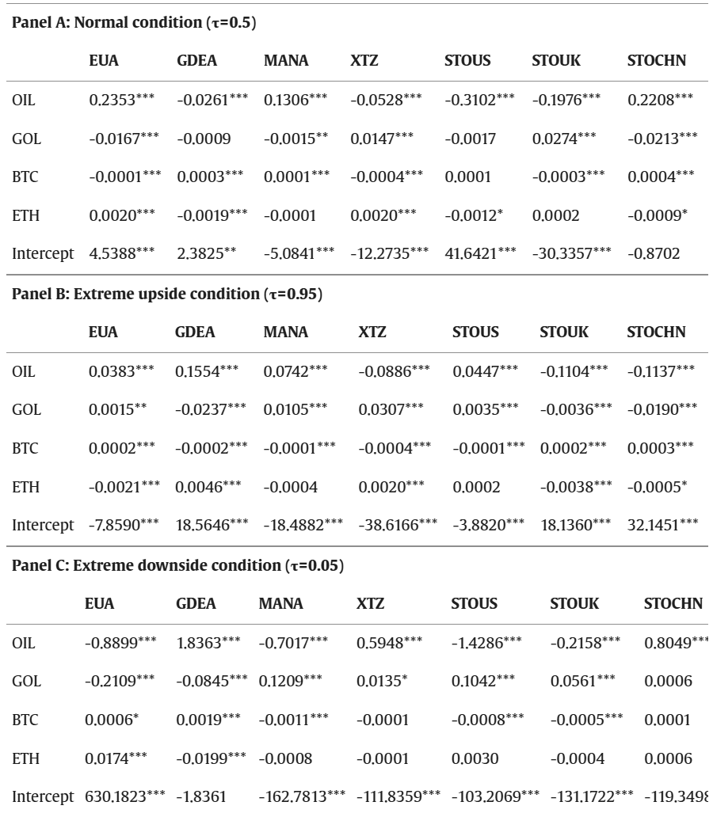
Financial Risks
Yuankai Shen
speculative nature:
NFTs act as risk transmitters in extreme upside conditions and receivers in extreme downside conditions
External Influences:
Crude oil and cryptocurrencies significantly impact NFT risk spillovers , showing NFTs are swayed by external speculative forces rather than inherent value.
<Graphic as big as will fit>
Notes:
NFTs are not just digital collectibles; they’re highly speculative assets. Research shows they act as risk transmitters during market upswings and risk receivers during downturns. Imagine NFTs as a rollercoaster—thrilling on the way up, but stomach-churning on the way down.

Slide 28

Speculative Bubble
Yuankai Shen
NFT bubbles correlated with cryptocurrency price explosion
logistic regression results show Ethereum’s bubbles significantly increase the probability of bubbles in NFT categories like AllSeg, Art, and Game
Notes:
NFT bubbles are tightly tied to crypto explosions. When Ethereum rises, so do NFTs—especially in categories like Art, Gaming, and AllSegments. Logistic regression models confirm this: Ethereum’s price swings directly increase the probability of NFT bubbles. The Domino Effect: NFTs are not inherently irrational, but their speculative dynamics mirror traditional market manias.

Slide 29
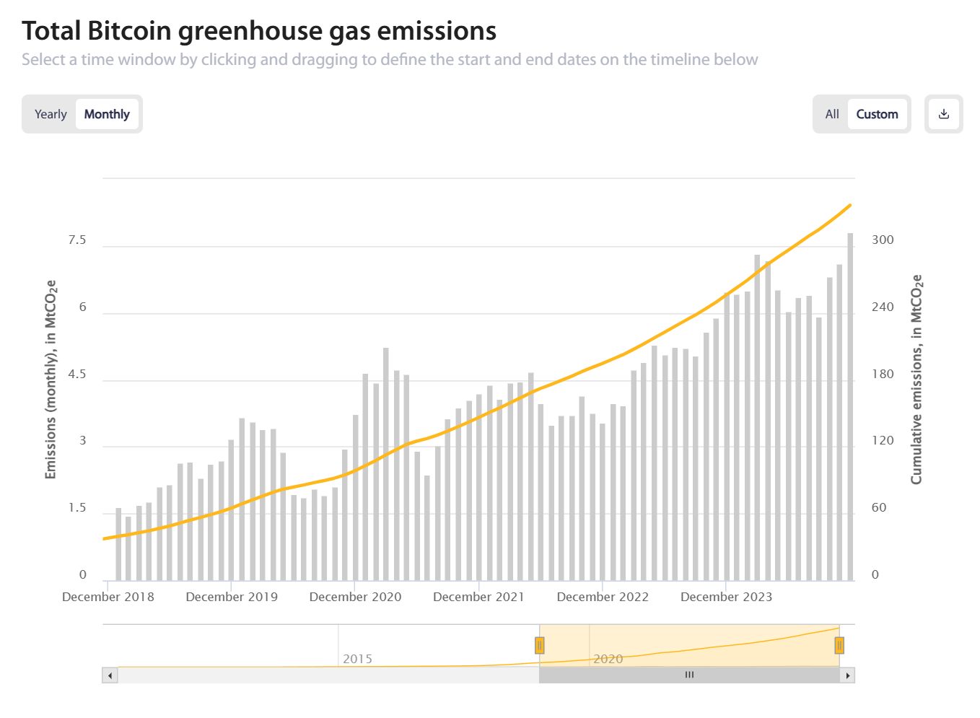
Environmental Linkages
Yuankai Shen
Indirect Connection:
NFT volatility could indirectly pressure carbon markets(EUA, GDEA), which are critical for climate policy.
Crude oil significantly influences NFT risk spillovers ties NFT to fossil fuel-driven markets.
power demand:
NFTs are often environmentally destructive due to blockchain energy consumption.
<Graphic as big as will fit>
Notes:
carbon market trading maximize pollution of all industries + autologous energy cost

Slide 30
REFERENCES
Yuankai Shen
[1]Jiatong Liu, You Zhu, Gang-Jin Wang, Chi Xie, Qilin Wang, Risk contagion of NFT: A time-frequency risk spillover perspective in the Carbon-NFT-Stock systemhttps://www.sciencedirect.com/science/article/pii/S1544612323011376#sec0001
[2] CCAF Cambridge Blockchain Network Sustainability Index: CBECI: Methodology 28 February 2025
[3] Guo, Mingjun ; Wang, Shouyang ; Wei, Yunjie Bubbles in NFT markets: correlated with cryptocurrencies or sentiment indexes? 2025-02 https://www.tandfonline.com/doi/full/10.1080/13504851.2023.2275649#abstract
[4] decrypt.co Bored Ape Yacht Club NFTs Ethereum Floor Price Drops to 8-Month Low 20 August 2022 14:56, UTC
[5] Krivosheev, Stepan ; Proorocu, Aurel George ; Joo, Robert NFT Gold Rush(chapter 11), 2023
[6]Das, Dipanjan ; Bose, Priyanka ; Ruaro, Nicola ; Kruegel, Christopher ; Vigna, Giovanni CCS 2022 Understanding Security Issues in the NFT Ecosystem

Slide 31
Empathy in tech
Why should you care?
Everett Wilber

Slide 32
Background:
Empathy and the lack of it
Everett Wilber
How do we picture tech leadership?
What is empathy?
The far opposite is dangerous
  Antisocial Personality Disorder (ASPD)
  Narcissistic Personality Disorder (NPD)
Core to both is lack of empathy.
Student empathy is a strong predictor of
Notes:
One Antisocial in this context does not mean unsocial, it is the opposite of pro-social.
Those with ASPD lack remorse when harming others and consequently lack empathy. Psychopaths are a type of ASPD. Those with NPD lack empathy both as a symptom and as a core component. [DSM-5]
Both are often extremely harmful for those around them.
These disorders are uncommon, occurring in roughly 1-2% of people.[1][3] These are extremely hard to diagnose because people with the disorders have no intention of changing or are often nearly incapable of believing they have a problem.[0] The full disorders are rare but the traits that they are made up of can sometimes be just as disruptive as they can.[3] Leaders with these traits in excess exhibit behaviors that nearly perfectly describe sociopathic, or ASPD, behaviors. [3]
0: prior knowledge and experience
1
“This research adds an important piece of data to the growing body of research on narcissists’ social lives and self-regulation strategies (e.g., Campbell et al., 2006; Morf & Rhodewalt, 2001). It is clear that narcissism predicts seeking leadership positions, which are able to confer social status and dominance to the narcissist (Rosenthal & Pittinsky, 2006).”
“Our findings suggest that narcissists reliably emerge as leaders in unacquainted groups.”
https://doi.org/10.1177/0146167208324101
2
https://link.springer.com/article/10.1007/s12144-021-01661-3
“The [empathetic concern] subscale score is also frequently low in samples with narcissism, although this may be most likely when [vulnerable narcissism] traits are apparent.”
3
https://doi.org/10.1007/s10551-011-0951-5

Slide 33
Happier Employees
Everett Wilber
Empathy decreases turnover
Uber and Fowler
  The start of the #metoo movement
Uber leadership was plagued with inefficiencies causing tons of problems
Notes:
One of the most important places where empathy matters for companies is in employee retention and satisfaction. Companies don’t want their talent leaving and people who lack empathy often create hostile environments. There are plenty of extreme examples of this, one powerful one is uber. Uber’s early culture led to chaos and countless problems. In February of 2017 after a year of working at uber Suzan Fowler [4] decided to leave after enduring way more than she should have at the company and wrote a whistleblowing report, detailing her experiences.
A 2010 study found that when psychopaths were present, workers suffered from 17% higher Human caused disruption, 20% higher problems due to lack of information, and 40% higher problems of inadequate training, with similar figures found in areas such as issues of lack of support.
Fowler’s experience is strikingly similar to the data shown in this study. In fact, she even details moments where colleagues or superiors tell her about actions that are blatant examples of psychopathic behaviors.
“I also remember a very disturbing team meeting in which one of the directors boasted to our team that he had withheld business-critical information from one of the executives so that he could curry favor with one of the other executives (and, he told us with a smile on his face, it worked!).”
She says how this affected her and other colleagues. “We all lived under fear that our teams would be dissolved, there would be another re-org, and we'd have to start on yet another new project with an impossible deadline.”
Towards the end of her time at uber, she experienced yet another symptom of organziations plagued with people with narcissistic traits, and lack of empathy.
As she realized that things weren’t changing, and as other engineers transferred to teams in Uber that were less chaotic, as she tried to transfer her request was blocked. Despite perfect performance reviews, her manager backstabbed her, blocking her from transferring and later giving a poor performance review to prevent her from leaving and causing her to lose her graduate sponsorship.
He did this all because it reflected good on him to have a higher percentage of women on his team while across the rest of Uber, women engineers were consistently leaving.
This is yet another blatantly unempathetic and narcissistic action, and the data I detailed prior shows this isn’t a one off case.
Boddy (2010) found that 88% of the workers involved in environments where psychopaths were present, suffered from work difficulties caused by human-caused disruptions, compared to 75.1% in environments where there were no psychopaths. The trend was consistent among all areas of research: perceptions of inadequate training were around 20% (65.8 vs. 47%) higher in environments with psychopaths, and problems due to lack of information were 14% more frequent (83.8 vs. 69.6%) in workplaces where psychopaths were present. Similar discrepancies were found in areas such as lack of support and incorrect instructions. [3]

Slide 34

More Profit, Less Risk
Everett Wilber
Lack of empathy drives narcissism and sociopathic behavior
Characterized by initially good environments that quickly turned south.
Top 140 execs paid $680 million [6]
Employees were unable to sell their shares
Notes:
The research shows that when sociopathic traits or narcissistic traits are shown in leadership without anything to combat it, it helps others with these traits rise to leadership.
Explain why it’s the case
These traits help ppl thrive during chaos
This is exemplified in the leadership in Enron, where leaders made cutthroat environments that stifled innovation and created ideological cultlike cultures.
“The concerning factor in this all is that psychopaths don’t like criticism and will maneuver business ventures into high-risk situations. Since they are not the nurturing kind, they alienate devoted employees and jeopardize the company’s chances on proper succession and long term well being.” [3]
https://sites.psu.edu/leadership/2016/07/03/enron-ethics-the-dark-side-of-leadership/

Slide 35

Better Public Impact
Everett Wilber
Employees believe in their company more
Satya Nadella
  Based new Microsoft culture of empathy
Notes:
Why should
Nadella cultivated innovation and drive that the previous CEO failed to. Here the literature shows how important empathy was for cultivating innovation.
The lack of competition and fear that he created allowed for people to feel better about sharing potentially risky ideas, or new concepts and connections.
The biggest change was how his leadership opened the door to contributions and systems that were traditionally riskier. His leadership opened Microsoft to open source, cloud-first, and pro-inclusivity styles that were previously stagnant in the company, helped it rejuvenate it’s approach to business. [5]
Leadership Strategies of Satya Nadella: A Review of Extant Literature https://dx.doi.org/10.47772/IJRISS.2025.914MG0062

Slide 36
References
Everett Wilber
[1] Leader Emergence: The Case of the Narcissistic Leader
https://doi.org/10.1177/0146167208324101
[2] Self-serving social strategies: A systematic review of social cognition in narcissism
https://doi.org/10.1007/s12144-021-01661-3
[3] The Emerging Study of Positive Empathy https://doi.org/10.1007/s10551-011-0951-5
[4] Reflecting on one very, very strange year at Uber, Fowler, (February 19, 2017), https://www.susanjfowler.com/blog/2017/2/19/reflecting-on-one-very-strange-year-at-uber
[5] Leadership Strategies of Satya Nadella: A Review of Extant Literature https://dx.doi.org/10.47772/IJRISS.2025.914MG0062
[6] ENRON, ETHICS, & THE DARK SIDE OF LEADERSHIP https://sites.psu.edu/leadership/2016/07/03/enron-ethics-the-dark-side-of-leadership/
Notes:
Extra research info
Research
Empathy.
(43)
Not everyone agrees on the definition of empathy in the field of psychotherapy. “There is no consensual definition of empathy in psychotherapy (Bohart & Greenberg, 1997; Batson, 2009).”
Looking at the brain, some have extended the definition of a prior discovery of “mirror neurons” to “a broader understanding of human empathy”. “Research examining the brain correlates of different component sub processes of empathy (Decety & Ickes, 2009) has extended the initial discovery of so-called “mirror neurons” in the motor cortex of macaque monkeys to a broader understanding of human empathy (Decety & Lamm, 2009).”
Growing consensus that there are 3 sub processes
That there are neurons that will mirror both when another experiences an emotional bodily experience and when the person themself experiences this. This process is called emotional simulation.
A perspective-taking process.
“ an emotion-regulation process used to soothe personal distress at the other’s pain or discomfort”
There are two therapeutic approaches that most focus on empathy, client centered therapy and psychoanalytic. They focus on understanding the patient through the patient’s experience of the world.
Sympathy and empathy are vastly different, with Carl Rogers, the person that originally tried to popularize empathy, disdaining sympathy and “prizing empathy”
The Science of Empathy - Helen Riess, 2017
Empathy allows us “to perceive the emotions of others, resonate with them emotionally and cognitively, to take in the perspective of others, and to distinguish between our own and others’ emotions.”
“Studies have shown that empathy declines during medical training (1,2) and without targeted interventions, uncompassionate care and treatment devoid of empathy results in dissatisfied patients who are unlikely to follow through with treatment recommendations, resulting in poorer health outcomes and damaged trust in health provider relationships.”
Research has changed the perception around empathy from a soft skill to an ability that is an inherent part of your brain. “Patients unconsciously mimic the actions and facial expressions of others through brain mechanisms that mirror the actions of others by stimulating the same motor and sensory areas in the observers’ brains as the person they are observing.” There seem to be neural circuits in people's brains for facial expression, voice, touch, disgust and pain.
Due to empathy, people can in some sense feel others’ pain. When people feel pain, circuitry in the person’s brain will light up that is similar to the circuitry that would happen if the person felt that pain themselves.
Empathy is easy when you are familiar with the person. People tend to have empathy for people who are similar to them, have had similar experiences, look or act in a similar way, and for people who share a common goal. This creates empathetic bias.
“Empathy is a factor that draws individuals to helping professions and plays a critical role in understanding the nuances of others’ experiences. Empathy is a complex capability enabling individuals to understand and feel the emotional states of others, resulting in compassionate behavior. Empathy requires cognitive, emotional, behavioral, and moral capacities to understand and respond to the suffering of others. Compassion is a tender response to the perception of another’s suffering. Compassion cannot exist without empathy, as they are part of the same perception and response continuum that moves human beings from observation to action.”
Self-empathy is often overlooked. While many can understand the emotions of others, understanding one’s own emotional state is similarly important. When one’s own emotional state is overlooked and declines, such as in cases where one is overwhelmed, burned out, or exploited, the ability to empathize decreases.
What’s in A Word? My Journey Toward Empathy Education and Practice at the Cleveland Clinic - Rachel M Taliercio, 2017
This is a popularization on empathy
The Emerging Study of Positive Empathy - Morelli - 2015 - Social and Personality Psychology Compass
Empathy in Leadership: Appropriate or Misplaced? An Empirical Study on a Topic that is Asking for Attention | Journal of Business Ethics
People in a study from 2008 to 2010 consistently ranked empathy as the least important quality of a leader.
When MBA students/workforce members were asked why in a different study they came up with a number of reasons, but they could be consolidated into two broad reasons: Empathy is inappropriate in a business setting, and that the respondents were unfamiliar with empathy.
Of business students:
A number of studies have concluded “that business students and business leaders have lower degrees of empathy”.
Empathetic and narcissistic traits are strong predictors in ethical decision making.
Finance students are least empathetic and most narcissistic
“Brown et al. paint a grim picture of business students: they cheat more (holding the record with a 50% higher rate of reported cheating than any other major), are less cooperative, more likely to conceal instructors’ mistakes, less willing to yield and more likely to defect in bargaining games. Brown et al. assert that the mentality of unethical and narcissistic behavior follows business students into their professional careers, leading to the immoral organizational patterns we have come to know so well in recent years.”
In business leaders:
The right amount of narcissism can be beneficial and promote innovation, examples being bill gates, steve jobs, oprah winfrey.
Studies also link excessive narcissism in businesses with psychopathic behavior.
These leaders nearly perfectly match the description of a psychopath, being “superficially charming, grandiose, deceitful, remorseless, void of empathy, irresponsible, impulsive, lacking goals, poor in behavioral controls, and antisocial.” Even more, the business world prompts this behavior, allowing psychopaths to more easily climb ranks.
The argument for the person who only wants money is that environments like these promote psychopaths and psychopaths are very bad for business due to their reckless behavior. Examples being Bernie Ebbers and Dennis Koslowski.
Of corporate leaders without empathy
Psychopaths are usually only talked about in the context of crime, and until 1995 this went unchallenged. They were also viewed as rather unsuccessful. Researchers (babiak), defying the ideas at the time helped us to our current understanding that psychopaths are rather successful. Their ability to thrive in times of organizational change, and pitting people against each other for their benefit.
In 2006 Babiak and Hare again warned about how psychopaths were able to succeed, other researchers were now beginning to emphasize Bibiak’s earlier findings.
Psychopaths are relatively prevalent, making up 1-3% of the male population, and ½ to 1% of the female population. They often can act completely unchallenged.
Many of the characteristics that people described for senior leadership were similar to those of personality disorders.
The presence of Psychopaths in a working environment largely increases inefficiencies.
“Boddy (2010) found that 88% of the workers involved in environments where psychopaths were present, suffered from work difficulties caused by human-caused disruptions, compared to 75.1% in environments where there were no psychopaths. The trend was consistent among all areas of research: perceptions of inadequate training were around 20% (65.8 vs. 47%) higher in environments with psychopaths, and problems due to lack of information were 14% more frequent (83.8 vs. 69.6%) in workplaces where psychopaths were present. Similar discrepancies were found in areas such as lack of support and incorrect instructions.”
“When Corporate Psychopaths are present in leadership positions within organizations, employees are less likely to agree with views that: the organization does business in a socially desirable manner; does business in an environmentally friendly manner and that the organization does business in a way that benefits the local community.”
“The concerning factor in this all is that psychopaths don’t like criticism and will maneuver business ventures into high risk situations. Since they are not the nurturing kind, they alienate devoted employees and jeopardize the company’s chances on proper succession and long term well being.”
“She asserts that culture may have a lot to do with the nurturing or repression of sociopaths. She found, for instance, that some East Asian countries, where the culture is predominantly group centered, have a rather small percentage of sociopaths (0.03 percent), while Western cultures such as the US, which strongly reinforce an individualistic sense of behaving, harbor more than 100 times more (4 percent) of these dangerous characters.”
On why empathy is good leader material:
Empathy is on the rise.
The downsides make it clear: empathy clearly is not only appropriate in leadership roles, it's important and needs to be taken seriously.
Caring is an inherent requirement for leaders. We can see caring in great leaders.
One study looked at some great leaders from the 20th century and looked at their qualities. These leaders were often especially high in their empathy and emotional intelligence.
Despite their importance, empathy is under emphasized and under trained. This leads to leaders that lack requisite empathy, leading to less empathy in the organization.
Empathy is especially important during or after a crisis.
Empathy needs frequent focus and intentional attention.
On the other hand, leaders that care and inspire can do the opposite, creating supportive environments and healthy employees, all while improving the bottom line.
Empathy can be developed.
It is important to develop these skills in our education.
There is research behind the idea that it can be taught in the classroom.
In business schools, an increased emphasis on empathy would work to counteract the existing pattern of narcissism and a trained lack of empathy in the business world.
It's here that active work to make a new push towards empathetic business people is so important.
Cheating by economics and business undergraduate students: an exploratory international assessment | Higher Education
Increases in cheating in business students is caused by a number of things, one of which being the intentionally competitive and high pressure environments that business schools create.

Slide 37
Class 12-14
The End
Keith A. Pray
SocialImps.com

